Slide 1
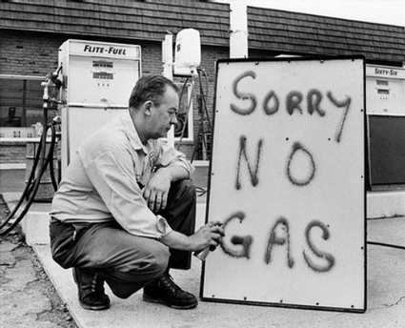
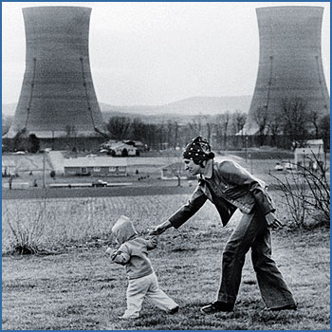
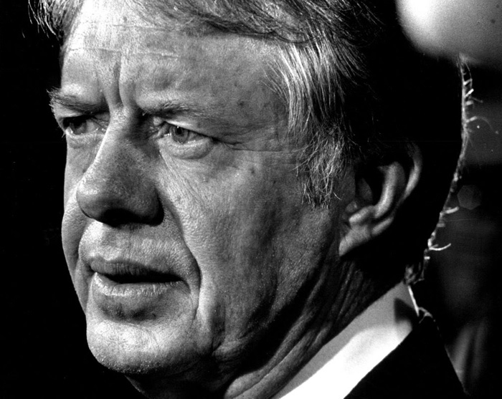
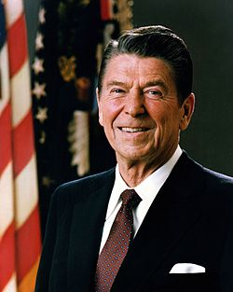
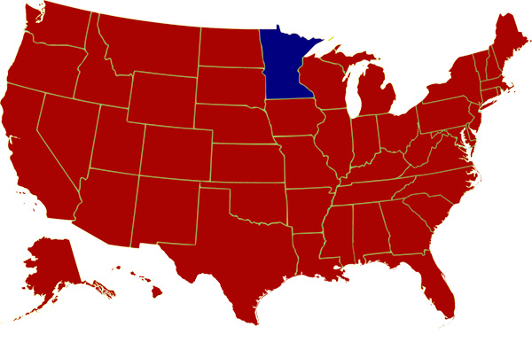
The Age of Limits & The Age of Reagan
1974 – 1990s

Slide 3
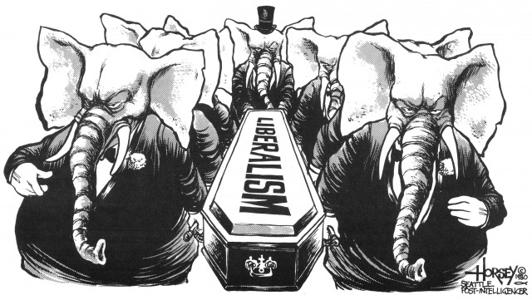
AP PARTS

Slide 4
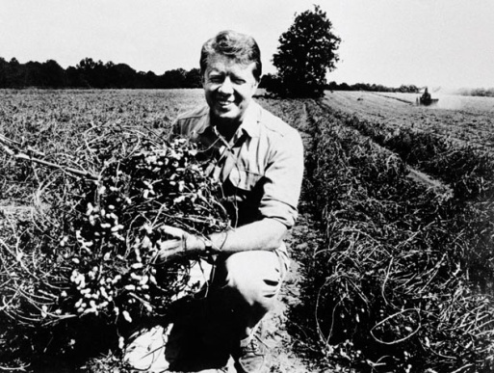
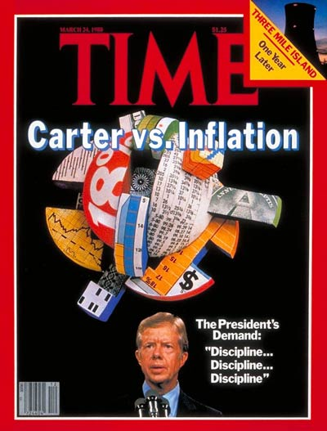
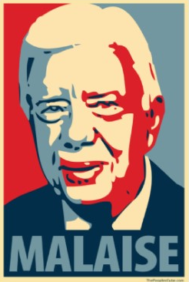
Malaise
President Jimmy Carter (1977 – 1981)
Washington ‘outsider’ w/ Cabinet of non-Washington insiders
Ambitious social welfare agenda, but w/o focus; little passed by Congress
Attempt to reduce unemployment by raising public spending & lowering taxes; effect: inflation (10% per yr) aka “stagflation”
OPEC kept oil prices high
Federal Reserve implemented a tight money policy (high interest rates & high currency reserves)
Carter gives his ‘malaise speech’ or the ‘crisis of confidence’
Approval rating lower than Nixon’s
Notes:
https://www.youtube.com/watch?v=0tGd_9Tahzw “malaise Speech”

Slide 5
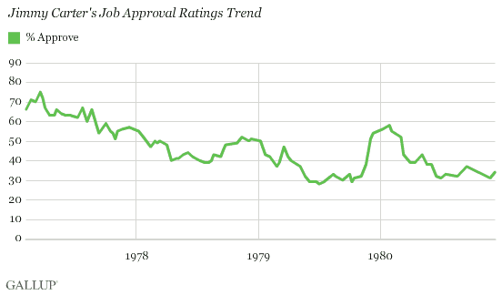

Slide 6
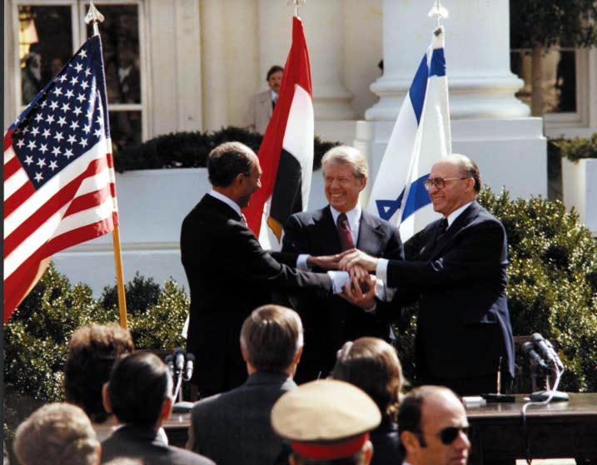
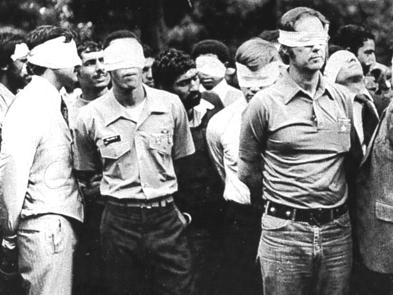
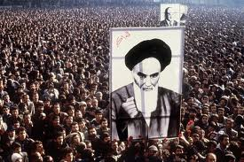
Foreign Policy mixed bag
Achievements
Failures
Turned over Panama Canal to Panama
Resumption of pre-1947 relations with China
Camp David Accords –peace treaty b/w Egypt & Israel
Congress refuses to pass SALT II treaty
Asylum for the deposed Shah of Iran
440 day long Iranian hostage crisis
USSR invades Afghanistan
Boycott of 1980 Moscow Olympics

Slide 7
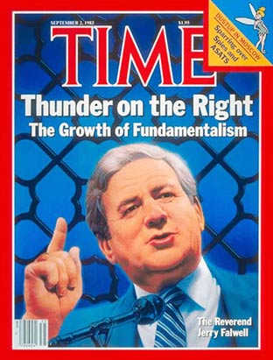
Religious Revivalism -4th Great Awakening
Beginning in early 1970s
Church of Scientology
People’s Temple –Jim Jones led mass suicide, 1978
Unification Church of the Reverend Sun Myung Moon - ‘Moonies’
Evangelicalism -‘born again’ Christians
By 1980, 25% of people identified as this
Birth of New Right
Moral Majority
Launched by Rev. Jerry Falwell
Rise of ‘televangelism’
Denounced -federal interference in local affairs, abortion, divorce, homosexuality
Defended –free enterprise & Anti-communist foreign policy
Considered Ronald Reagan the 1st leader of their conservative positions since Barry Goldwater (1964)
Notes:
https://www.youtube.com/watch?v=T8xJAzS1a9U Jim Jones song
https://www.youtube.com/watch?v=IY3cx3U0gYE Jonestown Massacre
https://www.youtube.com/watch?v=zm9Zlfn0zUA Jerry Falwell

Slide 8
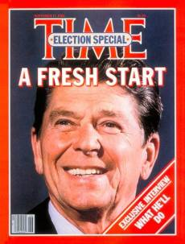
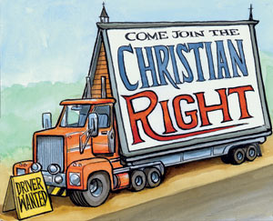
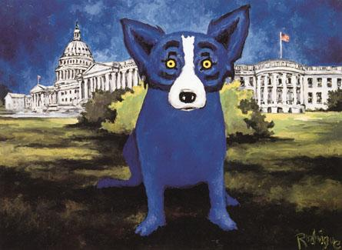
The ‘Reagan Revolution’
Election of 1980
Won electoral vote by 440 votes
1984 won by 525 EC votes
Built a coalition of:
‘blue dog’ Democrats
Christian conservatives
neo-conservatives (laissez-faire advocates)
those afraid of the ‘eastern establishment’
Notes:
https://www.youtube.com/watch?v=J9IcbVDTVls Regan as an actor

Slide 9
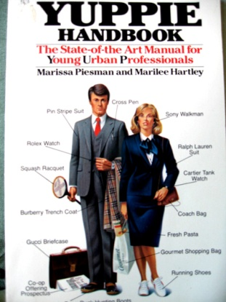
Reagan Era –Domestic Issues
‘Reaganomics’
Supply-side economics
Cut taxes –individuals will invest in businesses
Reduce welfare spending
Deregulation of business –less legislative oversight
Negative Effects
Increased deficit spending
Widening gap b/w rich & poor
Stagnation of income for middle class
Savings & Loan banking crisis of 1985
1982 recession –worst in 40 yrs (11 mos. long)
Federal Reserve lowered interest rates*
Positive Effects
Led to historic GDP growth & stock market
Notes:
https://www.youtube.com/watch?v=3h8O7V-WxWQ Regan vs. Obama

Slide 10
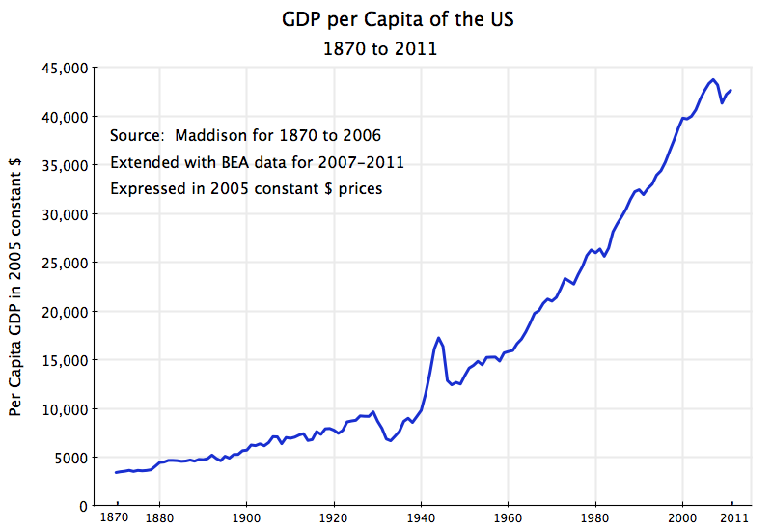

Slide 11
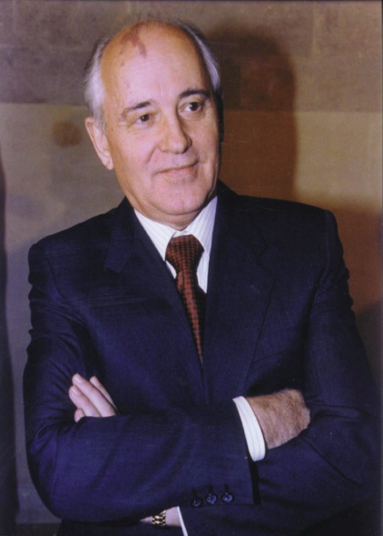
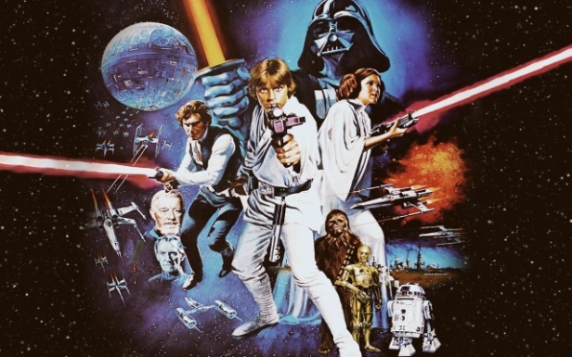
Reagan Era –Foreign Policy
Determined to restore American pride and prestige in the world
Soviet Union was ‘the evil empire’
Bankrupt the USSR through proliferation of nuclear arms build up
Strategic Defense Initiative (SDI) ‘Star Wars’
Soviet Premier Mikhail Gorbachev (1985 – 1991) made overtures to embrace market capitalism
Glasnost (openness) -political
Perestroika (restructuring) -economic
Notes:
https://www.youtube.com/watch?v=uLDK0G4Wktc Star Wars Program Propaganda

Slide 12
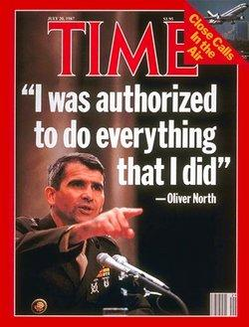
Reagan Doctrine
Military activism to roll back communist influence in Latin America, Africa & Asia
Funded anti-communist groups in Grenada, Nicaragua, Honduras
Iran-Contra Affair (1986)–Officials sold weapons to Iran to secure the release of American hostages & the profits were funneled to Contras to overthrow Marxist Nicaraguan gov’t
Reagan never indicted, but NSA staffer Oliver North was prosecuted –said Reagan had ‘no knowledge’
Illegal due to arms embargo against Iran
Violated the ‘Boland Amendment’ that limited US funding to Contras
Congress was not notified of arms sale or funding of Contras
Notes:
http://www.watchmojo.com/video/id/12181/ Top ten of 1980s Watch Mojo
http://www.watchmojo.com/video/id/9166/ Life and Death of Regan Watch Mojo

Slide 13
Group DBQ Activity
President Reagan asserted in his first presidential address that he wanted to limit the size & tax burden of government, protect traditional religious values, unleash American free enterprise, and bring fiscal responsibility to Washington; thereby restoring America’s faith in their own government.
Assess the extent to which President Reagan remained true to these goals
Each group must categorize their docs, construct a thesis, and develop an SFI list

