Slide 1
Warm Up
What does a lobbyist do?
What is a straight-party-ticket?
What is the first step of the initiative process?

Slide 2
3.3 Identify how interest groups and media bias impact political public opinion

Slide 3
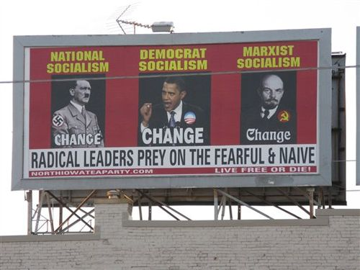
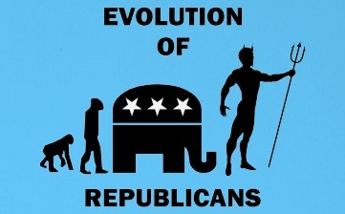

Slide 4
Questions
What are third parties?
Why do third parties generally struggle in the United States?
What are some general successes of third parties?
Opinion: do you think third parties should be able to have more influence in politics?

Slide 5
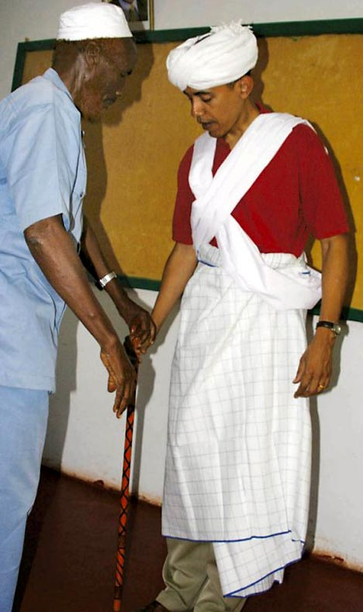
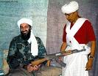
3.3
Media and Public Opinion

Slide 6
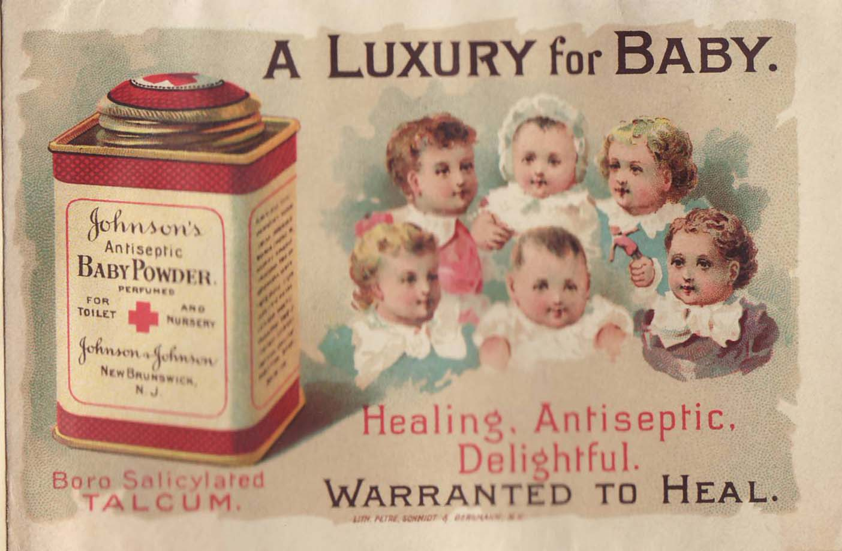
I. Media
Propaganda- technique of persuasion to influence behavior
create belief good or bad
Mass media- tv, newspaper, radio, etc.

Slide 7
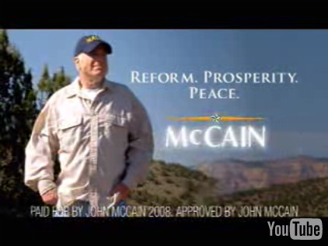
Glittering generalities- emotionally appealing words w/out anything to back them up

Slide 8
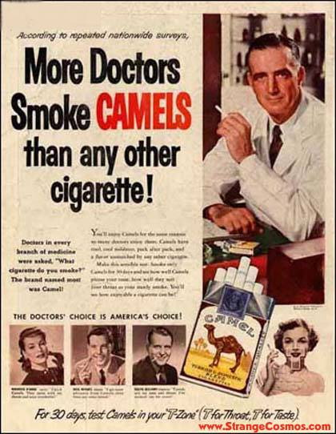
Bandwagon- everybody’s doing it
Endorsement- Celebrity/professional appeal

Slide 9
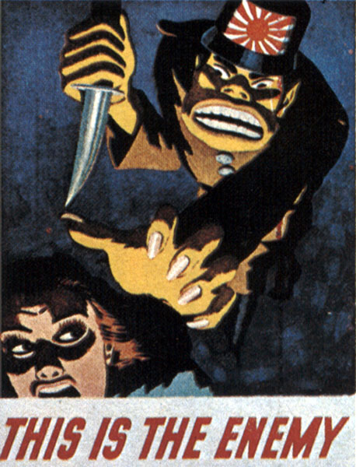
Stack Cards- show just one side

Slide 10
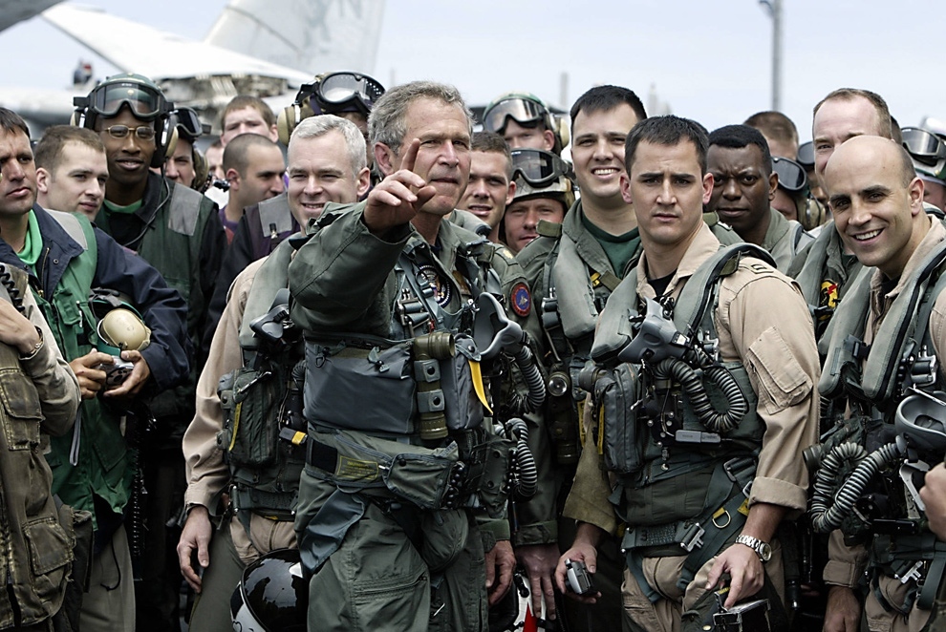
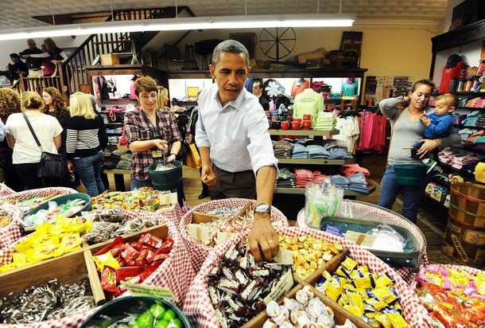
Just Plain Folks- show as one of the people

Slide 11
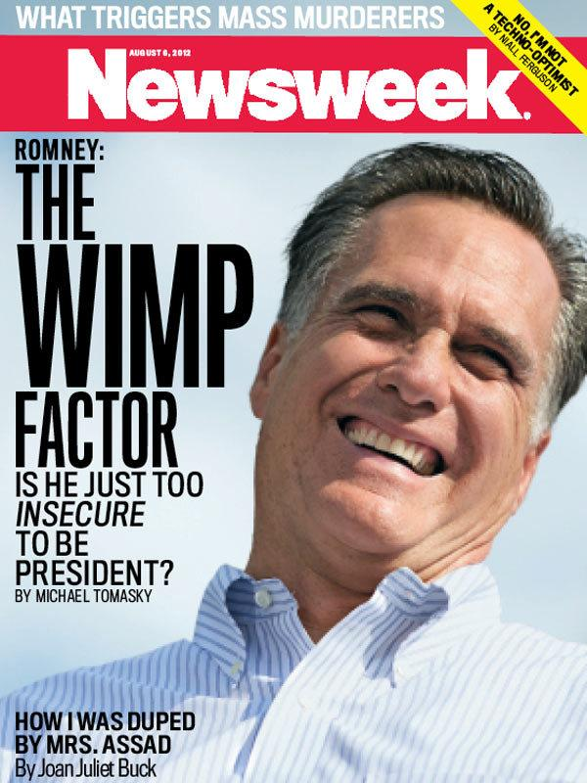
Name Calling- attacking with negative labels

Slide 12
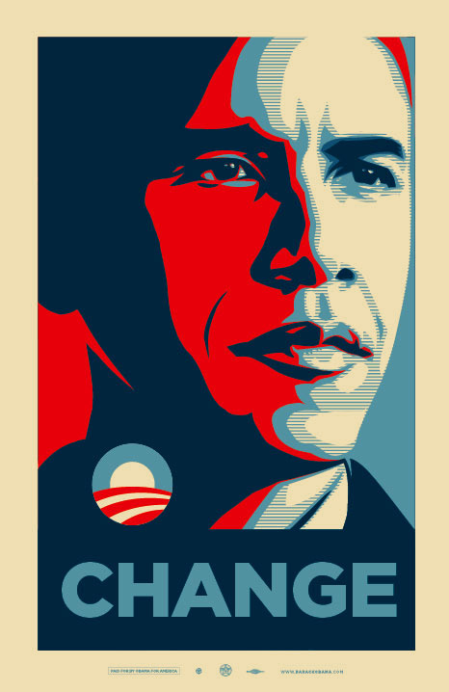
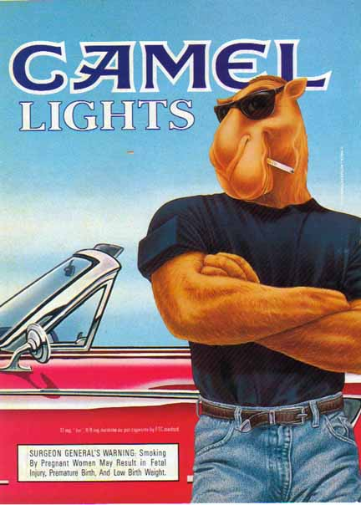
Transfer- combine ideas to transfer attitude from one idea to another

Slide 13
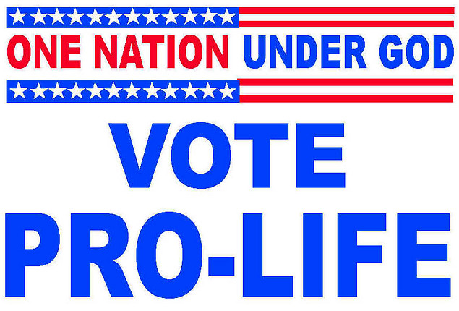
Euphemisms- call things by better names

