Slide 1
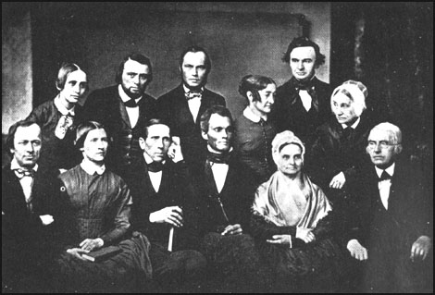
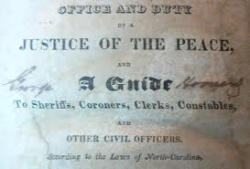
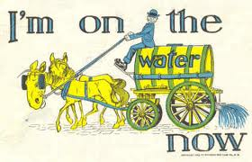
An Age of Reform, 1820–1860

Slide 2
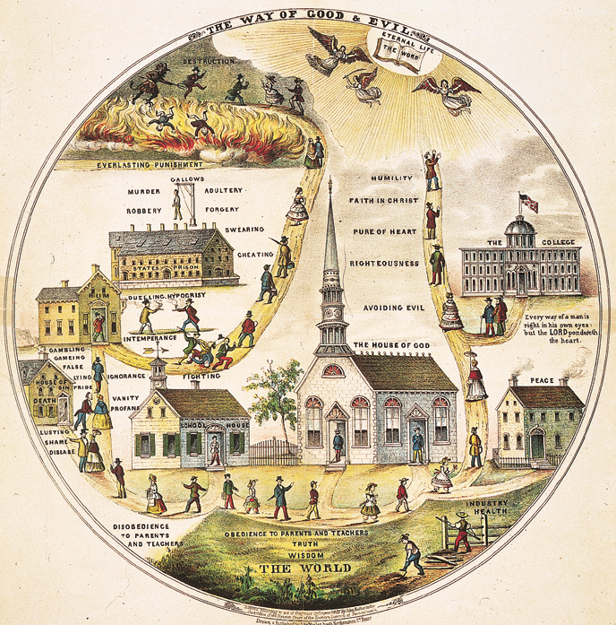
The 2nd Great Awakening

Slide 3
Revivalism and the Social Order
Society during the Jacksonian era was undergoing deep and rapid change
The revolution in markets brought both economic expansion and periodic depressions.
To combat this uncertainty reformers sought stability and order in religion
provided a means of social control in a disordered society
Churchgoers embraced the values of hard work, punctuality, and sobriety
Revivals brought unity and strength and a sense of peace

Slide 4
Second Great Awakening
As a result of the Second Great Awakening (a series of revivals in the 1790s-early 1800s), the dominant form of Christianity in America became evangelical Protestantism
Membership in the major Protestant churches soared
Congregational, Presbyterian, Baptist, and Methodist
By 1840, 50% of the adults were connected to some church, with the Methodists emerging as the largest denomination in both the North and the South
Like 1st, 2nd Awakening widened gaps between classes and religions
Notes:
Evangelical Protestantism was in line with the values of the early 1800s because it stressed the ability of everyone to bring about his or her salvation.
It upheld the American belief in individualism. It also catered to a mass audience without social distinctions. The revivals reinforced the American belief in democracy and equality.

Slide 5
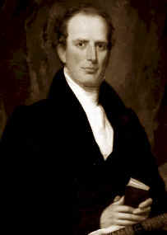
Charles Finney
Charles Finney conducted his own revivals in the mid 1820s and early 1830s
He rejected the Calvinist doctrine of predestination
adopted ideas of free will and salvation to all
People choose to be corrupt or not
Really popularized the new form of revival
Hey kids…Go watch these…
“A New Eden” –Ch 3 & 4 (23:10 -
http://www.pbs.org/godinamerica/view/
Charles Finney & Daniel Nash
http://www.youtube.com/watch?v=oISoPpL9WmU

Slide 6
Charles Finney and the Conversion Experience
New form of revival
Meeting night after night to build excitement
Speaking bluntly
Praying for sinners by name
Encouraging women to testify in public
Placing those struggling with conversion on the “anxious bench” at the front of the church
Notes:
Such techniques all heightened the emotions of the conversion process (born again)

Slide 7
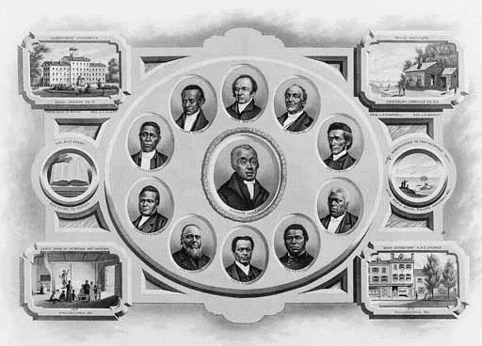
The Rise of African American Churches
Revivalism also spread to the African American community
The Second Great Awakening has been called the "central and defining event in the development of Afro-Christianity“
During these revivals Baptists and Methodists converted large numbers of blacks

Slide 8
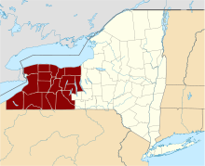
Burned Over District
District in Western NY -got its name from a “wild fire of new religions”
Gave birth to Seventh Day Adventists
believed the 2nd coming of Christ would occur on October 22, 1843
Members sold belongings, bought white robes for the ascension into heaven
Believers formed new church on October 23rd
Notes:
The Millerites believed the Second Coming of Christ would occur on October 22, 1843. Members of the church sold all of their belongings and bought white robes for the ascension into heaven. Needless to say on October 23, 1843 the religion fell apart. A small group stayed on and today they are the Seventh Day Adventist

Slide 9
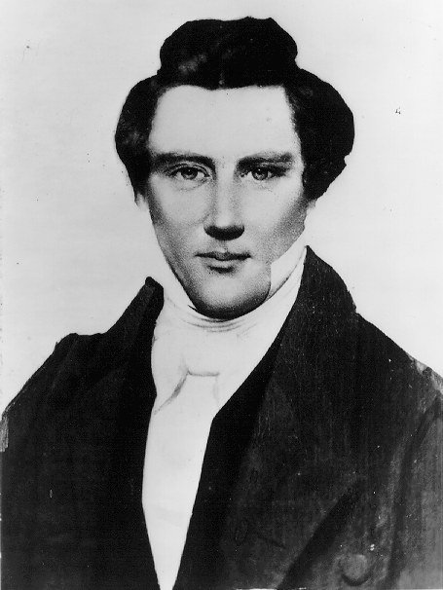
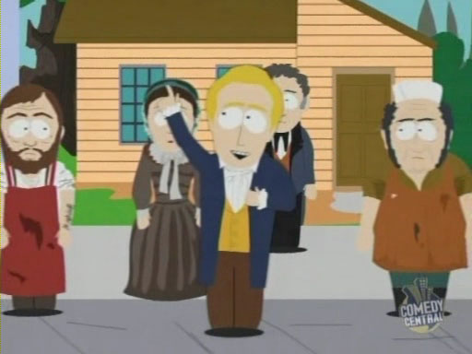
Remaking Society Through Faith
Some revivals sought to reform individual sinners, others sought to remake society
Mormons – The Church of Jesus Christ of Latter-Day Saints
Founded by Joseph Smith in western NY
In 1827, Smith announced that he had discovered a set of golden tablets on which was written the Book of Mormon
Proclaimed he had a commission from God to reestablish the true church

Slide 10
Mormons
Mormon culture upheld the middle-class values of hard work, and self-control
He tried to create a City of Zion: Kirkland, Ohio, Independence, Missouri, then to Nauvoo, Illinois.
His unorthodox teachings led to persecution and mob violence.
Smith was murdered in 1844 by an anti-Mormon mob in Carthage, Illinois.
Church in conflict

Slide 11
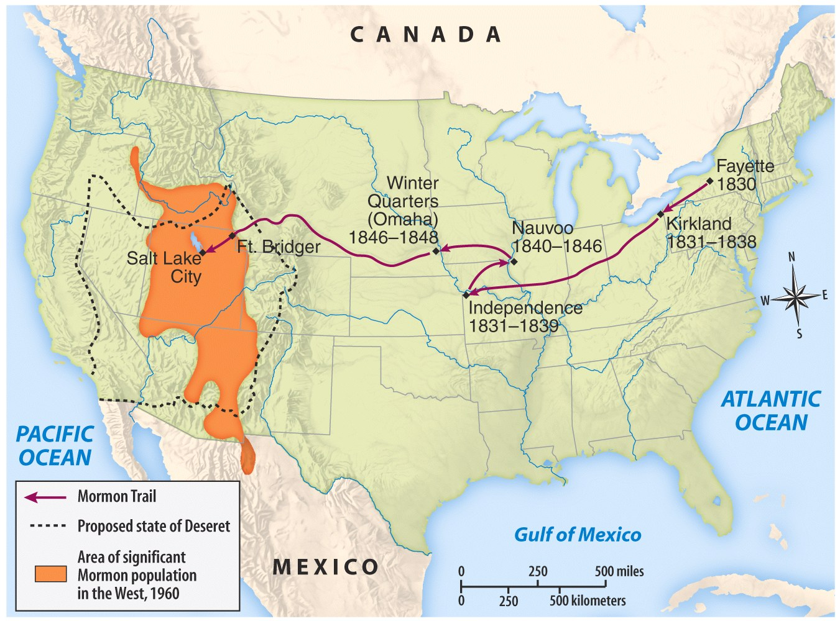

Slide 12
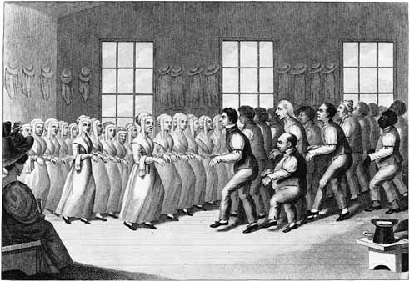
The Shakers
Mother Ann Lee – 1774
The Shakers used dancing as a worship practice
Shakers practiced celibacy, separating the sexes as far as practical
Shakers worked hard, lived simply (built furniture), and impressed outsiders with their cleanliness and order
Lacking any natural increase, membership began to decline after 1850, from a peak of about 6000 members

Slide 13
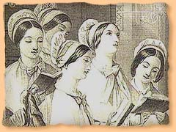
Shaker Hymn
'Tis the gift to be simple, 'Tis the gift to be free, 'Tis the gift to come down where you ought to be, And when we find ourselves in the place just right, 'Twill be in the valley of love and delight. When true simplicity is gained To bow and to bend we shan't be ashamed, To turn, turn will be our delight, 'Till by turning, turning we come round right.

Slide 14
Utopian Communities
From the 1790s-1850’s, more than 40 co-operative, communist communities were set up in the Eastern US
Most will fail within 5 yrs, Oneida & Shakers will last the longest
Robert Owen, 1825 –New Harmony, IN
Shakers in NY, VT & MA (celibacy)
Oneida, NY (complex marriage)
Brook Farm, MA
Notes:
The Oneida community (founded by John Humphrey Noyes)– opposite of the Shakers, “complex marriages and highly regulated group sex However men were not allowed to get women pregnant, only Noyes could do that. Today the Oneida Silverware Company is all that is left

Slide 15
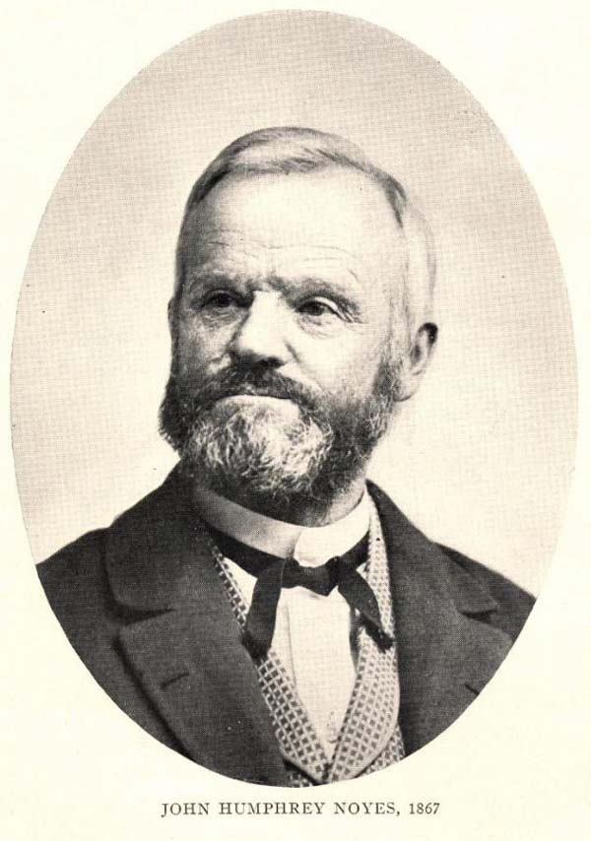
The Oneida Community New York, 1848
Millenarianism --> the 2nd coming of Christ had already occurred.
Humans were no longer obliged to follow the moral rules of the past.
all residents married to each other.
John Humphrey Noyes (1811-1886)
carefully regulated “free love.”

Slide 16
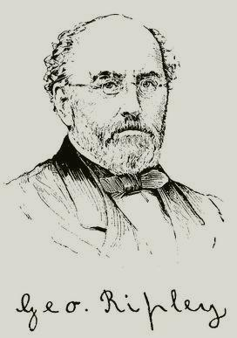
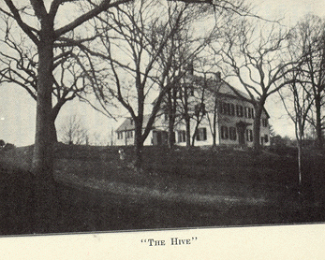
George Ripley (1802-1880)
Brook Farm West Roxbury, MA

Slide 17
Transcendentalism
“Liberation from understanding and the cultivation of reasoning.”
“Transcend” the limits of intellect and allow the emotions, the SOUL, to create an original relationship with the Universe.

Slide 18
Transcendentalist Intellectuals/Writers Concord, MA
Ralph Waldo
Emerson
Henry David
Thoreau
Nature (1832)
Resistance to Civil Disobedience (1849)
Self-Reliance (1841)
Walden (1854)
“The American Scholar” (1837)

Slide 19
The Second Great Awakening
“Spiritual Reform From Within” [Religious Revivalism]
Social Reforms & Redefining the Ideal of Equality
Temperance
Abolitionism
Education
Asylum & Prison Reform
Women’s Rights

Slide 20
Reformers sought to purify the nation by removing sins of slavery, intemperance (alcohol), male domination and war…..
Some removed themselves from society and tried to create Utopian societies based on collective ownership (socialism/communism)
Reformers used education, lyceum meetings, newspapers in inform public of their issues…..
Age of Reform 1820 to 1860
Ante-Belleum or before the Civil War
Romantic Age
2nd Great Awakening
Purifying the Nation
Reformers questioned the value of material progress in an age of industrialization if it were not accompanied by progress in solving the important human problems
Primarily a Northern movement
Southerners resisted reform movements because it feared abolition of slavery
Reformers pointed out the inequality in society stating the DOI as the basis of their argument…
Rise of Unitarians who believed a God of love instead of the Puritan concept of an angry God.
Unitarians believed one could show the love of God by helping others….
Developed a “social conscience” for improving the quality of life in society

Slide 21
Temperance Movement
The most significant reform movements of the period sought not to withdraw from society but to change it directly
Temperance Movement — undertook to eliminate social problems by curbing drinking
Led largely by clergy, the movement at first focused on drunkenness and did not oppose moderate drinking
In 1826 the American Temperance Society was founded, taking voluntary abstinence as its goal.

Slide 22
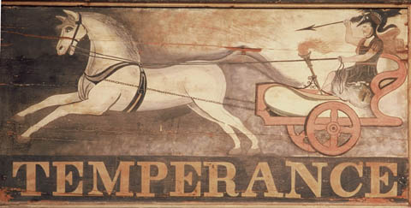
TEMPERANCE MOVEMENT
Lyman Beecher
Neal Dow
Lucretia Mott
Anti-Alcohol movement
American Temperance Society formed at Boston-----1826
sign pledges, pamphlets, anti-alcohol tract 10 nights in a Barroom and What I Saw There
Demon Drink adopt 2 major line attack
stressed temperance and individual will to resist

Slide 23
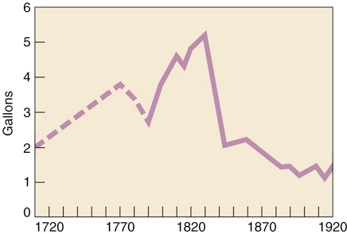
The Temperance Movement
During the next decade approximately 5000 local temperance societies were founded
As the movement gained momentum, annual per capita consumption of alcohol dropped sharply

Slide 24
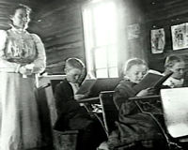
Educational Reform
In 1800 Massachusetts was the only state requiring free public schools supported by community funds
Middle-class reformers called for tax-supported education, arguing to business leaders that the new economic order needed educated workers

Slide 25
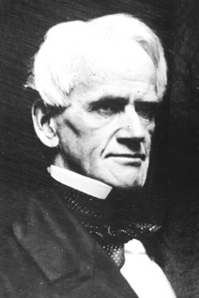
Educational Reform
Under Horace Mann’s leadership in the 1830s, Massachusetts created a state board of education and adopted a minimum-length school year.
Provided for training of teachers, and expanded the curriculum to include subjects such as history and geography

Slide 26
Educational Reform
By the 1850s the number of schools, attendance figures, and school budgets had all increased sharply
School reformers enjoyed their greatest success in the Northeast and the least in the South
Southern planters opposed paying taxes to educate poorer white children
Educational opportunities for women also expanded
In 1833 Oberlin College in Ohio became the first coeducational college.
Four years later the first all-female college was founded — Mount Holyoke, Massachusetts

Slide 27
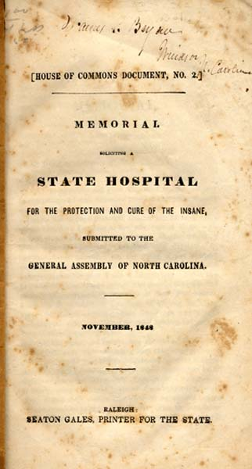
The Asylum Movement (orphanages, jails, hospitals)
Asylums isolated and separated the criminal, the insane, the ill, and the dependent from outside society
“Rehabilitation”
The goal of care in asylums, which had focused on confinement, shifted to the reform of personal character

Slide 28
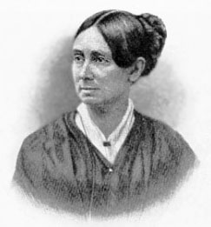
The Asylum Movement
Dorothea Dix, a Boston schoolteacher, took the lead in advocating state supported asylums for the mentally ill
She attracted much attention to the movement by her report detailing the horrors to which the mentally ill were subjected
being chained, kept in cages and closets, and beaten with rods
In response to her efforts, 28 states maintained mental institutions by 1860

Slide 29
Early 19c Women
Unable to vote.
Legal status of a minor.
Single --> could own her own property.
Married --> no control over her property or her children.
Could not initiate divorce.
Couldn’t make wills, sign a contract, or bring suit in court without her husband’s permission.
Lost her U.S. citizenship if she married a citizen of another nation

Slide 30
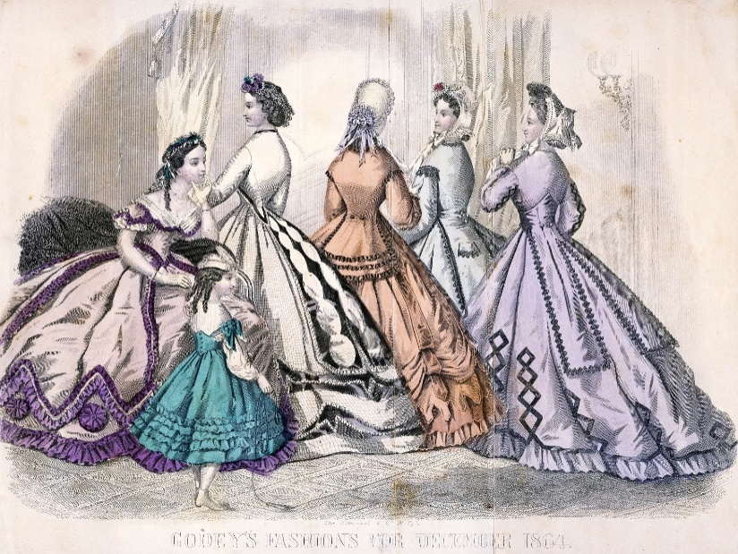
“Separate Spheres” Concept
Republican Motherhood evolved into the
“Cult of Domesticity”
A woman’s “sphere” was in the home (it was a refuge from the cruel world outside).
Her role was to “civilize” her husband and family.
The power of woman is her dependence. A woman who gives up that dependence on man to become a reformer yields the power God has given her for her protection, and her character becomes unnatural! - An 1830s MA minister

Slide 31
Women’s Rights Movement
In 1840, abolitionists divided over the issue of female participation
women found it easy to identify with the situation of the slaves
1848: Feminist reform led to Seneca Falls Convention
“Declaration of Sentiments”
launched modern women’s rights movement
Established the program for the women’s rights movement for the 19th century

Slide 32
AP PARTS
We hold these truths to be self-evident that all men and women are created equal; that they are endowed by their Creator with certain inalienable rights; that among these are life, liberty and the pursuit of happiness; that to secure these rights governments are instituted, deriving their just powers from the consent of the governed……
The history of mankind is a history of repeated injuries and usurpations on the part of man toward woman, having in direct object the establishment of an absolute tyranny over her. To prove this, let facts be submitted to a candid world….
He has made her, if married, in the eye of the law, civilly dead.
He has taken from all right in property, even to the wages she earns.

Slide 33
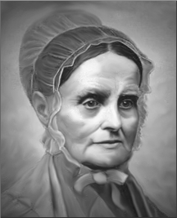
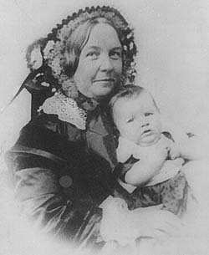
Women’s Rights
1840 --> split in the abolitionist movement over women’s role in it.
London --> World Anti-Slavery Convention
Lucretia Mott
Elizabeth Cady Stanton
1848 --> Seneca Falls Declaration of Sentiments

Slide 34
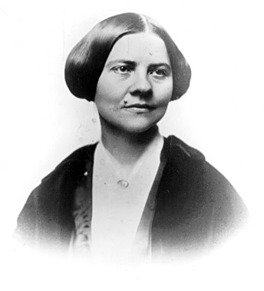
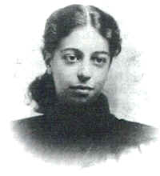
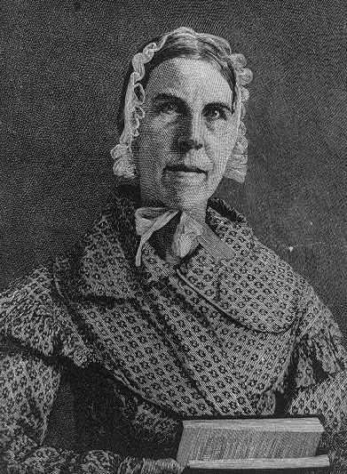
Cult of Domesticity = Abolition of Slavery
The 2nd Great Awakening inspired women to improve society.
Lucy Stone
Angelina Grimké
Sarah Grimké
American Women’s Suffrage Assoc.
edited Woman’s Journal
Southern Abolitionists
R2-9

Slide 35
SENECA FALLS
Declaration of Sentiments:
Educational and professional opportunities
Property rights
Legal equality
repeal of laws awarding the father custody of the children in divorce.
Suffrage rights

Slide 36
SENECA FALLS
The following is an excerpt from the Seneca Falls Declaration written by Elizabeth Cady Stanton.
Notice that the language and wording is similar to the Declaration of Independence.

Slide 37
He has made her, morally, an irresponsible being, as she can commit many crimes with impunity, provided they be done in the presence of her husband.
In the covenant of marriage, she is compelled to promise obedience to her husband, he becoming, to all intents and purposes, her master; the law giving him power to deprive her of her liberty, and to administer chastisement.

Slide 38
Seneca Falls Declaration
AP PARTS
“The married women and their legal status. What is servitude? “The condition of a slave.” What is a slave? “A person who is robbed of the proceeds of his labor; a person who is subject to the will of another…”
I submit the deprivation by law of ownership of one’s own person, wages, property, children, the denial of right as an individual, to sue and be sued, to vote, and to testify in the courts, is a condition of servitude most bitter and absolute, though under the sacred name of marriage.

Slide 39
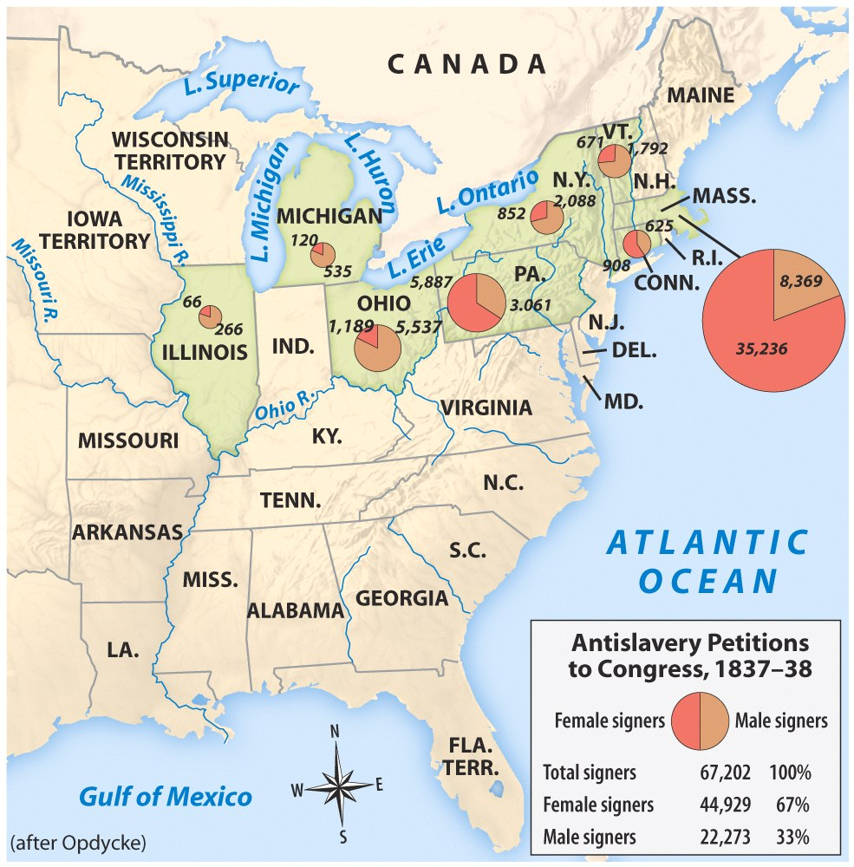
Gag rule was passed in Congress which nothing concerning slavery could be discussed.
Under the gag rule, anti-slavery petitions were not read on the floor of Congress
The rule was renewed in each Congress between 1837 and 1839.
In 1840 the House passed an even stricter rule, which refused to accept all anti-slavery petition. On December 3, 1844, the gag rule was repealed

Slide 40
Abolitionism: Division and Opposition
Abolitionism forced the churches to face the question of slavery head-on, and in the 1840s the Methodist and Baptist churches each split into northern and southern organizations over the issue of slavery
Even the abolitionists themselves splintered
More conservative reformers wanted to work within established institutions, using churches and political action to end slavery

Slide 41
Abolitionist Movement
American Colonization Society-1816
Return black Americans to greater freedom in Africa
William Lloyd Garrison-The Liberator
Called for an immediate end to slavery
Frederick Douglass-escaped slavery and joined abolitionist movement
Narrative on the Life of Frederick Douglass
Black Abolitionists
David Walker: 1829-Appeal to the Colored Citizens of the World
Sojourner Truth: 1850- The Narrative of Sojourner Truth

Slide 42
The Underground Railroad
“Conductor” ==== leader of the escape
“Passengers” ==== escaping slaves
“Tracks” ==== routes
“Trains” ==== farm wagons transporting the escaping slaves
“Depots” ==== safe houses to rest/sleep

