Slide 1
Langston Hughes – HAP-P
What happens to a dream deferred?
Does it dry up like a raisin in the sun? Or fester like a sore– And then run? Does it stink like rotten meat? Or crust and sugar over– like a syrupy sweet?
Maybe it just sags like a heavy load.
Or does it explode?

Slide 2
Prof. Alan Brinkley reading
“The years from the end of World War II to the end of the 1950s were dominated by four powerful changes in American life. The first was the birth of the Cold War, and the great fears that it created. The second was the dramatic growth of affluence, which transformed the lives of many, but not all, Americans. The third was a growing anxiety among many Americans who felt that their lives were too constricted by the staid culture of the era. And the fourth was the emergence of a new subversive culture growing beneath the smooth, stable surface of the decade that would explode in the 1960s.”

Slide 3
 | The Cold War | Affluent Society | Society in the 50s | The Shadow Nation
Synopsis of Segment:
Important facts (at least 3)
Why does Brinley describe this segment as a “powerful change”?

Slide 4
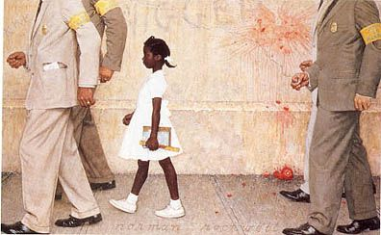
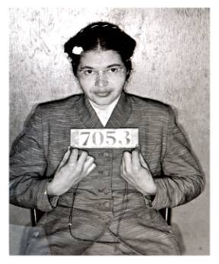
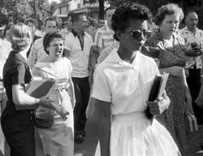
Civil Rights Era
Unit 8

Slide 5
What event occurred at each of the following dates?
1870
1896
1909
1910-1930
1954
1955
1957
1962
1963
1964
1965
1968 (what two people died?)
2008
Answer each of the following:
What were Jim Crow Laws?
What influenced Kennedy to join the Civil Rights
Movement?
Who were the Black Panthers and Malcom X?
Notes:
https://www.youtube.com/watch?v=URxwe6LPvkM History of the Civil Rights Movement

Slide 6
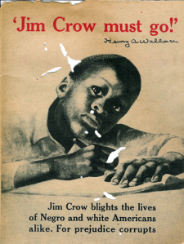
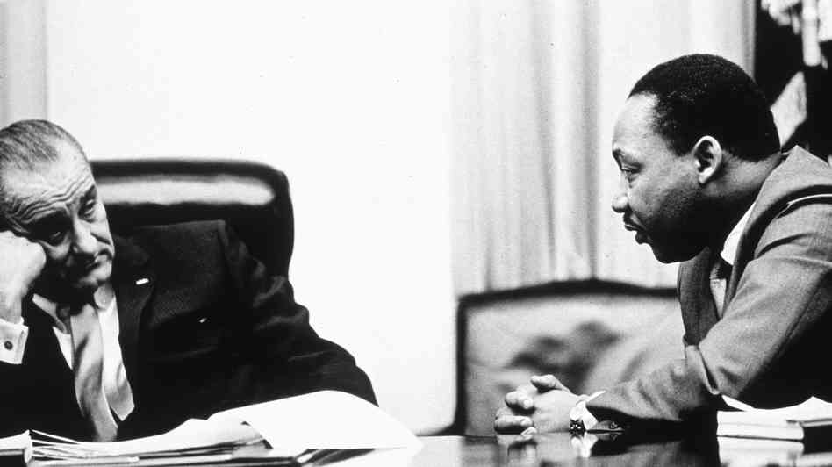
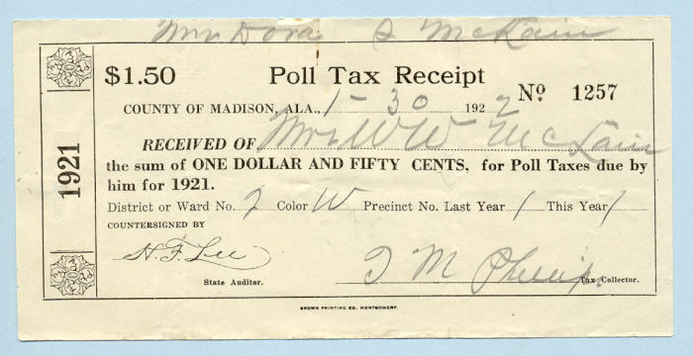
Civil Rights Act of 1957
Estab. Commission on Civil Rights to investigate unconstitutional treatment (esp. voting rights)
Civil Rights Act of 1964
Equal access to public facilities & employment
Voting Rights Act of 1965
Attorney General could register voters where literacy test & poll taxes had been used to deny voting rights
24th Amendment,
Prohibits poll taxes or other taxes in order to deny voting rights
ensures right to vote in federal elections
Plessey v. Ferguson, 1896
Separate but equal is constitutional
Brown v. BOE, 1954
Separate is inherently unequal
Integration of public schools begins
Shuttlesworth V. Birmingham BOE, 1958
Scholastic ability & social behavior could not be used to maintain segregation

Slide 7
Civil Rights Movement Time line
Tuskegee Institute founded, 1882
Atlanta Compromise Speech, 1895
NAACP founded, 1909
Great Migration, 1910 – 1920
Scottsboro Case, 1931 – 1952
Congress of Racial Equality (CORE) founded, 1942
Montgomery Bus Boycott, 1955
Southern Christian Leadership Conference founded by MLK, Jr., 1957
Little Rock Nine, 1957
Greensboro Sit-in, 1960
Freedom Rides, 1961
Attempt to desegregate interstate bus travel in the South
March on Washington, 1963

Slide 8
MLK – I Have a Dream
What is the purpose of this speech? In it Martin Luther King, Jr. states “Nineteen sixty-three is not an end, but a beginning.” Based on evidence from this text, what is he hoping will begin? How does he convince the audience that it is time for this new beginning?
Notes:
https://www.youtube.com/watch?v=smEqnnklfYs

Slide 9
Henry David Thoreau, Civil Disobedience, 1849
“But, to speak practically and as a citizen, unlike those who call themselves no-government men, I ask for, not at once no government, but at once a better government. Let every man make known what kind of government would command his respect, and that will be one step toward obtaining it.”

Slide 10
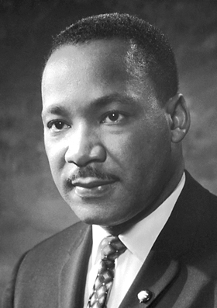
Mahatma Ghandi
“Power is of two kinds. One is obtained by the fear of punishment and the other by acts of love. Power based on love is a thousand times more effective and permanent then the one derived from fear of punishment”
“I object to violence because when it appears to do good, the good is only temporary; the evil it does is permanent.”

Slide 11
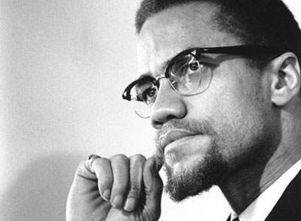
Marcus Garvey
“There can be no solution to the race problem until you, yourselves, strike the first blow.”

Slide 12
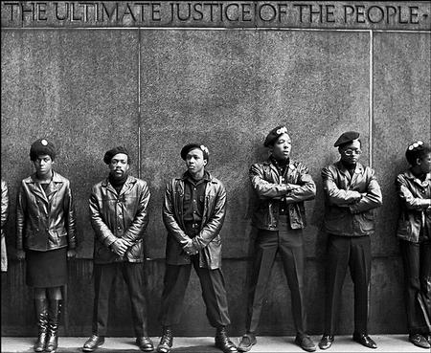
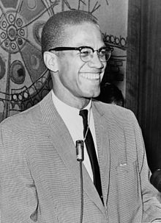
The Other Side of the Civil Rights Movement
Malcom X (Little)
The Nation of Islam
Black Panthers

Slide 13
MLK and Malcom X Debate
-List the points that each makes during the debate.
-Which leader do you feel had a better overall argument? Which side made more sense, considering the circumstances of the time?
-Why do you think that MLK is heralded as the principal civil rights leader by most historians?
Notes:
MLK vs. Malcolm X Debate https://www.youtube.com/watch?v=jphm4cFDREw

Slide 14
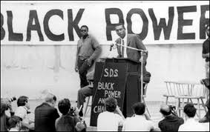
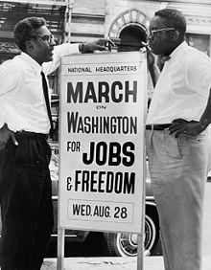
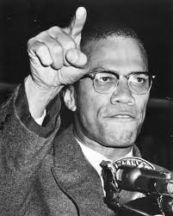
EQ: Was the Civil Rights movement the efforts of black leaders to secure equality in American society, or was it an attempt by white leaders to pacify militancy amongst black youth?

