Slide 1
Gilded Age Politics: 1877 – 1900

Slide 2
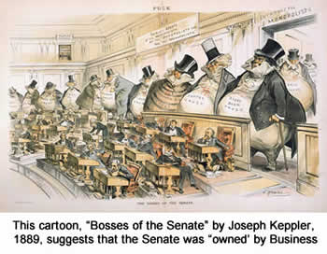
Politics of the Gilded Age in a “Nutshell”
Forgettable presidents, none served a consecutive term
Politicians who largely ignored the problems inherent in society
General stalemate in government between the major parties
Laissez-Faire economics by government

Slide 3
Presidents of the Gilded Age:
Grant (1869-1872) Republican
Rutherford B. Hayes (1877-1881) Republican
James Garfield (1881) Republican
Chester A. Arthur (1881-1885) Republican
Grover Cleveland (1885-1889) Democrat **First since 1869**
Benjamin Harrison (1889 – 1893) Republican
Grover Cleveland (1893 - 1897) Democrat
William McKinley (1897 – 1901) Republican

Slide 4
Parties and Issues of the Gilded Age
Patronage Problems
Money Problems
Tariff Problems

Slide 5
Short Answer Practice
-Explain how one of the following political issues was central to debates between political parties during the Gilded Age:
Patronage Problems
Money Problems
Tariff Problems
-Explain how one of the other choices is not as effective for answering the prompt.
-Compare and contrast the basic differences between the major party platforms during the Gilded age.

Slide 6
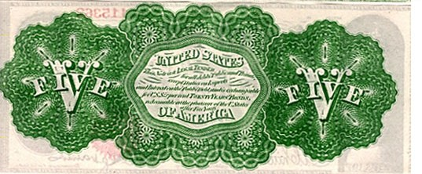
Money Problems
How to expand and stabilize the money supply
Specie: gold or silver currency
Easy/Soft Money Supply
Vs
Sound/Hard Money Supply

Slide 7
Tariff Problems
By 1890s, Tariffs provided more than half of federal revenue
Tariffs generally caused higher prices for consumer goods
Caused issues for farmers

Slide 8
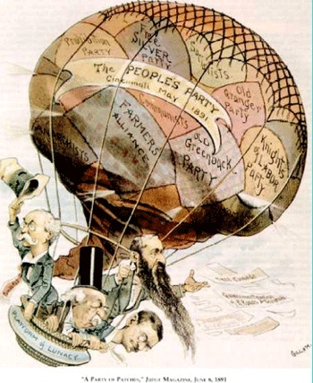
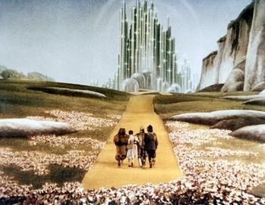
Populist Party (late 19th century) Third Party
Rose out of agrarian discontent with government support of the cities and big business
Formation a result of earlier Grange and Farmers’ Alliance movements
Aka the “people’s” party

Slide 9
The “Omaha Platform” aka platform of the Populists
More Power to common man, called for:
Direct popular election of US Senators
Increased use of initiatives and referendums
Economic reform, called for:
Unlimited coinage of silver
Progressive income tax
Public ownership of RR’s and Telephone industry (by U.S.)
Loans and subsidies for farmers
Eight hour workday for wage workers

Slide 10
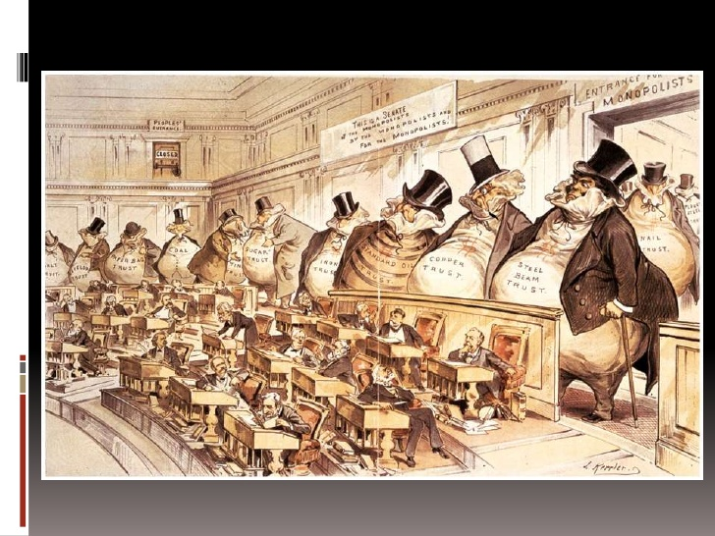
Republicans
Continued use of “Waving the Bloody Shirt” appealing to Democrats
Reformers and African Americans generally favored the party
Middle class and business men
High tariffs to protect American industry
Pro-big government (in the form of protecting industry)
Pro-business with high protective tariffs
Hamiltonian by tradition.

Slide 11
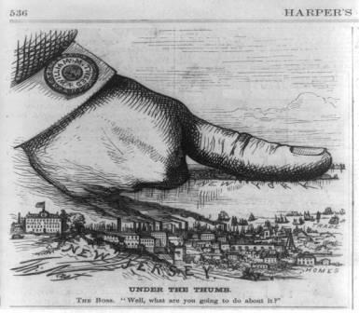
Democrats
South vote overwhelmingly democratic
In the North, political machines which favored immigrants helped to retain power
States’ rights and limit powers of Federal Gov.
Low Tariffs to protect American farmers and rural America
Jeffersonian by tradition

Slide 12
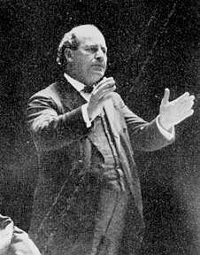
1896 Election
“Gold” Democrats loyal to Cleveland vs. Prosilver Democrats
William Jennings Bryan becomes a prominent leader for the prosilver democrats
“Cross of Gold” speech helps him become a nominee for President in 1896 (but loses to McKinley)

Slide 13
Changes by election of 1896 (McKinley)
Start of another era of Republican dominance at the Presidency and Congress
Republicans shift from “free soil, free labor, and free men” of the Civil War to party of business and industry
Decline of Populist party

