Slide 1
Utilizing Data to Make Informed Instructional Decisions
Presenter: Sig Arnesen
School: Ardrey Kell High School
Charlotte, NC
Sigurdj.arnesen@cms.k12.nc.us

Slide 2
Objectives
To analyze the importance of data collection and utilization in the classroom
To discuss techniques to integrate data collection and utilization in the classroom

Slide 3
Hook
Can you identify with anything that you saw in the video?

Slide 4
Agenda
Introduction to My Study
Warm-up
Discussion: Qualitative v. Quantitative
Pre-Assessments that Matter
Student Self-Assessment
Teacher Daily and Long Term Data
NC Evaluation Rubric
Exit Ticket

Slide 5
What is the Governor’s Teacher Network (GTN)?
North Carolina Gov. Pat McCrory, in partnership with the NC Department of Public Instruction (NCDPI) has established the Governor's Teacher Network (GTN). This initiative will provide a statewide platform for teachers to share their best work around instruction and professional development and help advance Race to the Top (RttT) funded educational remodeling efforts across the state.

Slide 6
What is the my role in the GTN?
Pathway 1: Professional Development Teachers will create professional development sessions and materials (face-to-face, webinars and online modules) to address classroom instructional needs and increase the PD offerings in the state-wide Professional Development system in Home Base.

Slide 7
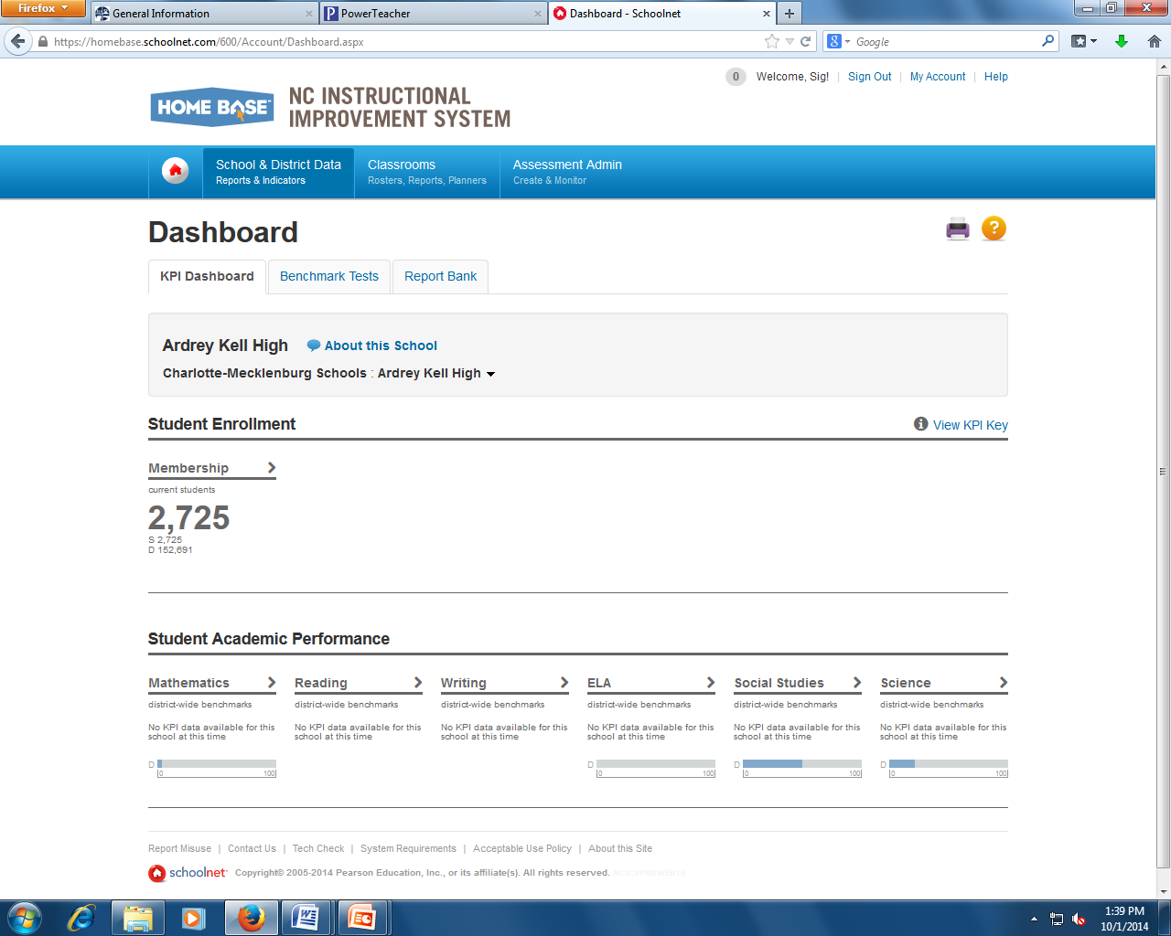
Home Base
Teachers will use the Home Base to:
Supplement their teaching with individualized educational materials
See a diagnostic breakdown of each child's performance including knowledge and skill areas that require extra attention
Engage in professional development modules according to personal interests, district goals, and state standards

Slide 8
What is the purpose of my study?
Educators are faced with making many decisions each and every day, most of which are made on the fly. We take into account a wide variety of factors and we are trusted to make decisions using our best judgment. Herein lies the premise of this study: how can educators refine their decision making using best practices centered on data?

Slide 9
Warm-Up
What is “data” and why is it important?
In what ways do you collect data in your classroom?
How do you use that data?

Slide 10
What is the difference between Qualitative and Quantitative?
Quantitative:
Teacher assessments
Standardized tests
Report cards
State Made Assessments
Quizzes
Pre Assessments
Qualitative:
Field notes
Journals
Questionnaires
Audio and Video

Slide 11
North Carolina and Data
Standard I: 1A, 1B, 1D
Standard II: 2C
Standard III: 3A
Standard IV: 4B, 4C, 4D, 4H
Standard V: 5A, 5C

Slide 12
Standard I: 1A: “Uses classroom assessment data to inform program planning”
What is federalism?
Separating the branches of government
Shared power between the state and federal government
A government where the federal government has all of the power
A government where sovereign states unite for a limited purpose
(Obj. 1.1)
Pre-Assessments that matter

Slide 13
Using Pre-Assessment’s to drive instruction: item analysis
Question # | % 0f class Missed
1 | 80%
2 | 50%
3 | 60%
4 | 0%
5 | 14%
6 | 2%
7 | 25%
8 | 30%
Objective and topic
1.1: Federalism
1.1: Separation of Powers
1.1: Checks and Balances
1.2: Democracy
1.2: Republic
1.2: Duties and Responsibilities
1.3: 1st Amendment
1.3: 1st Amendment
Take the extra step!

Slide 14
Using Pre-Assessment’s to drive instruction: item analysis
Next steps?
Compare with your content team members (standard 1B)!
Use the data to decide how to plan accordingly for the unit
Figure out what concepts/ideas students are really going to struggle with most
How can we use this information to help us make informed instructional decisions?
When should we give a pre-assessment?
How do we get students to actually TRY on pre-assessments?

Slide 15
Using Pre-Assessment to drive instruction: Individual Student Data
Student Name | Score
Student A | 100%
Student B | 50%
Student C | 0%
Student D | 25%
Student E | 75%
Student F | 90%
Student G | 85%
Next Steps?
Use this information to guide you in creating learning teams.
Guide your decision on selecting students for remediation.
Use this information to target student growth at the end of a unit!
What can we do with this information?

Slide 16
Brain Break!
https://www.youtube.com/watch?v=KdxEAt91D7k

Slide 17
Standard I: 1A: “Encourages students to take responsibility for their own learning”
Assess. Name | Pre-Assess | Quiz 1 | Quiz 2 | Unit Test
Grade:
Did I Study (Y/N)
How Long?
What else can we do to meet this standard?
20%
65%
75%
78%
-
N
Y
Y
10 Min
30 Min
-
-
HOW?

Slide 18
Standard 4: 4H: “Teaches students and encourages them to use peer and self-assessment feedback to assess their own learning”
The most important part: Reflection!
+58% (78-20)
% Change?
1-10 Effort?
What could I have done better?
What are my goals for next unit?
3
Standard 2: 2C: “Helps students hold high expectations for themselves and their peers”

Slide 19
Standard 5: 5C: “Adapts professional practice based on data and evaluates impact on student learning”
Why do we need to adapt our teaching based on data?
We should:
Collect data daily (qualitative)
Collect data consistently (quantitative)
Analyze our data (don’t just let it sit there)
Use the data to make informed instructional decisions

Slide 20
2/13/2015
OBJ? 1.1 Identify the concept of Federalism as it applies to the Constitution.
 | On Task: ”Assignment A” | Participation | Observation
Student A | Y | IIII | A loves to participate, answers q’s wrong though
Student B | N | II
Student C | Y | I | Has been very talkative
Student D | Y
Student E | N-Staring at pg |  | E seems to struggle with reading
Student F | Y | III
Student G | Y |  | Quiet, but on task
Example of DAILY data

Slide 21
Assessment Data: Goal 1
Goal: 1/1/15-2/12/15
1.1 Identify the concept of Federalism as it applies to the Constitution
(list all objectives for the unit)
 | Pre | Quiz 1.1 | Quiz 1.2 | T or KT? | Test Unit 1 | Change?
Student A | 32% | 60% | 75% | T (9/27) | 80% | +48
Student B | 40% | 60% | 70% | KT (19-29th) | 83% | +43
Student C | 50% | 85% | 90% |  | 93% | +43
Student D | 55% | 88% | 95% |  | 90% | +35
Student E | 12% | 30% | 60% | KT Invite (19th) | 68% | +56
Student F | 40% | 80% | 90% | KT (19-29th) | 91% | +51
Student G | 60% | 90% | 85% |  | 85% | +25
Cont (to class size) | - | - | - | - | - | -
AVERAGE: | 41% | 70% | 81% | - | 84% | +43
Lets take a closer look on the next slide!

Slide 22
 | Pre | Quiz 1.1 | Quiz 1.2 | Remediation? | Test Unit 1 | Change?
Student A | 32% | 60% | 75% | 1/15 | 80% | +48
Student B | 40% | 60% | 70% | 1/19-29th | 83% | +43
Student C | 50% | 85% | 90% |  | 93% | +43
Student D | 55% | 88% | 95% |  | 90% | +35
Student E | 12% | 30% | 60% | Invited (19th) | 68% | +56
Student F | 40% | 80% | 90% | 1/19-29th | 91% | +51
Student G | 60% | 90% | 85% |  | 85% | +25
Student H | 90% | 95% | 100% |  | - | -
AVERAGE: | 41% | 70% | 81% | - | 84% | +43

Slide 23
So, I have data… NOW WHAT?

Slide 24
Other “goodies” from the NC Evaluation Rubric:
Standard 1: 1D: “Actively participates, promotes, and provides strong supporting evidence for implementation of initiatives to improve education”
Standard 3: 3A: “Makes necessary changes to instructional practice to improve student learning”
Standard 4: 4B: “Monitors student performance and responds to cultural diversity and learning needs throughout the school improvement process”
Standard 4: 4C: “Stays abrest of emerging research areas and new and innovative materials and incorporates them into lesson plans and instructional strategies”
Standard 5: 5A: “Provides a detailed analysis about what can be done to improve student learning and uses such analysis to adapt instructional practices”

Slide 25
Exit Ticket
Sigurdj.arnesen@cms.k12.nc.us
Is there anything that you feel you could take away from today and reasonably incorporate into your classroom?
Did today help you to think differently about education?
What suggestions do you have for the presenter?
Miscellaneous feedback:
Thank You!!

