Slide 1
Industrial America between 1865 and 1900

Slide 2
Why was the US so successful by 1900?
Abundance of raw materials
Abundant labor supply supplemented by immigrants
Vast transportation network
European and American investors
New technologies (440,000 new patents between 1860 -1890)
Business friendly government policies
Ambitious and talented entrepreneurs

Slide 3
The Rail Road Industry
Rail Road Boom
Mileage increases:
35,000 miles in 1865 to 193,000 miles in 1900
Created national market for goods
Helped grow other industries like coal and steel
Standardization in the East

Slide 4
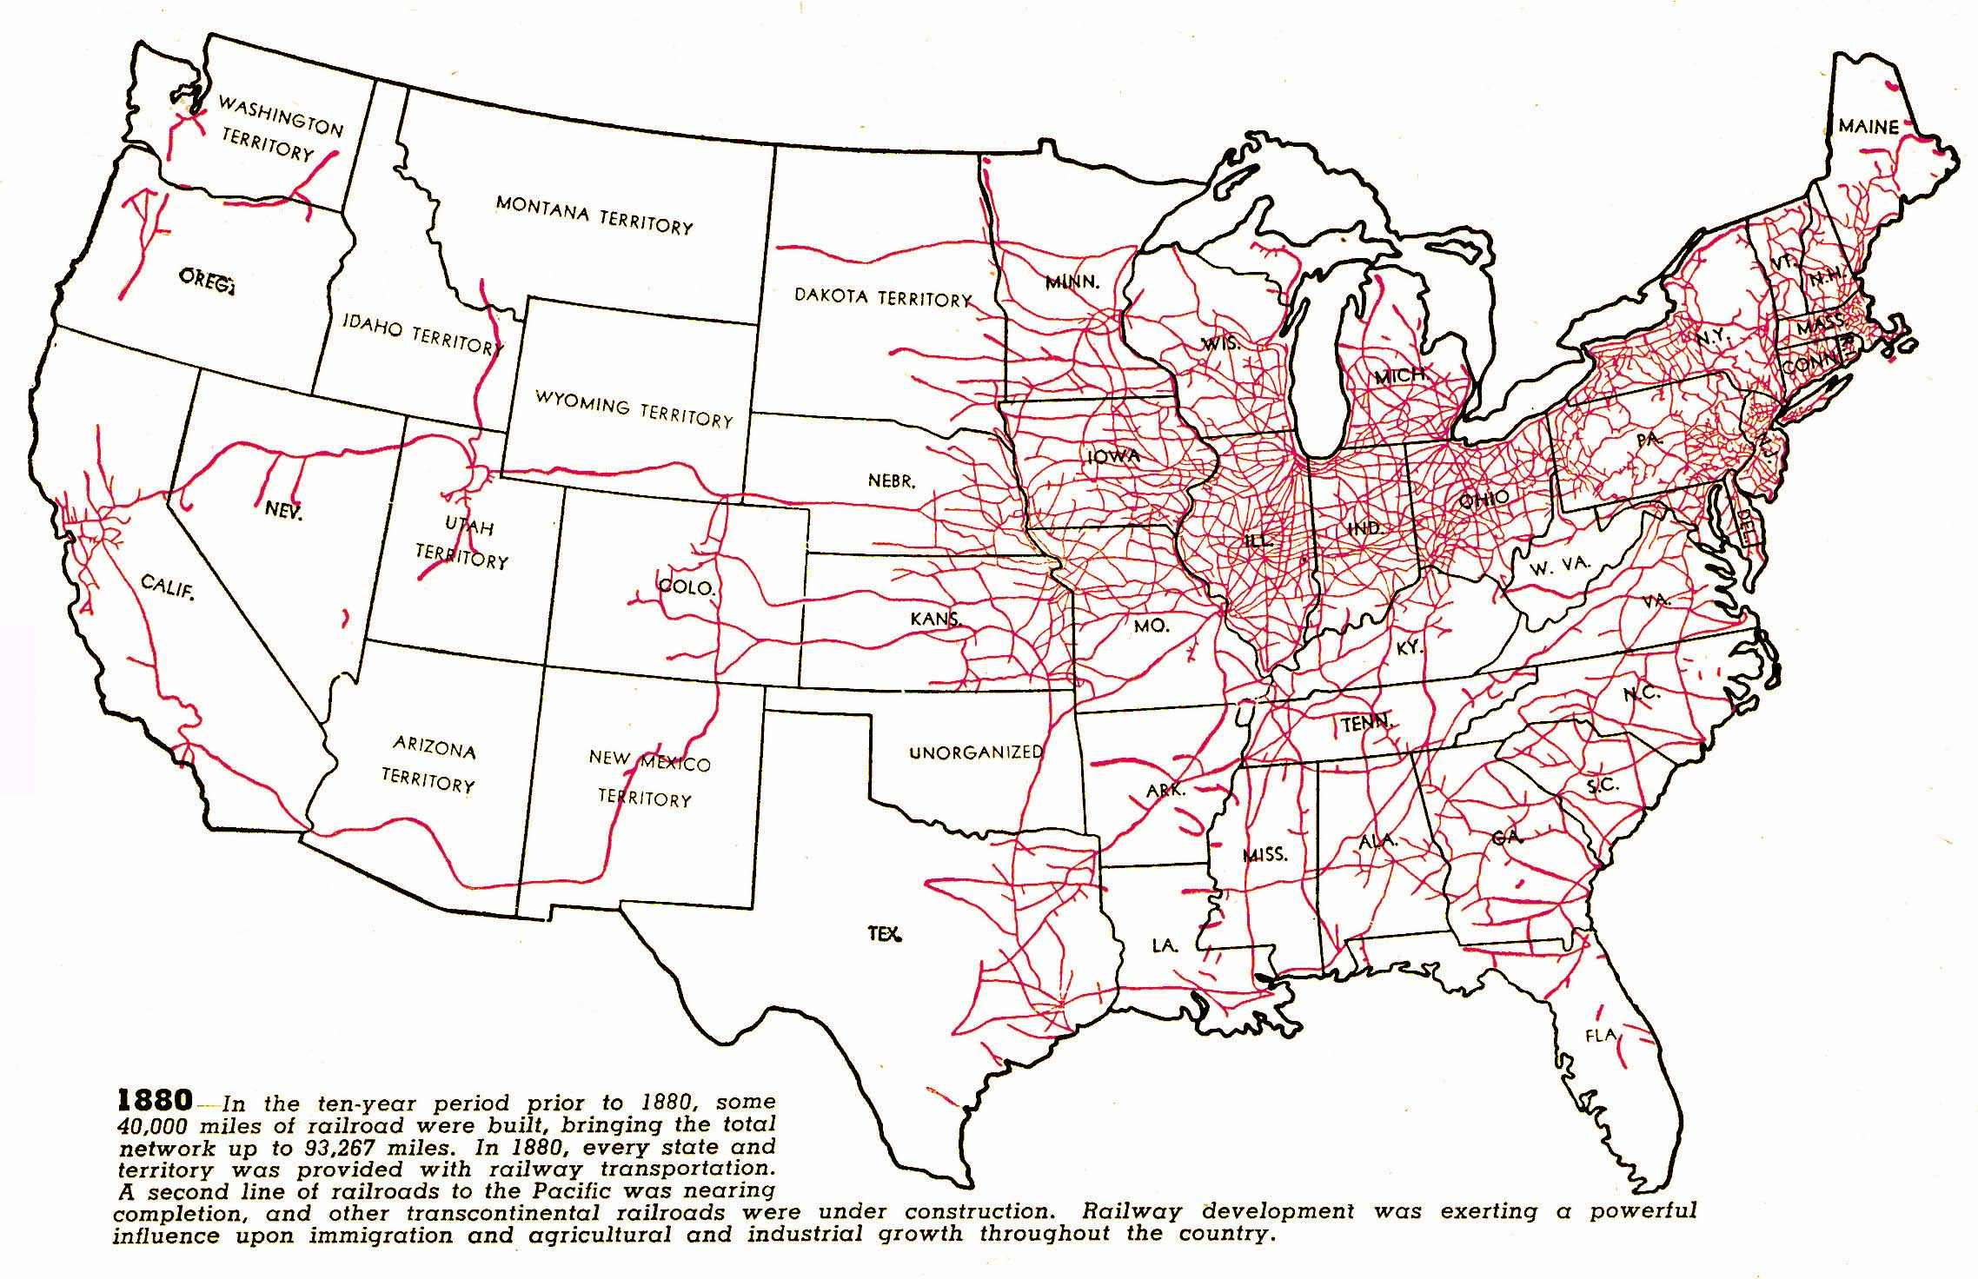

Slide 5
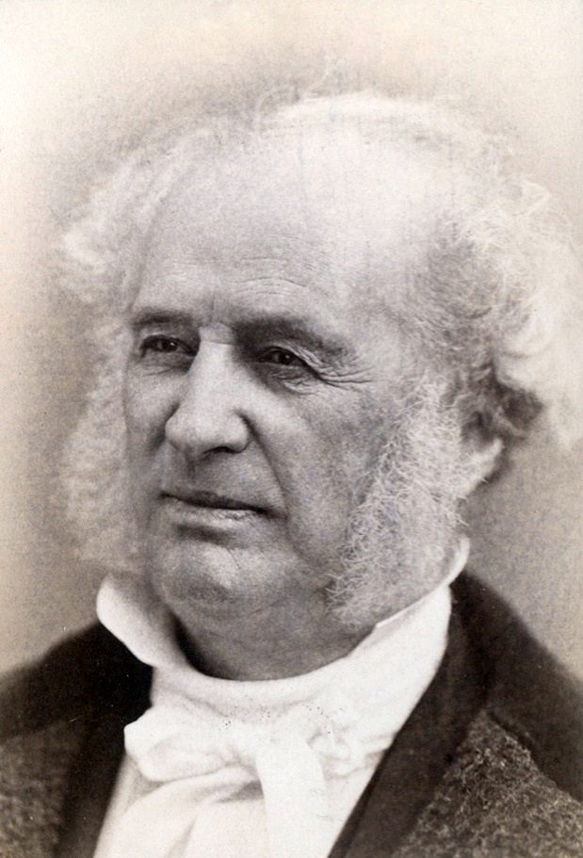
Cornelius Vanderbilt used money earned originally in steamboat business to consolidate local RR’s in New York into the New York Central RR (1867)
Standard gauge (distance between tracks) was implemented
Other large RRs:
Baltimore RR, Ohio RR, Pennsylvania RR

Slide 6
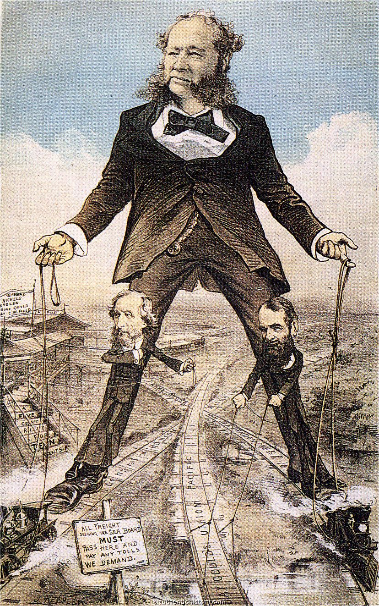
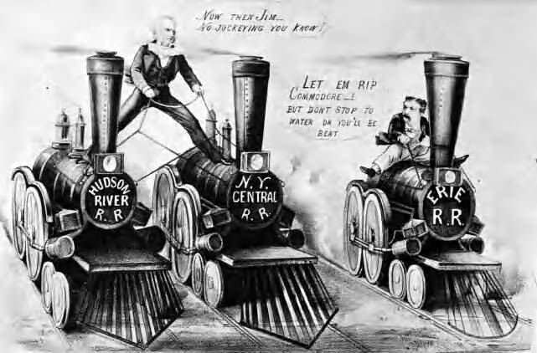
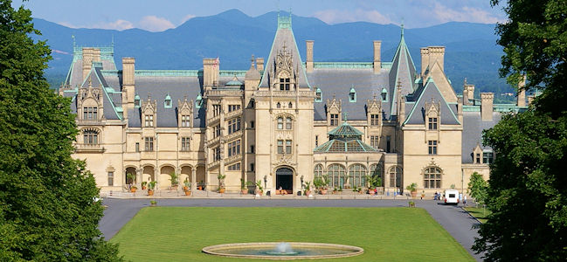

Slide 7
Western RR’s and the Closing of the West
Tied east to west and promoted a national market
Federal Land Grants
Massive subsidies provided to RR companies to expand business

Slide 8
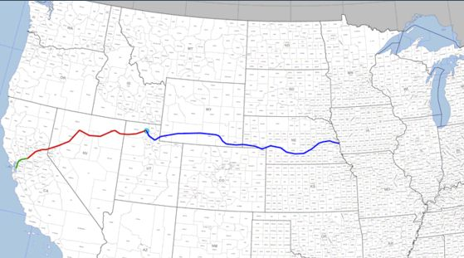
Transcontinental Railroads (TRR)
First TRR authorized by Congress during the Civil War to connect California to the rest of the union
Two corporations divided the workload: Union Pacific and Central Pacific
Union Pacific:
Central Pacific:

Slide 9
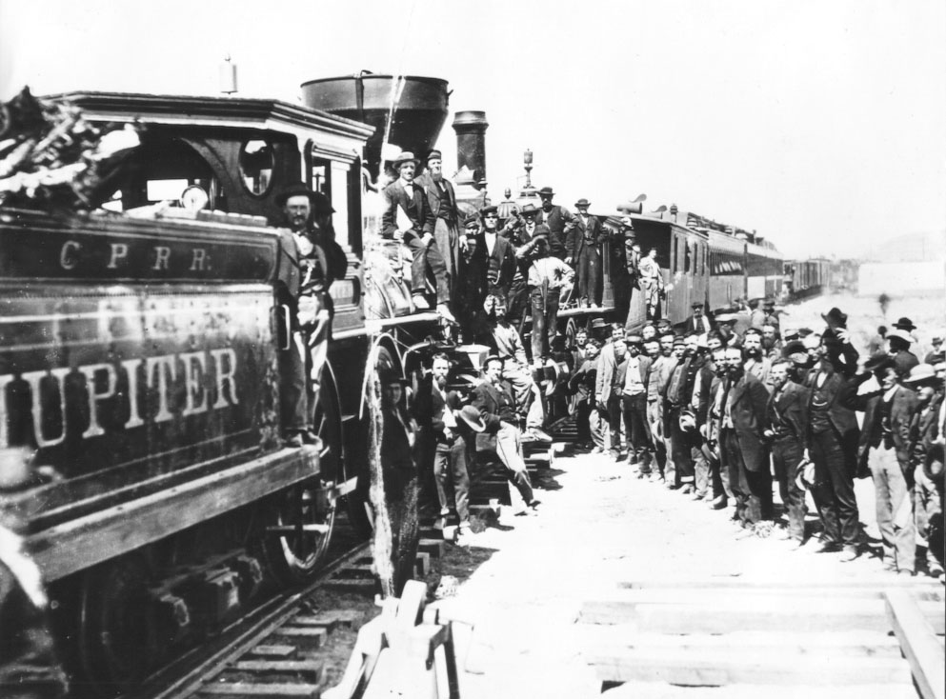

Slide 10
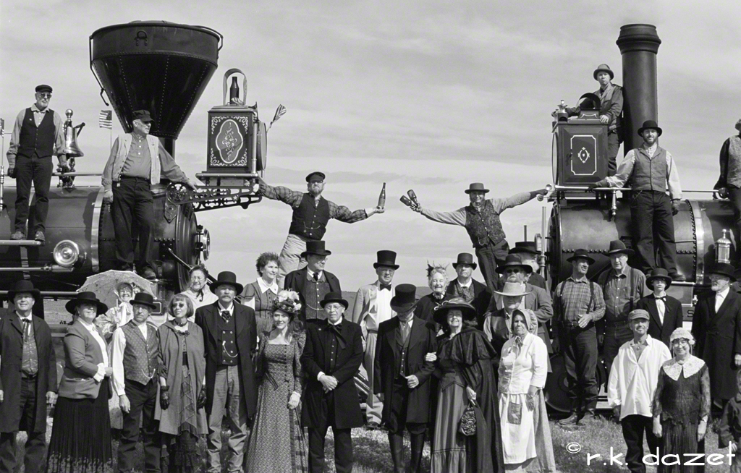
The Meeting of the TRR’s
Promontory Point, Utah (May 10, 1869)
Golden spike ceremoniously driven in to tie East and West

Slide 11
1883: Three other TRR’s completed
The Southern Pacific: New Orleans to LA
The Atchison, Topeka, and Santa Fe linked Kansas City and LA
The Northern Pacific: Duluth to Seattle.
1893: The Great Northern: St. Paul to Seattle
Overall, they helped to connect east to west, but proved business failures as they had little short term profit return and lack of customers (due to high prices)

Slide 12
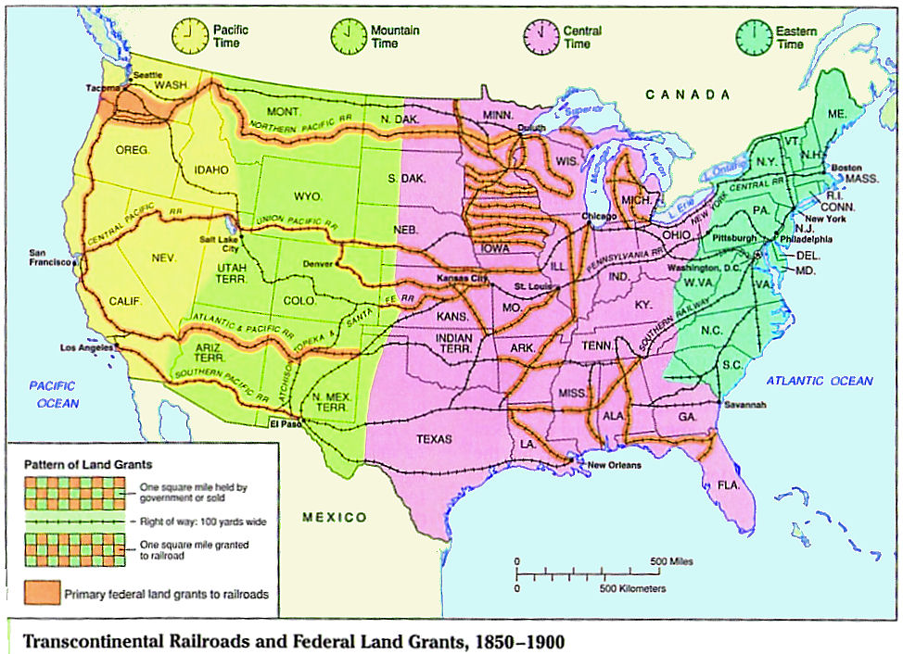

Slide 13
Competition and Fraud of RR’s
Speculative Bubble: investors overbuilding technology with hope of big returns
Future ex. Dot com bubble, housing bubble
Overinvestment in RRs in 1870s and 1880s

Slide 14
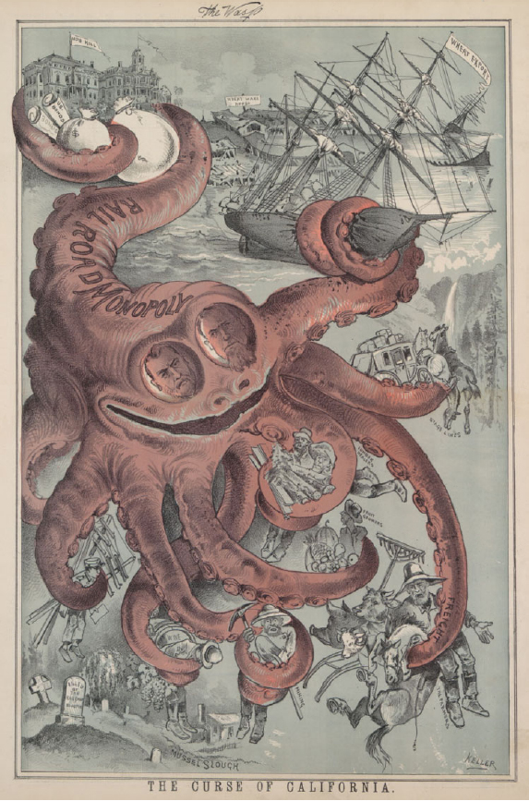
Fraud and Corruption
Credit Mobilier Affair
RR titans gave stock to Congressman to avoid investigation of massive profits in the industry
Jay Gould Affair
Investors made quick profits by selling stock at inflated prices
RR’s offered rebates/discounts to large customers and extremely expensive rates to small customers (like farmers)
Price fixing occurred as well
Monopolies and Consolidation

Slide 15
1893 recession forces many rr’s into bankruptcy
JP Morgan (a wealthy banker) bought out bankrupt rr’s and consolidated them into larger companies (other wealthy investors did the same)
By 1900, 7 rr companies controlled the system
Powerful men, like Morgan controlled policies through multiple boards and a system of interlocking directorates (corporate board members who sat on competing boards)

Slide 16
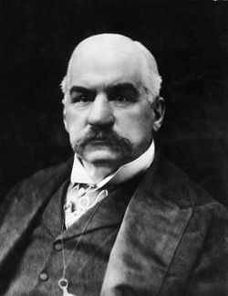
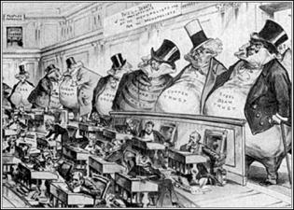

Slide 17
Discussion Qs
How did the rise of big business in the United States transform the economy and affect the lives of working people?
List some similarities and differences between the Pullman Strike and Haymarket Square events. What were some of their causes as well as some of their effects?
What was Tammany Hall and how did men like Boss Tweed end up controlling local politics in the second half of the 19th century?

Slide 18
Adam Smith Quotes
“People of the same trade seldom meet together, even for merriment and diversion, but the conversation ends in a conspiracy against the public, or in some contrivance to raise prices.”
“Wherever there is great property there is great inequality. For one very rich man there must be at least five hundred poor, and the affluence of the few supposes the indigence of the many. The affluence of the rich excites the indignation of the poor, who are often both driven by want, and prompt
“Man is an animal that makes bargains: no other animal does this - no dog exchanges bones with another.”

Slide 19
The Second Industrial Revolution
Laissez-Faire Capitalism
The Wealth of Nations – Adam Smith (1776)
Business should be regulated by competition and supply and demand (the “invisible hand”), rather than the government
Business is motivated by competing self-interest
Improves goods and services and lowers prices
Inconsistencies
Big business benefitted from big government help (high tariffs and subsidies)
Monopolistic Trusts formed from horizontal integration removed competition as a regulating force

Slide 20
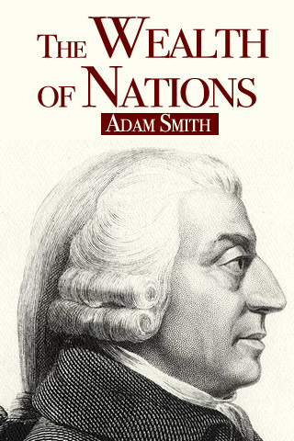
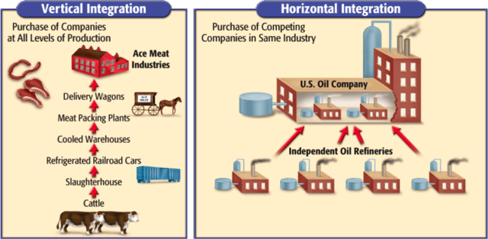

Slide 21
“[I]t is indisputably the mediocre, if not the low, both as regards morality and intelligence, who succeed in life and multiply the fastest.”

Slide 22
Social Darwinism – Herbert Spencer
“Survival of the fittest” – concentrating wealth in the hands of the “fit” benefits everyone economically
William Graham Sumner (Yale) argued that helping the poor detracted from human-kind as a whole
Further fed into race inequality in America

Slide 23
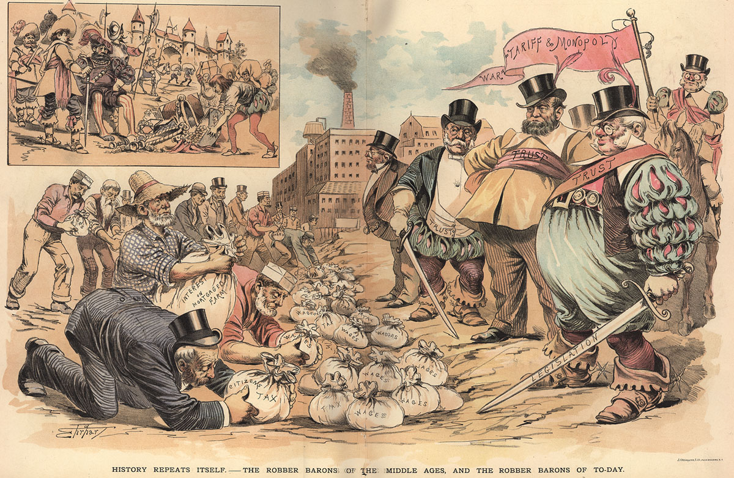

Slide 24
Warm-Up Questions
1. What were some of the major features of industrial cities that arose in the United States in the late nineteenth and early twentieth centuries? What institutions and innovations helped make urban life distinctive?
2. What were the limitations and achievements of urban governments run by political machines?
3. Why did so many reform initiatives emerge in large cities? What were some of those initiatives, and what was their political impact?

Slide 25
Horatio Alger Myth/”Rags to Riches”
Novelist, Horatio Alger, wrote books about young men in rags to riches situations
Gave false hopes to many
Based stories off of Andrew Carnegie story
Most wealthy businesspeople of the day were: white, anglo, protestant males from upper or middle class backgrounds

Slide 26
Gospel of Wealth Quotes
“People who are unable to motivate themselves must be content with mediocrity, no matter how impressive their other talents.”
“When fate hands us a lemon, let's try to make lemonade.”
“He that cannot reason is a fool. He that will not is a bigot. He that dare not is a slave.”
“You cannot push anyone up a ladder unless he is willing to climb a little.”
“I don't believe in God. My God is patriotism. Teach a man to be a good citizen and you have solved the problem of life.”
“The man who dies rich, dies disgraced.”

Slide 27
Gospel of Wealth – Carnegie and Rockefeller
“God gave me my riches”
Based on Protestant work ethic of hard work and material success being signs of God’s favor
Reverend Russell Conwell in “Acres of Diamonds” lecture, preached that everyone had a god-given duty to become rich.

Slide 28
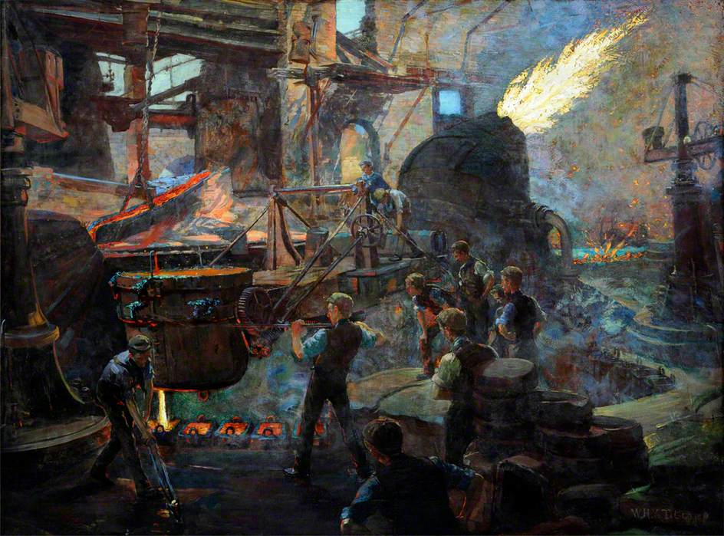
The Steel Industry
Henry Bessemer (Eng) and William Kelly (US) both discovered an easy way to turn Iron into Steel (a more durable metal) (1850s)
Bessemer Process: blasting air through molten iron
Great Lakes Region used abundance of Coal (for furnaces) and Iron to become the prominent steel region of the country

Slide 29
Andrew Carnegie
1870s started manufacturing steel in Pittsburg
Vertical Integration: company controls every stage of the industrial process, from mining to transportation of final good.
By 1900, Carnegie Steel out produced all mills in Britain combined
Also, in 1900 Carnegie sells his company to J.P. Morgan so he could devote himself to philanthropy

Slide 30
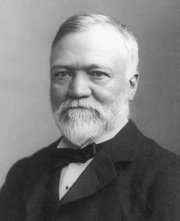
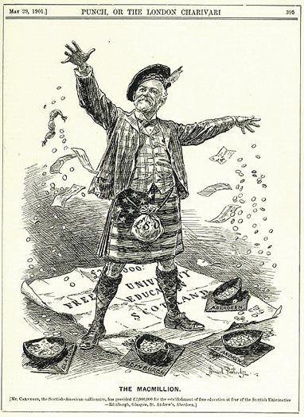

Slide 31
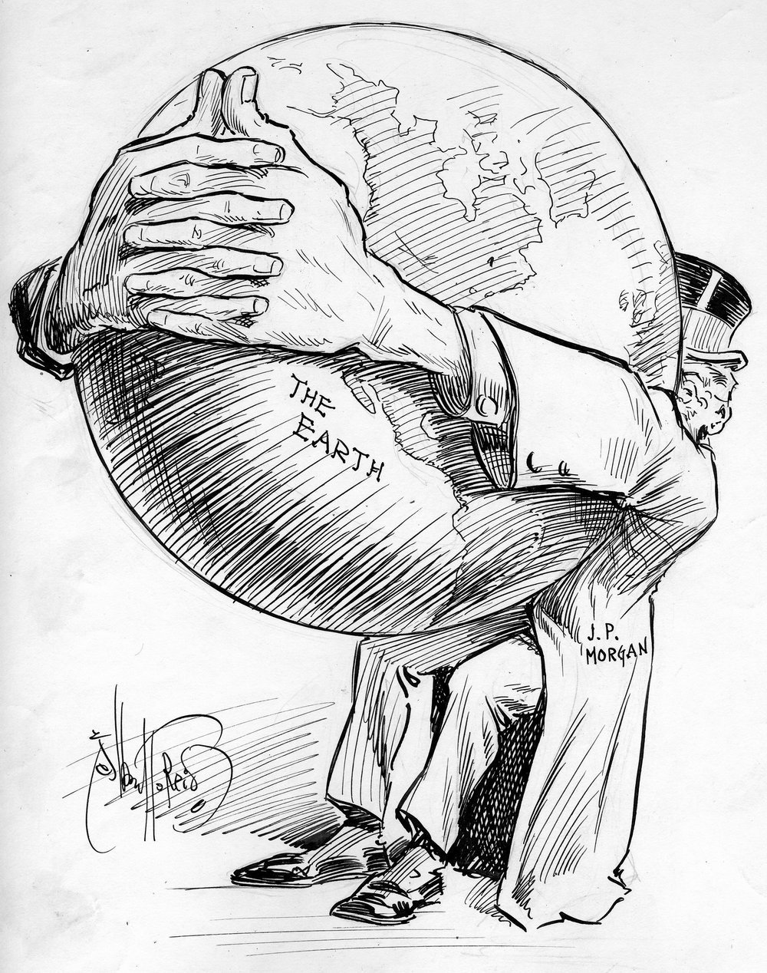
J.P. Morgan forms a huge steel conglomerate called US Steel
First billion dollar business in the world and largest company in the world (168,000 employees)

Slide 32
The Oil Industry
1863- John D. Rockefeller founded an oil company that would eventually become Standard Oil
1881- Standard Oil Trust: controls 90% of business
Horizontal Integration: company buys out other competing companies
Former competitors are all brought under the direction of a single corporate board’s control (a Trust)

Slide 33
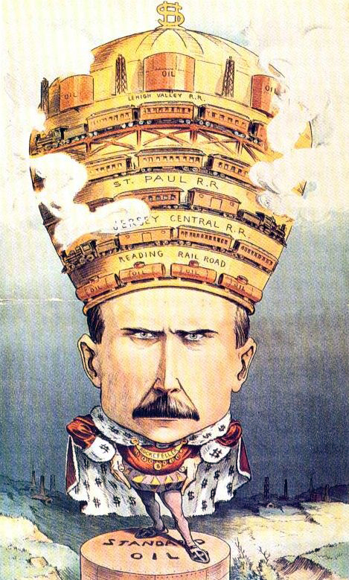
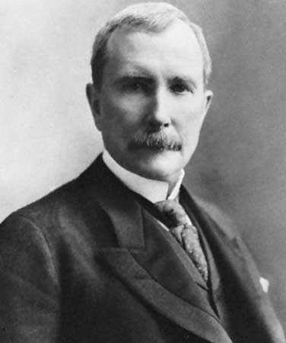

Slide 34
Innovations
Communications and Retail Revolution
Telegraph (1844): Samuel F. Morse
Improved transatlantic cable (1866): Cyrus W. Field
Typewriter (1867)
Telephone (1876): Alexander Graham Bell
Cash Register (1879)
Calculating Machine and adding machine (precursors to the calculator) (1887 and 1888 respectively)

Slide 35
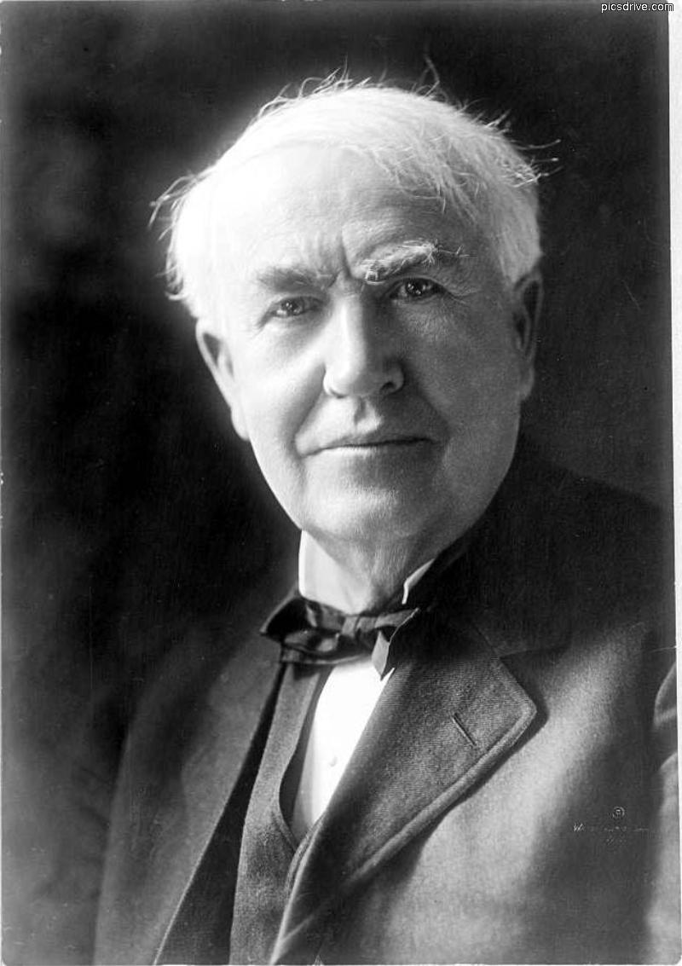
Thomas Edison
Research Laboratory created in 1876 to est. an area for researchers and engineers to work together
More than 1000 patented inventions, including:
Phonograph
Improvement of the incandescent lamp in 1879
The dynamo (for electric power)
The motion picture camera

Slide 36
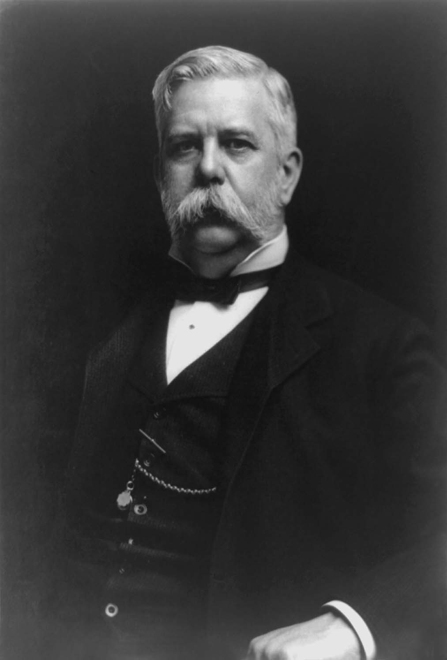
George Westinghouse
More than 400 patents
Transformer (for electricity) (1885)

Slide 37
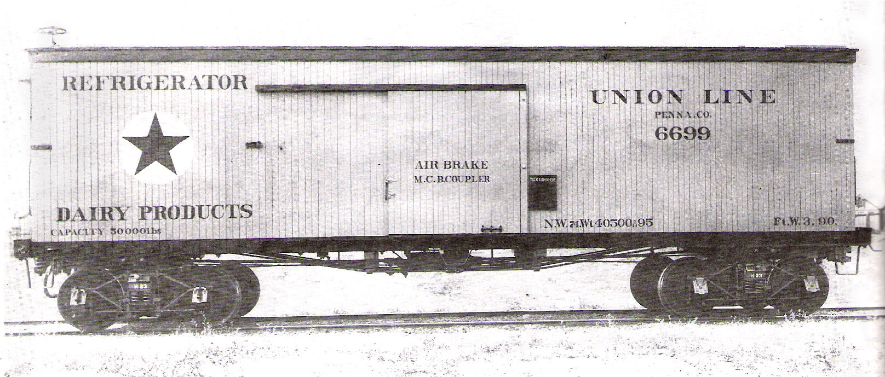
Consumer Economy and Consumer Culture
R.H. Macy and Marshall Field pioneered large department stores for urban shopping
Frank Woolworth “Five and Ten Cent Store”
Mail Order Catalogues (“Wish Books”
Packaged foods
Refrigerated RR cars and canning helped with mass producing and preserving foods

