Slide 1
Warm Up
Why does the term counterculture describe the behavior of many baby boomers during the late 1960’s?
What was the relationship between American domestic affairs and the conduct of the Vietnam War?
Compare & contrast the ideals expressed in The Port Huron Statement & LBJ’s “Great Society” speech.

Slide 2
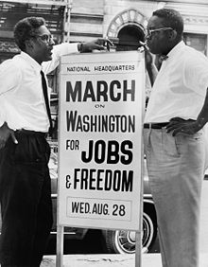
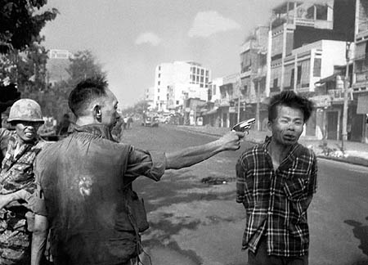
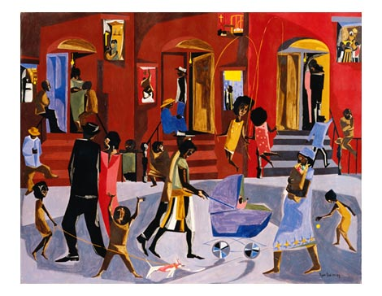
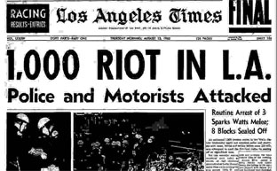
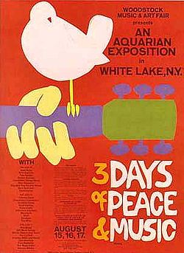
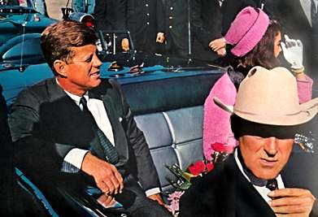
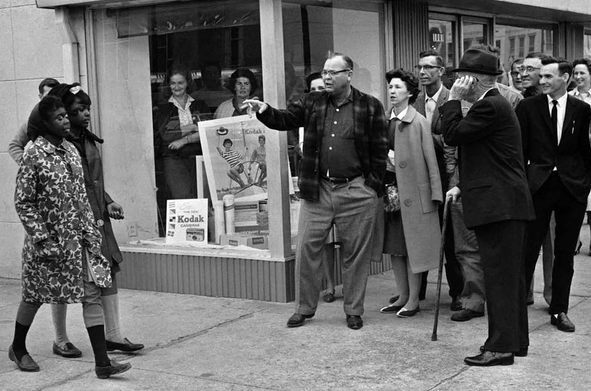
The 60s

Slide 3
“We stand today on the edge of a new frontier –the frontier of the 1960s, a frontier of unknown opportunities and paths, a frontier of unfulfilled hopes & threats. The new frontier I speak is not a set of promises –it is a set of challenges”

Slide 4
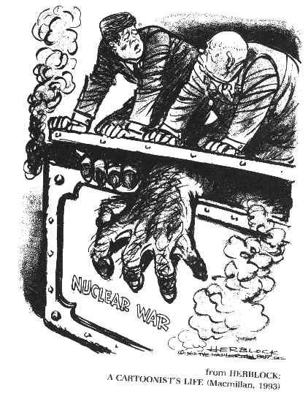
HAPP

Slide 5
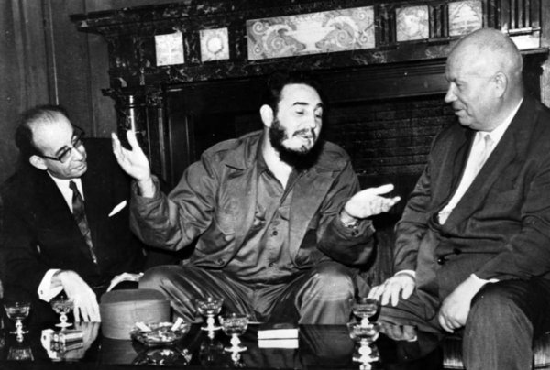
Communism in the West
US presence in Latin America was more economic than militaristic from the 1929 onward
Guatemala
US owned United Fruit Company owned more than 40% of land
CIA supported coup d’etat against socialist President Jacabo Guzman
Cuba
Fidel Castro takes over in 1959
solidify Cuba’s relationship w/ the USSR
After Castro’s speech at UN
http://www.youtube.com/watch?v=d_OQBEDgwOc
Notes:
http://www.youtube.com/watch?v=d_OQBEDgwOc After Castro’s speech at UN

Slide 6
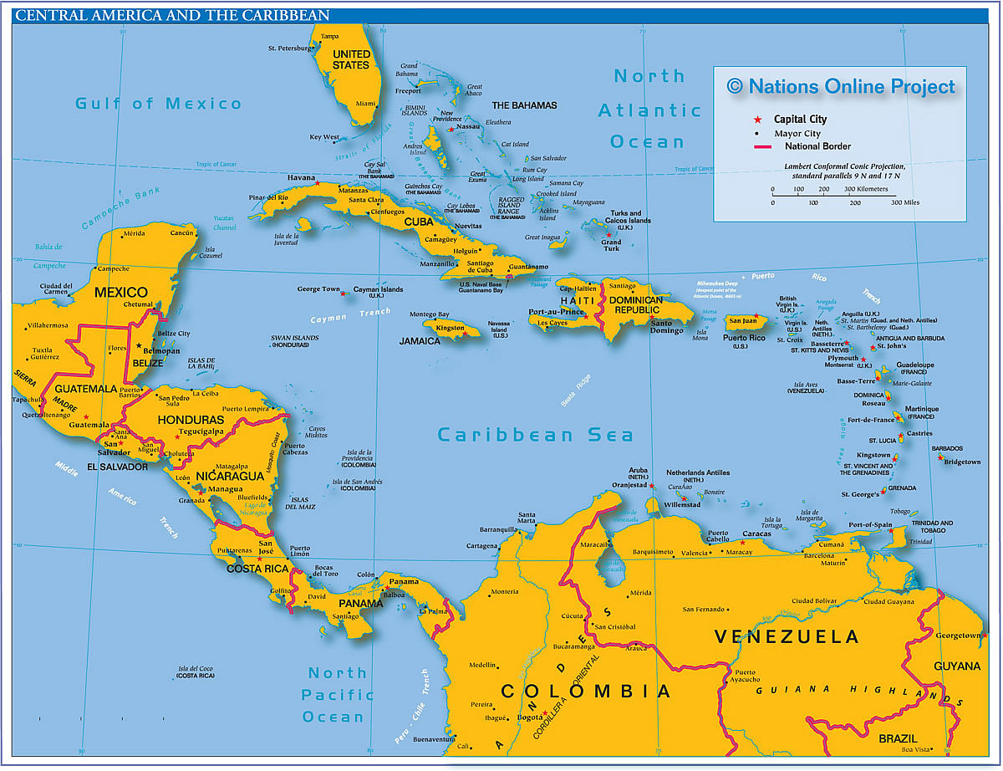
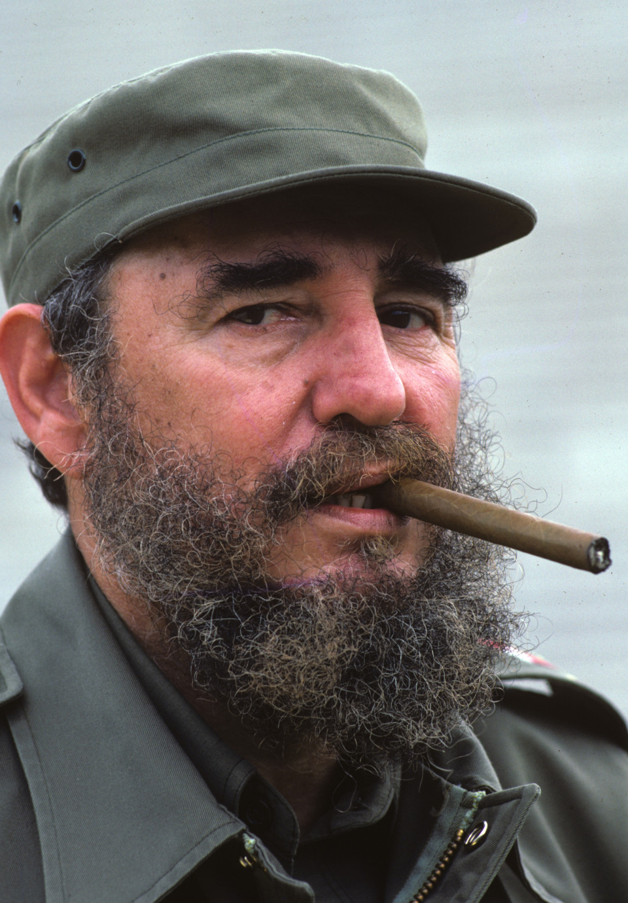
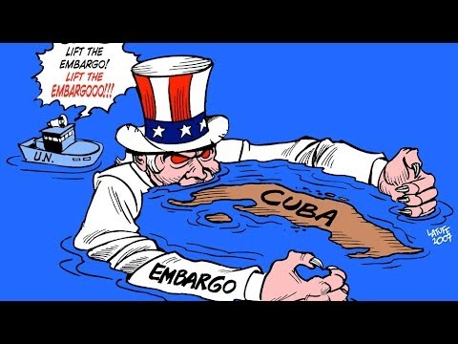

Slide 7
Election 1960
Vice-President Richard Nixon vs. Senator John F. Kennedy
Only 118,00 popular votes separated the two candidates, but a difference of 84 electoral votes
Debate:
What do you think? Who appears to have won the debate?
Notes:
https://www.youtube.com/watch?v=QazmVHAO0os Nixon JFK Debate

Slide 8
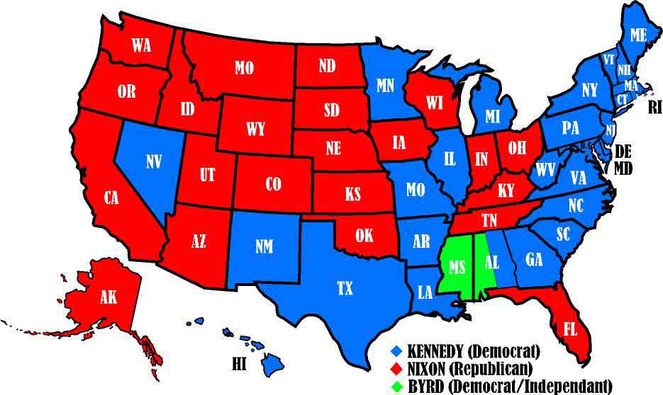

Slide 9
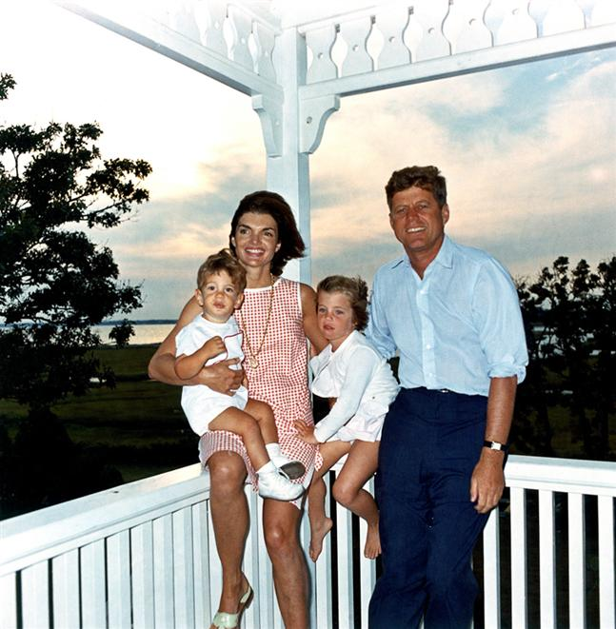
Camelot
Kennedy
Youngest elected president w/ a young cabinet
1st Catholic president (only non-Protestant)
WWII hero
Family controlled the same Senate seat from 1953-2009
“The New Frontier”: Domestic Agenda
Created the Peace Corps
Set goal of going to the moon; Championed NASA
Notes:
https://www.youtube.com/watch?v=-t03ktje7jE New Frontier Speech

Slide 10
HAPP - Speech
https://www.youtube.com/watch?v=i2QS-zTWDxo

Slide 11
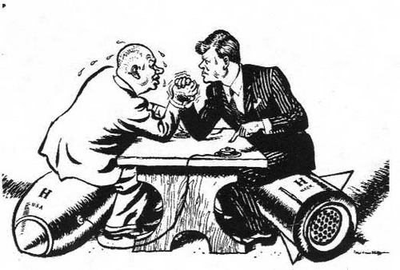
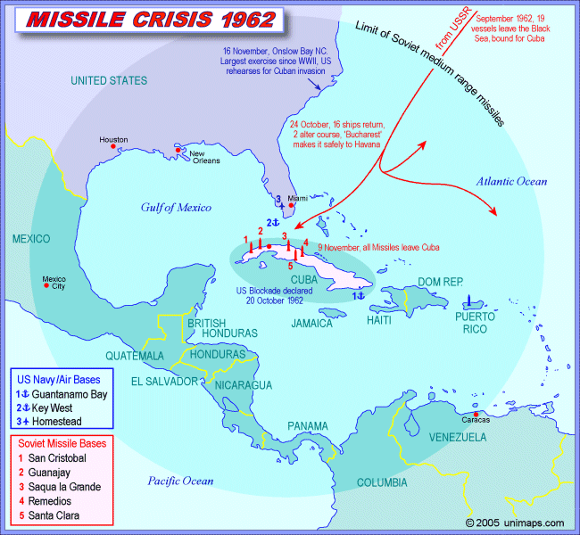
Containment Part II
Kennedy like his predecessors support
containment
Bay of Pigs invasion, April 1961
Failed CIA attempt to depose Castro gov’t of Cuba
Cuban Missile Crisis, October, 1962 -13 day crisis
May 1962 –Khrushchev offers to place nuclear missile on Cuban soil to prevent US invasion attempts
Oct. 15, US begins ‘quarantine’ of Soviet vessels
Closest US & USSR came to Mutual Assured Destruction (MAD)
Oct. 28, USSR agrees to remove missiles from Cuba = US agrees to remove some missiles from Turkey & Italy

Slide 12
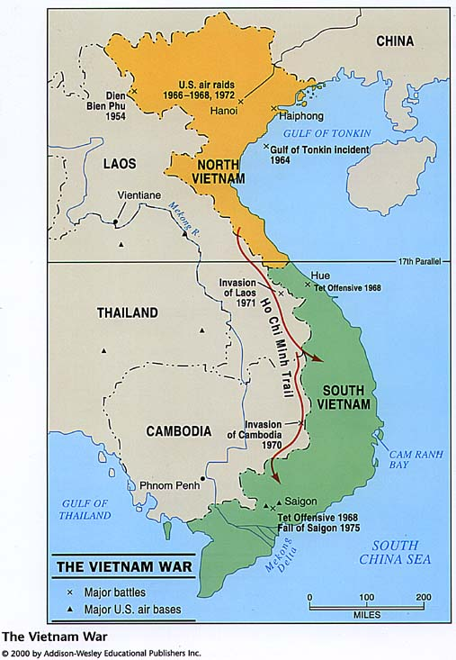
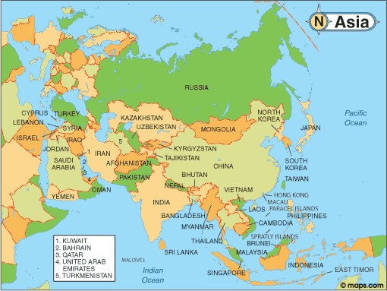

Slide 13
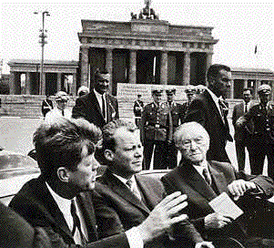
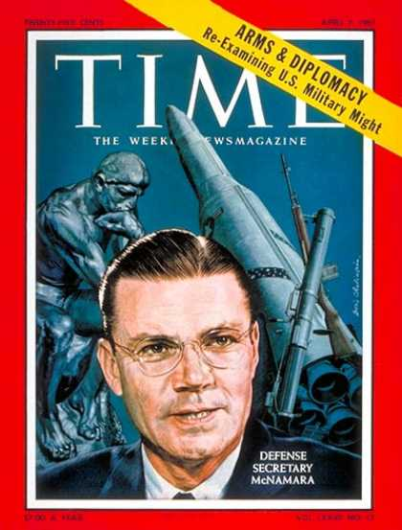
‘Ich bin ein Berliner’ –I am a Berliner
June, 1963 visits Berlin Wall to confront Soviet support of building the wall
Nuclear Test Ban Treaty, Aug. 1963
Agreement b/w US, Great Britain and USSR to halt nuclear testing within the atmosphere (only below ground)
‘Flexible Response’ –Sec. of Defense Robert McNamara strategy to increase funding on conventional military forces
Threats against pro-American gov’t in South Vietnam
By the end of 1963, more than 15,000 troops sent
Notes:
https://www.youtube.com/watch?v=yEje927dygM “Castle Bravo”
https://www.youtube.com/watch?v=aMYYEsKvHvk “Tsar Bomba”
https://www.youtube.com/watch?v=6YcXkaUlqug 5:30 nuke in space

Slide 14
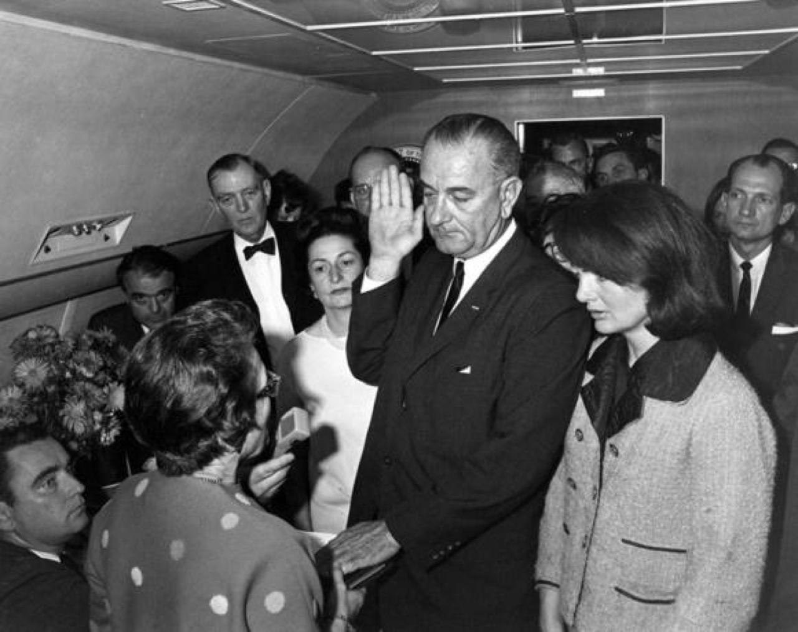
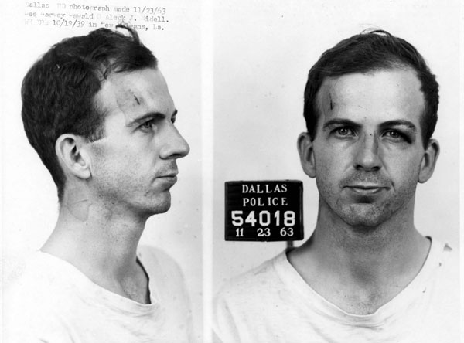
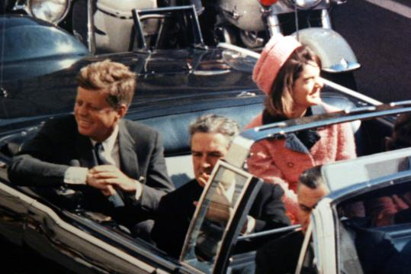

Slide 15
The Great Society: Domestic Agenda
LBJ fulfilled and extended JFK’s New Frontier programs
War on Poverty
Elementary & Secondary Schools Act, 1965
Aid to individual children, not school
College loans
Medicare (retired), 1965 & Medicaid (poor & disabled), 1966
Office of Economic Opportunity (OEO) -created ‘Community Action’ committees
Spent $3 billion in 1st two years with little success, too expensive to fund
Estab. Housing & Urban Development (HUD) Cabinet position & agency, 1966
Civil Rights Civil rights Act of 1964 & Voting Rights Act of 1965
Immigration Act of 1965 –removed national origin quotas from the 1920’s

Slide 16
Key Dates of the Vietnam Conflict
1954
1955
1956
End of 1950s (what starts happening?)
1963
1964
1965
March 1965
1968
1969
1973
1975
What was “Operation Rolling Thunder?”
What is “Vietnamization”?
What happened at Kent State?
Notes:
https://www.youtube.com/watch?v=G9PNAUjDnGU Vietnam War in 6 minutes

Slide 17
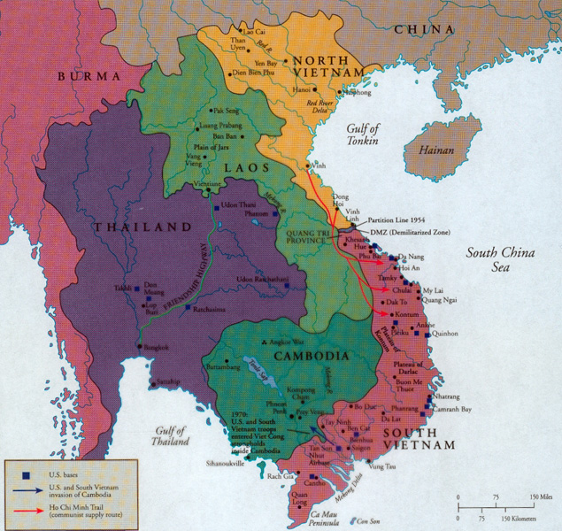
From Aid to Intervention
1946 -1954 US contributed 1 billion in aid to France to regain control of Vietnam from Ho Chi Minh gov’t
1954, Geneva Agreements –Indochina divided into 4 states
Laos, Cambodia, N. Vietnam, S. Vietnam (at 17th parallel)
Over the period,1962 – 1968, US sent 500,000 troops
1964, Gulf of Tonkin Resolution –Congress gave LBJ ‘take all necessary measures to prevent further aggression’
American destroyers in international waters
Helped LBJ win his 1964 presidential bid against a overly bellicose Barry Goldwater
1968, Tet Offensive –Viet Cong offensive against US troops
Shock to American public who had been told by high ranking officials that the US was finally ‘winning’ the war
Notes:
http://www.youtube.com/watch?v=dDTBnsqxZ3k LBJ’s ‘Daisy Ad’
http://www.youtube.com/watch?v=OwJHg9UBNPE Goldwater Ad

Slide 18
US Population by age 1950 -1970
 | Under 20 | 21-44 | 45-64 | 65+ | Total
1950 | 33.9 | 37.6 | 20.3 | 8.1 | 152+ mil
1960 | 38.4 | 32.2 | 20.1 | 9.2 | 179+ mil
1970 | 37.9 | 31.7 | 20.6 | 9.8 | 203+ mil
What demographic shift do you see between 1950 – 1970?
What factors do you think caused these changes?
What potential social conflicts might arise?

Slide 19
When you come in…
Sign the AP exam sheet on the front table!

Slide 20
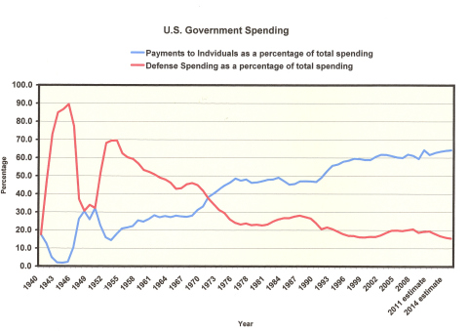
What do you think?

Slide 21
Warm Up: Successors to the New Deal
 | New Frontier | Great Society
President
Mission
Economic Policies
Programs
Effective-ness

Slide 22
Vietnam at home
Formation of the New Left
Protest as a result of demographic changes –by 1970 over half of the US population was under 30
8 million Americans attended college; 8 times the number in 1950
Overwhelmingly white & affluent, but embraced minority causes; many unaware of the degree of injustice
Not usually communist, but supportive of 3rd World Marxist leadership
Opposition to the military draft
Anti-deferment for college students, teachers, fathers
Draft card burning common at anti-war rallies
Draft evaders, pardoned in 1977 (Ford and Carter)
Notes:
https://www.youtube.com/watch?v=2I4hH79nmxM

Slide 23
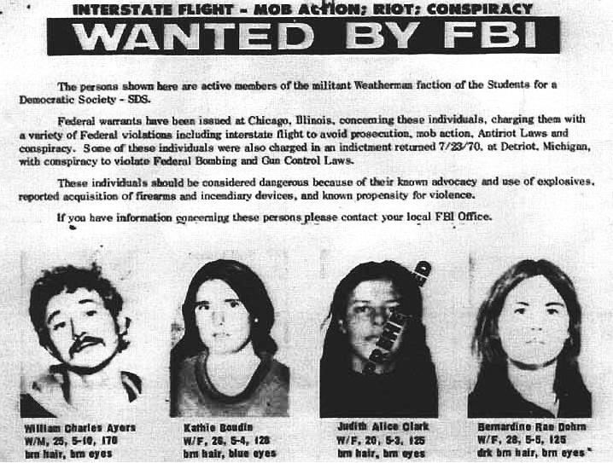
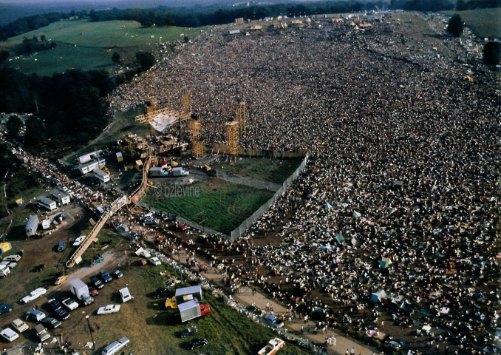
Students for a Democratic Society –Port Huron Statement, 1962
Weathermen –violent offshoot of SDS -Formed in 1967
Free Speech Movement begins at UC Berkeley, 1964
Student Riots & occupation of campus buildings, Columbia Univ. 1968; UC Berkley, 1969
Counterculture
Hippies were related to New Left, but more focused on flouting social conventions & embracing sensual pleasure
Haight-Asbury neighborhood of San Francisco
Woodstock music festival, July 1969
Notes:
http://www.youtube.com/watch?v=AJeAF3E2yl0 SDS founder
https://www.youtube.com/watch?v=Wyx053CNMag Woodstock

Slide 24
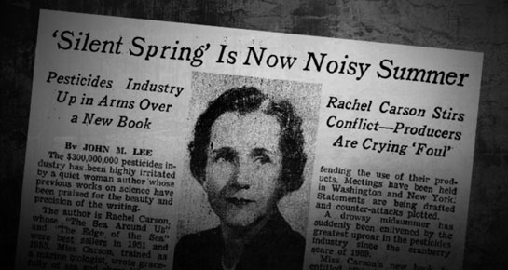
Public Awareness
Environmentalism
Rachel Carson’s ‘Silent Spring’ (1962)
Gov’t sponsored pesticide usage killing wildlife, without public consent
Environmental Protection Agency founded by Richard Nixon in 1970
Consumer safety & rights
Ralph Nader’s ‘Unsafe at Any Speed’ (1965)
Indictment of US automakers for not making vehicles safer, when they possessed the know-how to stop injuries & fatalities
Seat belts & redesigned steering column, bumpers & dashboards became federally mandated features
Notes:
http://www.youtube.com/watch?v=LGnofDIR6vA @ 7:00-10:40 Old Top Gear Episode Chevy Corvair

Slide 25
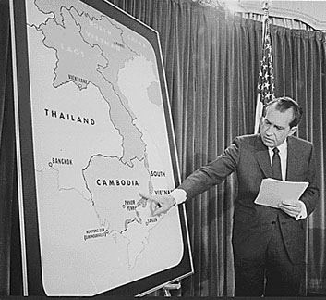
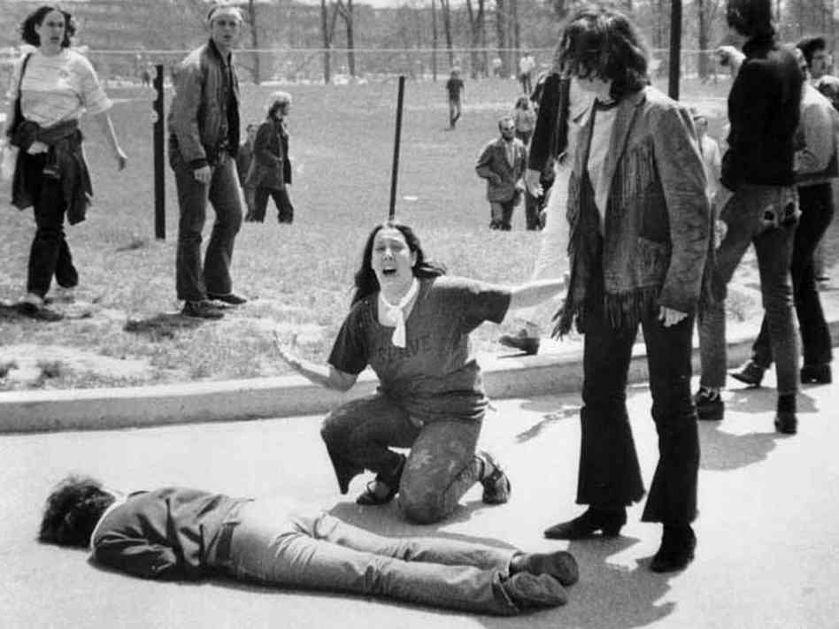
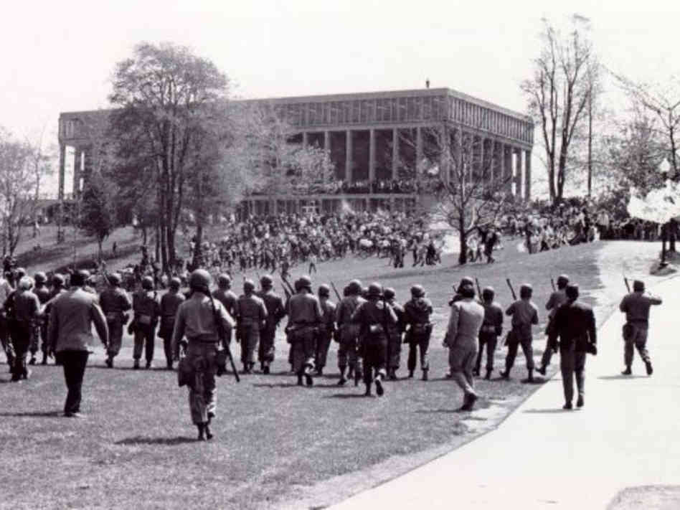
Vietnamization
(1969) After the My Lai Massacre & Tet Offensive of 1968, Nixon’s first agenda is to remove combat troops & train South Vietnamese to defend themselves
Known as the Nixon Doctrine
Nixon publically defends invasion of Cambodia by US & S. Vietnamese forces1970
New rallying point for college protest
Kent State Univ. & Jackson State Univ. riots result in student deaths
Congress will pass Cooper-Church bill to limit Executive war powers forbidding invasion of Laos & Thailand

Slide 26
Compare & contrast Richard Nixon’s use of executive power with that of Jackson/T.R.
Nixon | SIMILARITIES | Jackson / T. Roosevelt

Slide 27
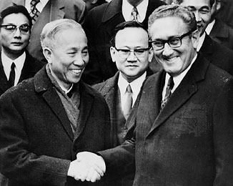
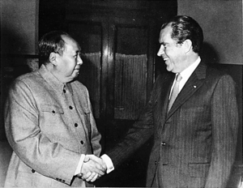
Successes of the Nixon Administration
Founding of the EPA & OSHA
Expansion Food Stamps, Medicaid, AFDC & automatic cost of living increases for Social Security
‘Philadelphia Plan’ to stop employment discrimination
Détente w/the USSR (DE-TAUNT ☺)
Strategic Arms Limitation Treaty (SALT I)
Won a 2nd term w/ 61% of the vote over George McGovern
Henry Kissinger's negotiations of armistice with North Vietnam
‘normalized’ US relations w/China, and accepted ‘one-China’ policy

Slide 28
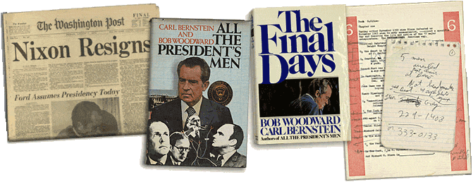
Failures of the Nixon Era
Undisclosed bombing of Cambodia, 1970
‘Christmas Bombing’ of North Vietnam, 1972
100,000 bombs dropped in a 2 week period
Pentagon Papers –
NY Times v. Nixon
VP Spiro Agnew resigns due to corruption & tax evasion indictments
Watergate break-in (July, 1972)
CREEP –
Woodward & Bernstein, Deep Throat informant
John Dean, WH counsel revealed ‘secret tapes’
US v. Nixon –limits on executive privilege
Forced Nixon’s resignation
Presidency of Gerald Ford
1st non-elected president
Pardoned Nixon
Notes:
http://m.youtube.com/watch?v=ZEOGJJ7UKFM Nixon Resignation
http://m.youtube.com/watch?v=vFHYiOfBRng Frost vs. Nixon clip
https://www.youtube.com/watch?v=IHnmriyXYeg Watergate “Watch Mojo”

Slide 29
Could you answer these?
To what extent did Nixon’s illegal actions change the American peoples view of and trust in the President?
Analyze the election of 1972, examining the events leading to the Watergate scandal that changed the American people’s view of government?
To what extent did Richard Nixon go beyond the boundaries of executive power granted by the Constitution?

Slide 30
“The feminine mystique has succeeded in burying millions of American women alive.”
Betty Friedan
“the problem lay buried, unspoken, for many years in the minds of American women. It was a strong sense of dissatisfaction... Each suburban wife struggled with it alone. –she was afraid to even ask herself the silent question –’Is this all?”
Betty Friedan
“I've yet to be on a campus where most women weren't worrying about some aspect of combining marriage, children, and a career. I've yet to find one where many men were worrying about the same thing.”
Gloria Steinem
“Feminism is doomed to failure because it is based on an attempt to repeal and restructure human nature.”
Phyllis Schlafly
Who would agree with these statements? –Elizabeth Cady Stanton or Catherine Beecher

Slide 31
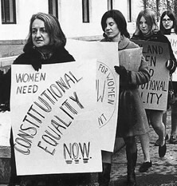
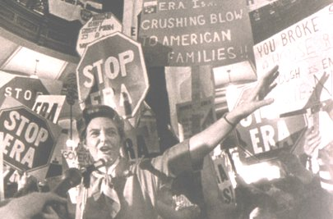
Women’s Liberation Movement
Origins
Betty Friedan (1963) The Feminine Mystique & founder of NOW –National Organization of Women (1966)
Purpose
End sexism & male chauvinism
Equal Rights Amendment –never ratified; intro 1923 by Alice Paul, passed by Congress, 1972
Gloria Steinem – equality in work place
abortion rights, wrote After Black Power, Women’s Liberation
Phyllis Schlafly –Stop ERA advocate; afraid that women would lose ‘gender-specific privileges’
Notes:
Princess Power https://www.youtube.com/watch?v=CtyOC6ayKoU

Slide 32
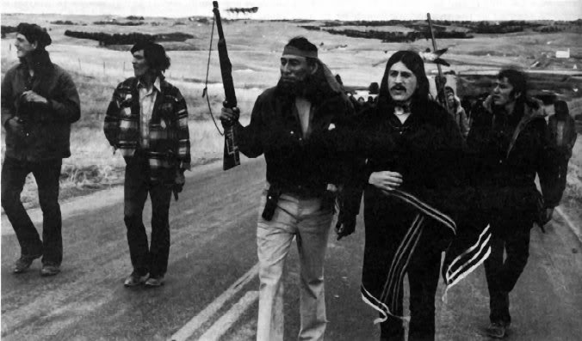
Other minority protest
American Indians
1953 Congress’ ‘termination policy’ of ending traditional Native culture and reservations; overturned Indian Reorganization Act of 1934
American Indian Movement (AIM)
2nd massacre @Wounded Knee, 1973
Indians of All Tribes (IAT)
Seizure of Alcatraz Island, 1969
Notes:
http://www.youtube.com/watch?v=t9bErRmuIGU Inspired song “Bury My Heart at Wounded Knee”

Slide 33
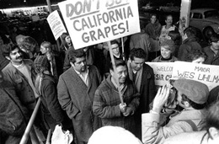
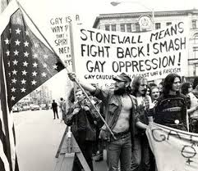
Chicano –Mexican Americans
Inspire by ‘Operation Wetback’ –1950s gov’t deportation practices
Often labor relations (migrant workers) & education issues in the Southwest
Caesar Chavez –founded United Farm Workers union
Gay & Lesbian Rights
Stonewall Inn Raid and riots
NYC, Greenwich Village (1969)
National Gay Task Force (1975)
Pushed for Nondiscrimination ordinances
Repeal of same-sex relation statutes
Notes:
https://www.youtube.com/watch?v=2SDW137TPpk “Remembering Stonewall”

