Slide 1
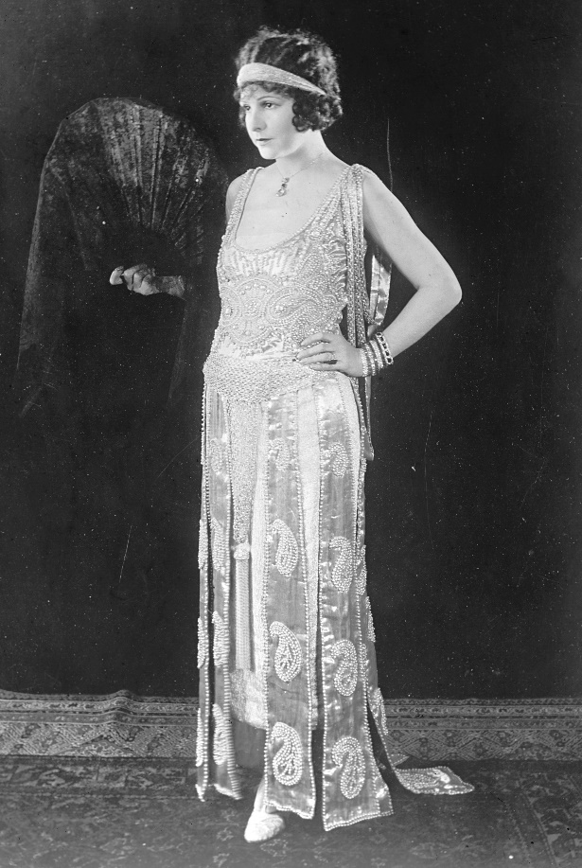
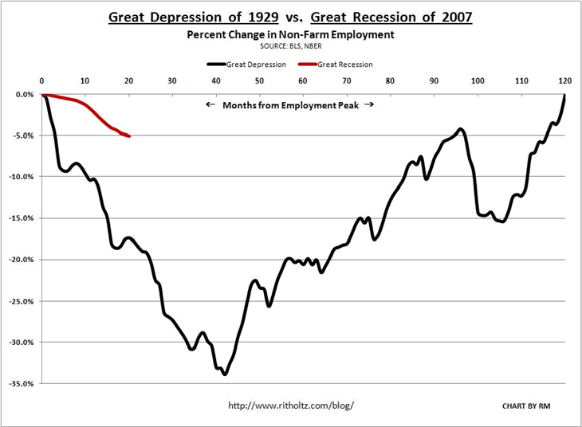
Post-War Normalcy: The Roaring 20’s

Slide 2
For the Long Essay topic, please write a thesis and a brief outline addressing the main points you would make.
United States involvement in World War I resulted in significant economic, cultural, and political developments in the United States between 1919 and 1929. Support, modify, or refute this contention using specific evidence.

Slide 3
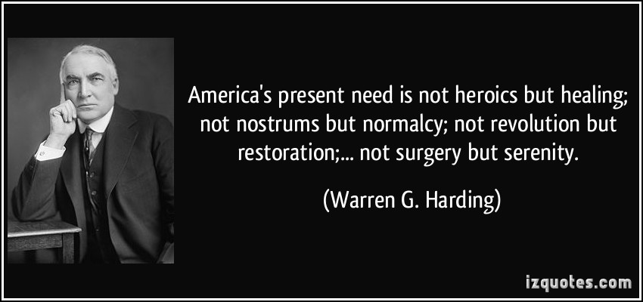
Politics of Normalcy
Republicans dominant once again after Woodrow Wilson exited office
Platform didn’t revert completely to pre-war status, instead stuck with model focusing on extremely limited gov’t control of business

Slide 4
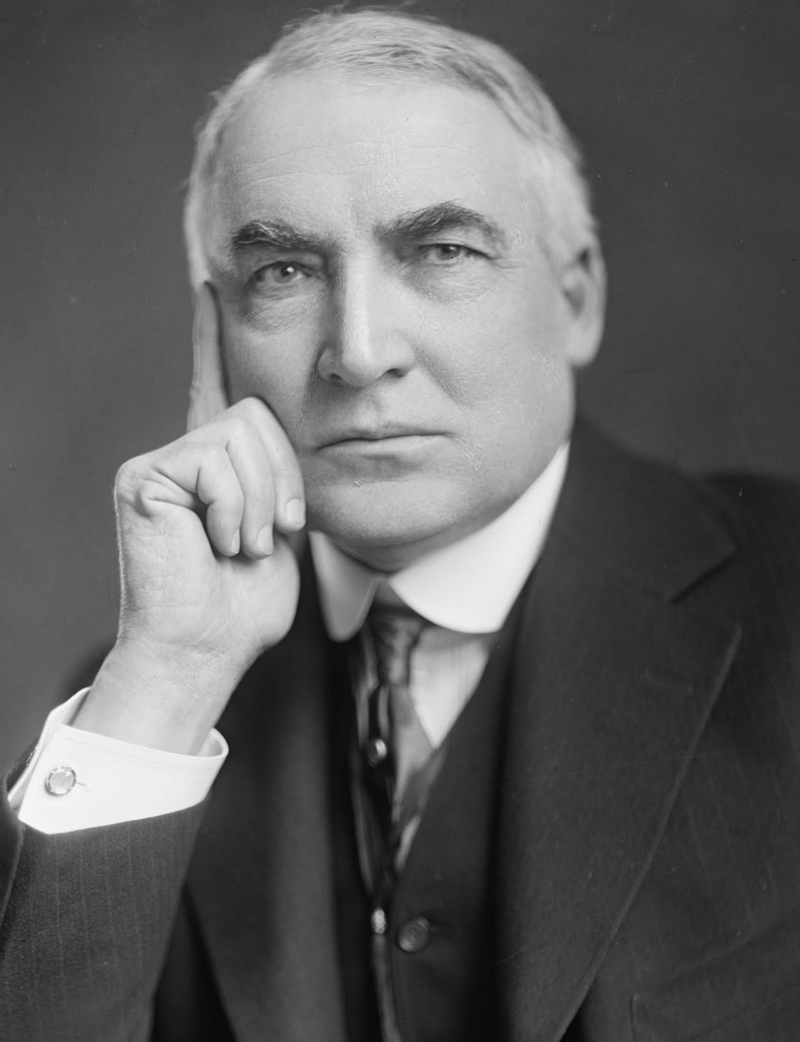
Warren Harding (R) 1921-1923 “return to normalcy”
Generally considered a weak leader, who agreed to most decisions of the Republican Congress
Notable Instances of Presidency:
Reduction in income tax
Fordney-McCumber Tariff Act (1922): increase in Tariff rates
Bureau of the Budget: all gov’t expenditures in single budget
Random death: August 1923

Slide 5
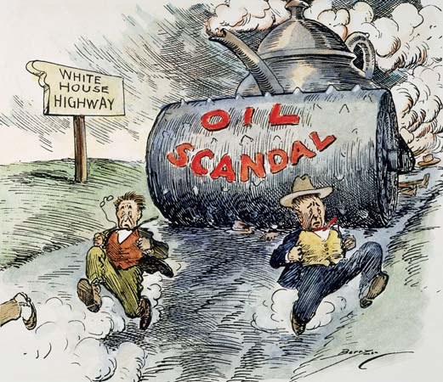

Slide 6
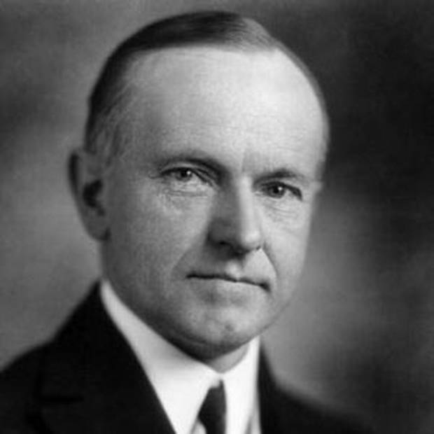
Calvin Coolidge (R) 1923-1929
Vice President of Harding
Aka “Silent Cal” – “The business of America is business.”
“Coolidge Prosperity”
Believed in extremely limited government – even vetoed some Republican Bills

Slide 7
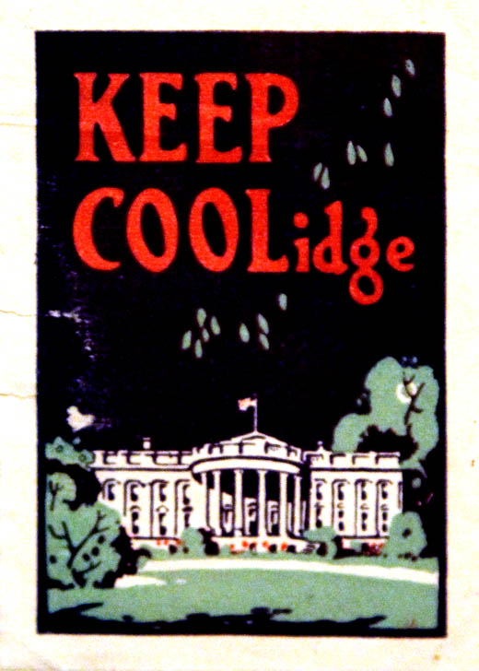

Slide 8
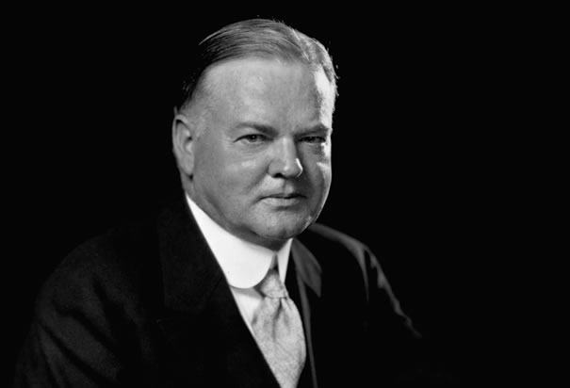
Herbert Hoover (R) 1929-1933
Served three Presidents in Bureaucratic roles
Great Depression largely tarnishes his reputation

Slide 9
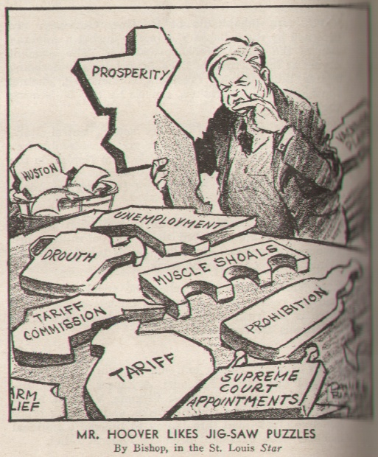

Slide 10
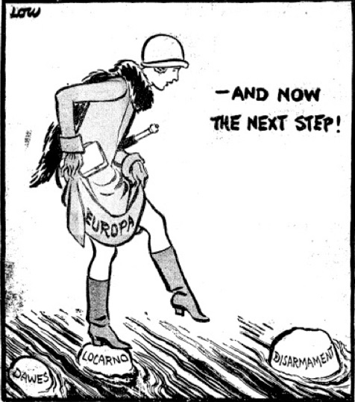
Foreign Policy of the 1920s
Actively pursued pro-American arrangements while maintaining world peace, despite not joining the League of Nations

Slide 11
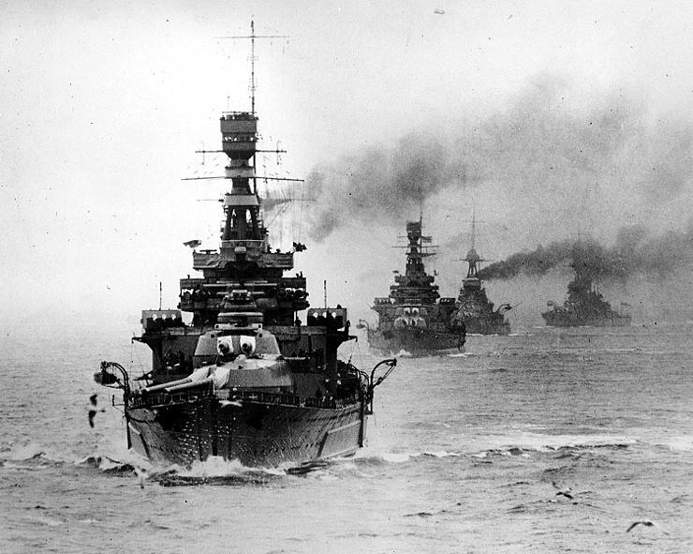
Foreign Policy Cont…
Washington Conference (1921)
Sec. of State initiated talks on Naval disarmament among the great powers of the world
Kellogg-Briand Pact (1928)
Don’t use force to achieve goals as a country
Many nations sign this agreement
Generally ineffective

Slide 12
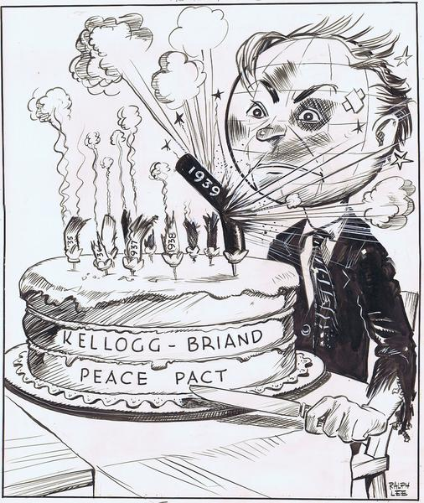

Slide 13
International Business
Increased investment by American enterprise in the 20’s in Latin America
Oil drilling by Britain and America in the Middle East
Fordney-McCumber Tariff (1922): increased duties on foreign manufactured goods by 25%
Slowed European nations abilities to recover from war, thus they also enacted protective tariffs
One reason for the Great Depression

Slide 14
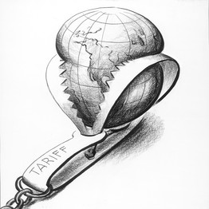

Slide 15
War Debts
Dawes Plan (cycle)
US banks to lend money to Germany to help rebuild infrastructure and economy
Germany would then pay off reparations to British and French, who in turn,
Would pay debts back to American banks
Failure: Great Depression halts the plan

Slide 16
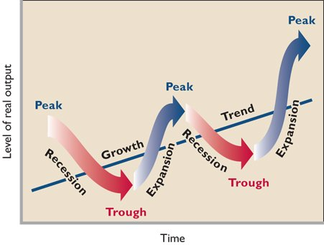
Economic Development in the 1920s
Postwar Recession (1921), Prosperity (1922-1928), Crash (1929)

Slide 17
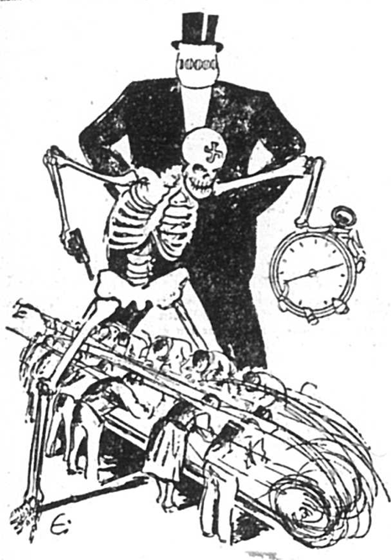
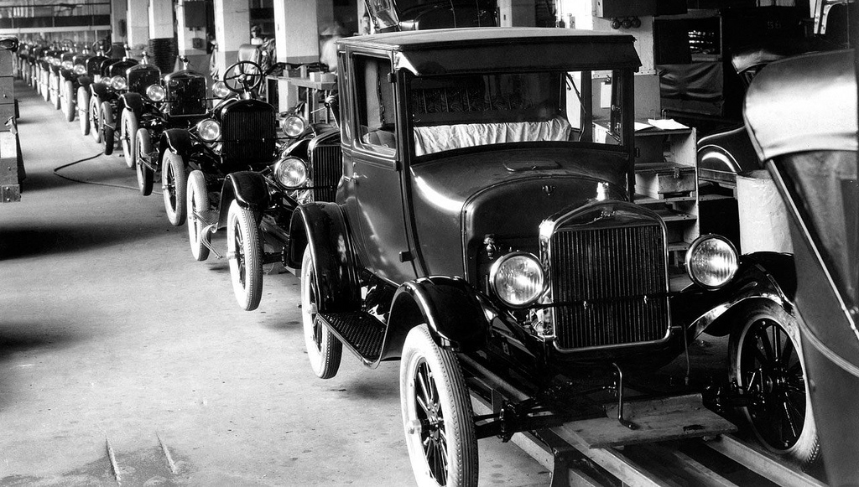
Postwar Prosperity (1922-1928)
Increased Productivity
Scientific Management (Frederick Taylor’s)
Improved methods of mass production
1914 Henry Ford: assembly line

Slide 18
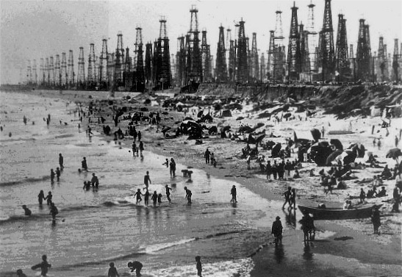
Energy Output
Oil becomes more prominent in American homes and industry (rather than coal)
Oil output: 3% in 1900 to 23% in 1930
Electrical generation increases 300% in the 20s

Slide 19
Limited Government
Corporate tax cuts and little enforcement of progressive era anti-trust laws
Tax cuts for the richest Americans
Federal Reserve: low interest rates and relaxed regulation of banks (loose money policy)

Slide 20
Consumers
New Technologies/appliances
Automobiles, home refrigerators, home washing machines, vacuum’s
Automobiles
1.2 million in 1913 to 26.5 million in 1929
Replaced railroad industry as key economic booster
Other industries dependent: oil, steel, glass, rubber, highway construction
Credit: allowing consumers to use loans and pay back later
Convenience stores:
Woolworths

Slide 21
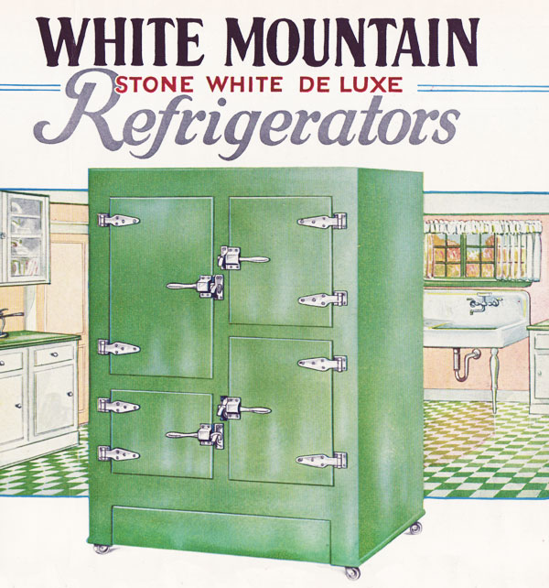
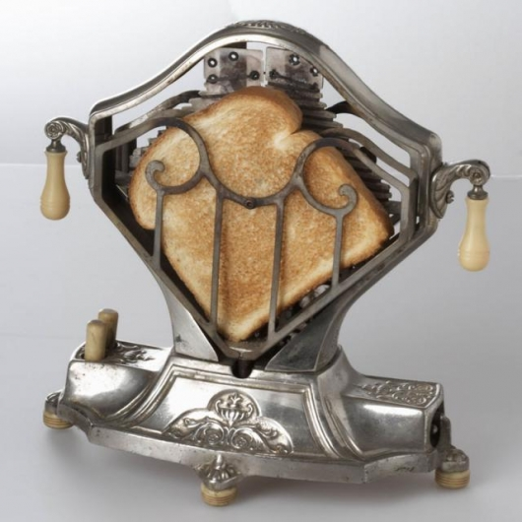
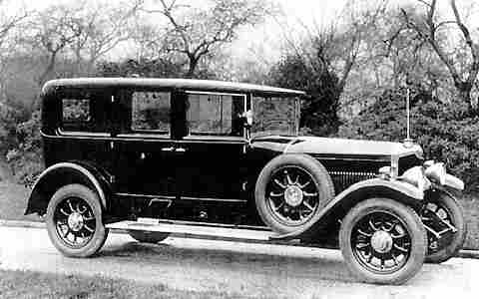

Slide 22
Issues w/ Prosperity
Farmers
High debt among farmers due to heavy expansion during WWI years
New Technologies (fertilizers, tractors, etc) helped to increase production which further led to falling prices
Labor
Fall in unionization (memberships declined 20% in the 1920s)
Welfare Capitalism: companies voluntarily offering increased benefits and wages to reduce union membership
Government assistance in stopping strikes (militia and injunctions)

Slide 23
Directions:
Using your notes, or what you have learned in class, write a short answer question.
Provide a possible response to this question.

Slide 24
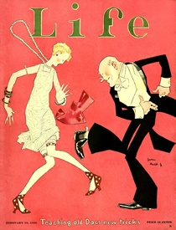
Culture of the 1920s
“The Jazz Age”
Communication
Radio: first commercial station in 1920
Movies: “Talkies” (movies with sound) develop in 1927
Draw of watching Movie stars and glamor of going to the movies
Notes:
https://www.youtube.com/watch?v=mpjEyBKSfJQ

Slide 25
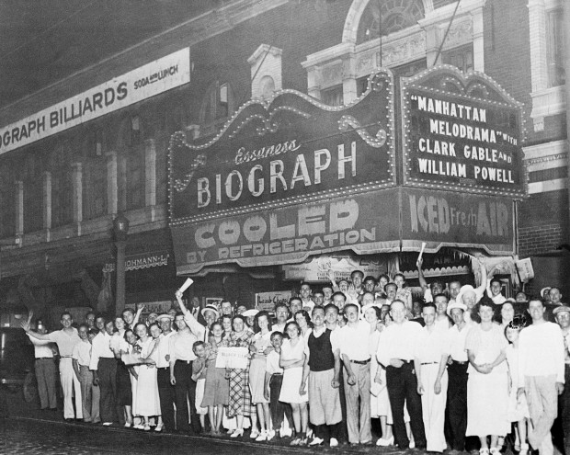

Slide 26
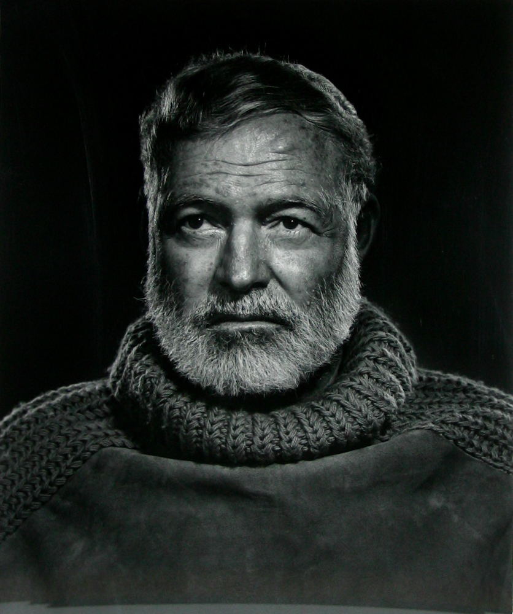
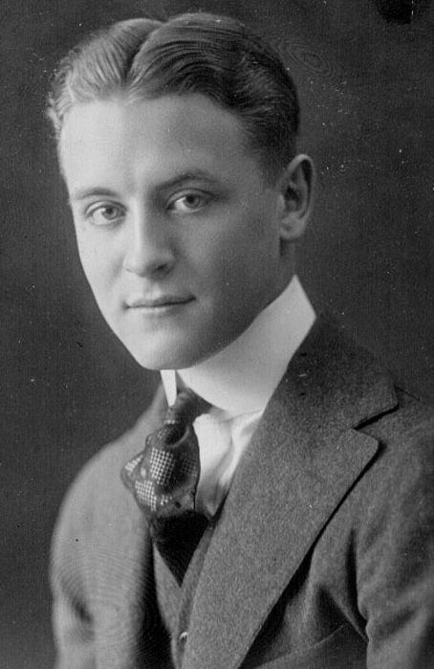
Art
The Lost Generation (Coined by Gertrude Stein)
F. Scott Fitzgerald, Ernest Hemingway, Sinclair Lewis, T.S. Eliot, etc.
Art Deco: modernist design mixed with machine age methods or materials
Painters:
Edward Hopper, Grant Wood, Thomas Hart Benton

Slide 27
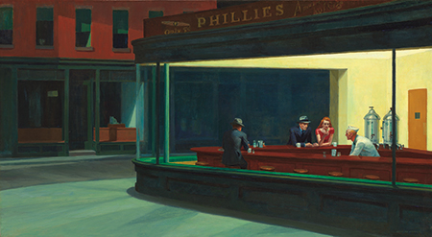
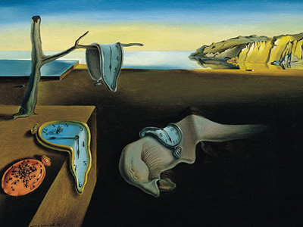
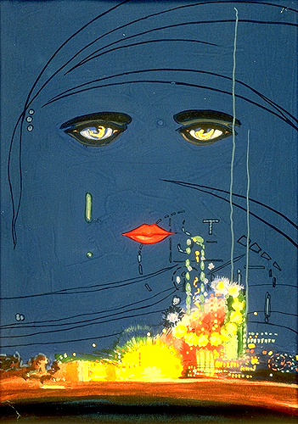

Slide 28
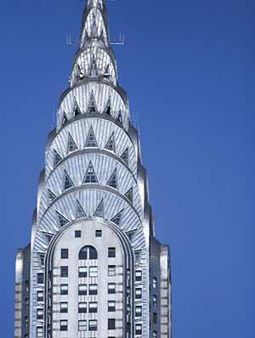

Slide 29
Harlem Renaissance
Poets: Langston Hughes, Countee Cullen, Etc.
Jazz Musicians: Duke Ellington and Louis Armstrong
Garveyism: Back to Africa movement
Notes:
https://www.youtube.com/watch?v=h2iEulpX910

Slide 30
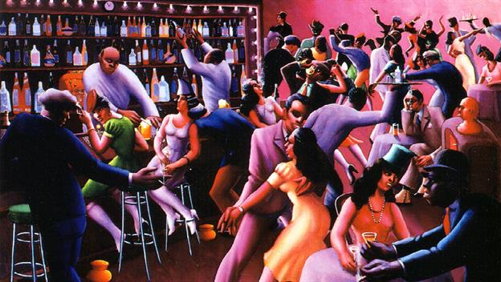
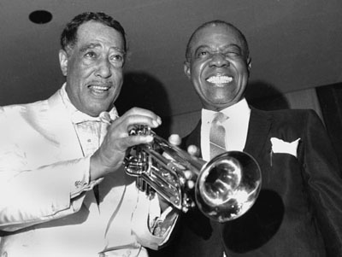

Slide 31
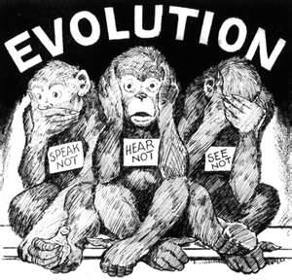
Conflict in Society
Religion
Modernism
Fundamentalism
Evangelists such as Billy Sunday helped to spread Fundamentalist doctrine through the use of the radio
The Scopes Trial (Tenn)

Slide 32
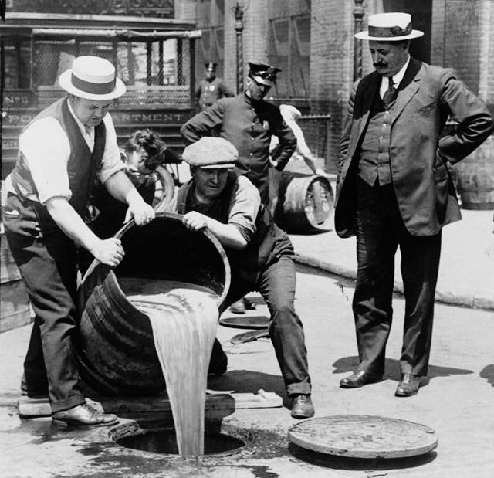
The Noble Experiment
18th Amendment (1919
Volestead Act of 1919: a federal law that enforced the 18th amendment
Bootlegging:
Speakeasies:
Organized Crime
Ex. Al Capone in Chicago
21st Amendment (1933):

Slide 33
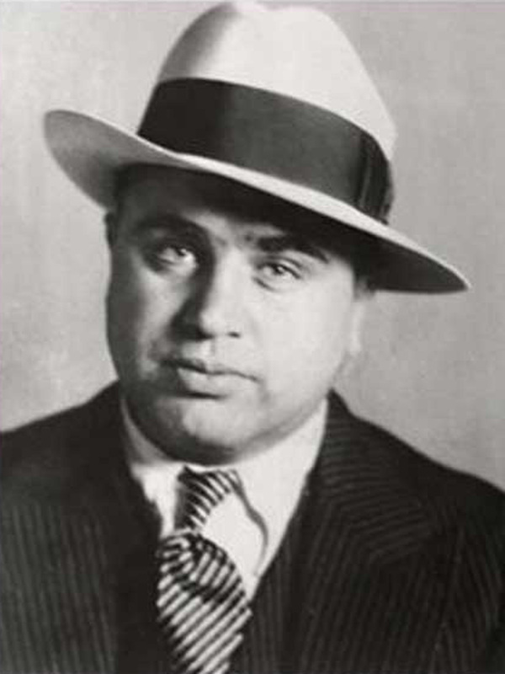
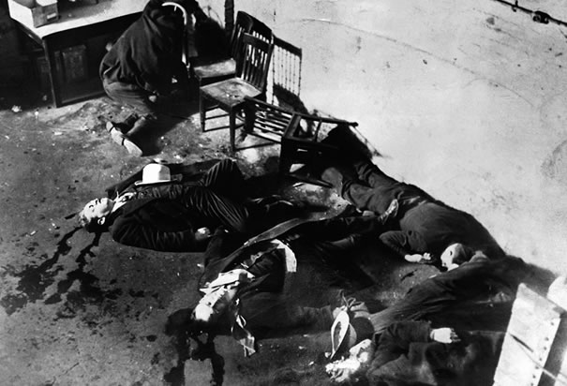

Slide 34
Women in Society
19th Amendment (1920):
Domesticity
Labor
Generally limited to certain job types: teachers, nurses, secretaries
Moral Change
Women who revolted against traditional sexual taboos
Flapper Girls
Sigmund Freud:
Growing acceptance of Birth Control (advocate Margaret Sanger)
Relaxed divorce laws Universal high school education

Slide 35
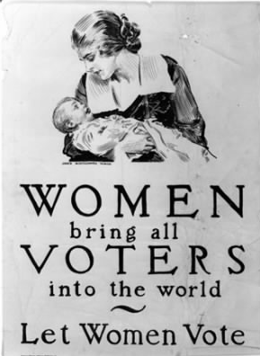

Slide 36
Nativism
Protestant isolationist prejudices and fear of job competition led to wide support for reducing immigrants into the US
Quotas
Quota Acts of 1921 and 1924: limited the amounts of immigrants from particular nationalities into the US
All Japanese barred from entering
Sacco and Vanzetti Case
The “new” Ku Klux Klan (1915)

Slide 37
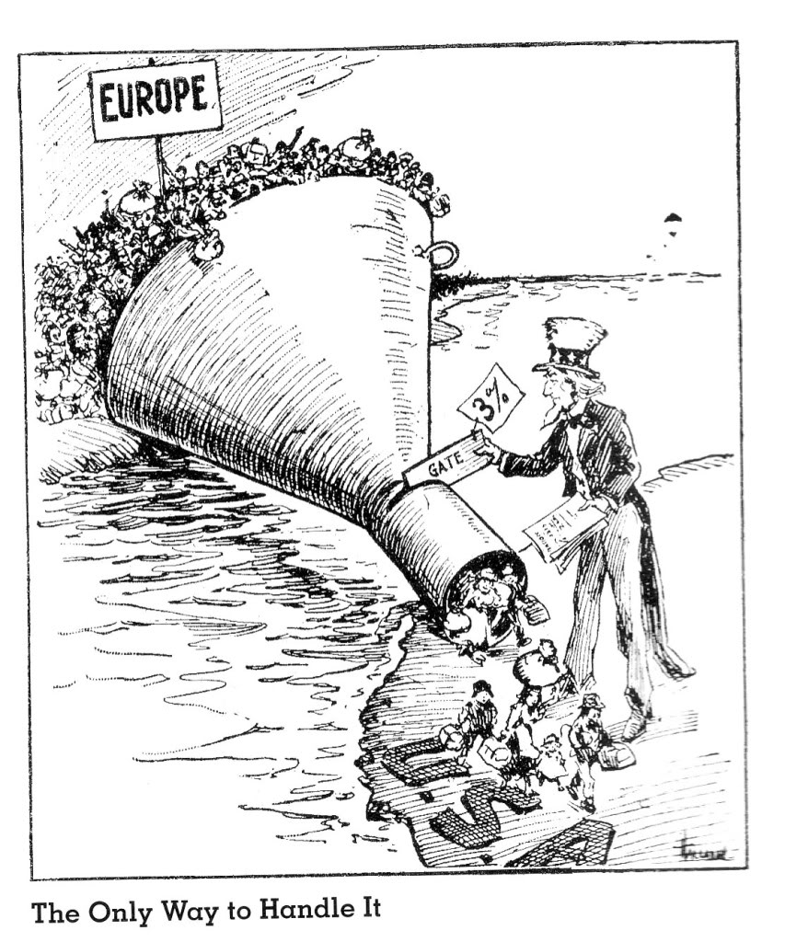
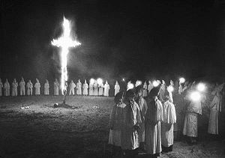

Slide 38
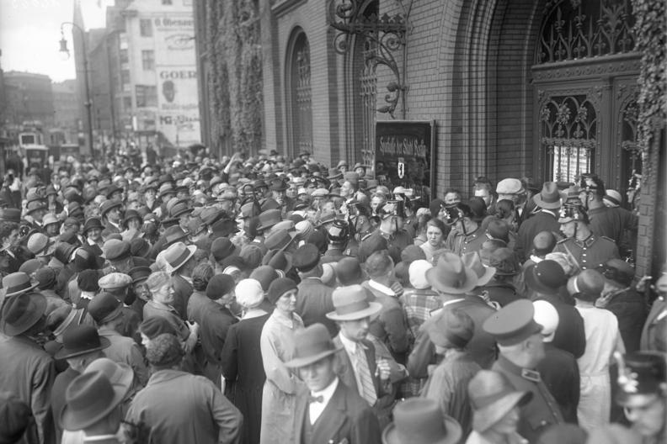
Causes of the Great Depression (1929-1933)
Stock Market Crash
Prosperous stock market during the 20s caused a massive increase in investors
Black Thursday (October 24, 1929):
Bankers bought millions of dollars of stocks in attempt to save the market
Black Tuesday (October 29, 1929):

Slide 39
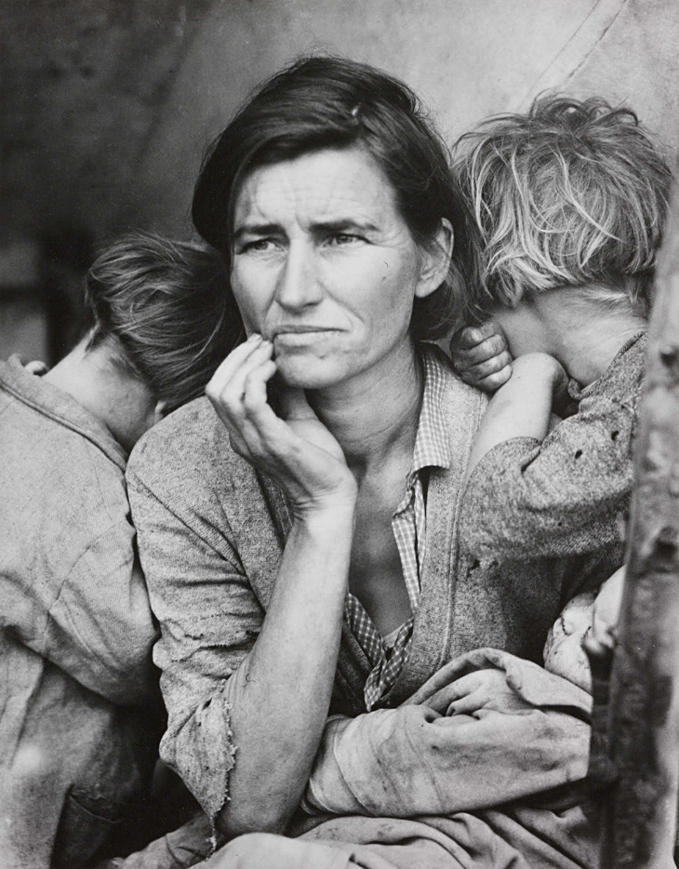
Other Factors
Income Gap:
Speculation:
Buying on Margin:
Credit:
Overproduction
Farmers
Government Policy
International Problems

