Slide 1
Post-WWII American Society
1945 -1960
We Didn’t Start the Fire
http://www.youtube.com/watch?v=eFTLKWw542g
Rock Around the Clock
https://www.youtube.com/watch?v=ZgdufzXvjqw
Mack the Knife
https://www.youtube.com/watch?v=h8iPUK0AGRo
I’ve Got You Under my Skin
https://www.youtube.com/watch?v=C1AHec7sfZ8

Slide 2
When you finish the test…
Please study the table of statistical info which is Part B of the Economic Recovery packet:
Answer –
What is the relationship b/w education & income in post-war America?
What can you conclude about the following concepts: inflation, standard of living, wages?
In 1947, the US went off price & wage controls of the WWII Era, how did that impact Americans?

Slide 3
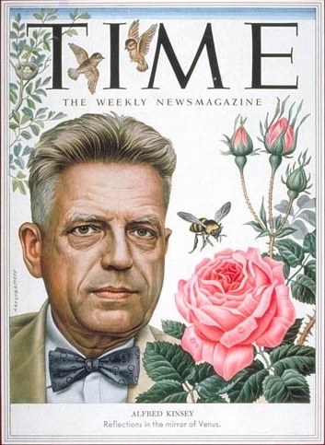
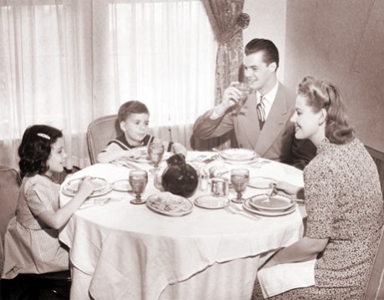
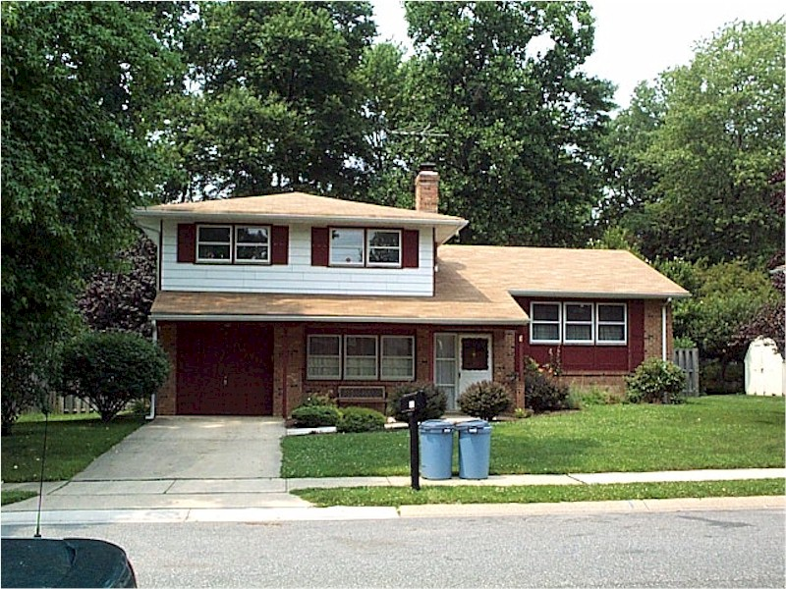
Sit & read with at least two other people whom share your article.
To be turned in
What is the author’s thesis?
What support does he/she offer?
What did you learn about the cultural values of Americans during the 1950’s?

Slide 4
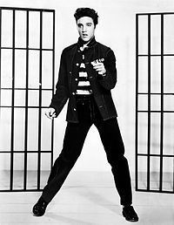
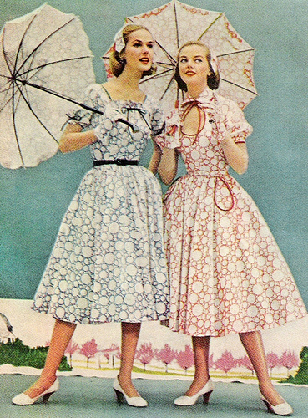
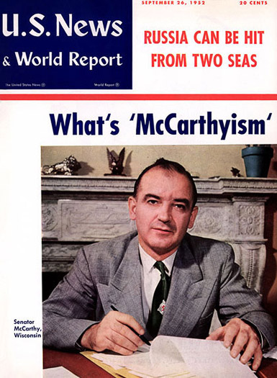
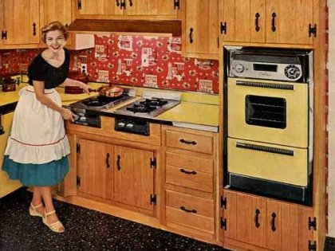
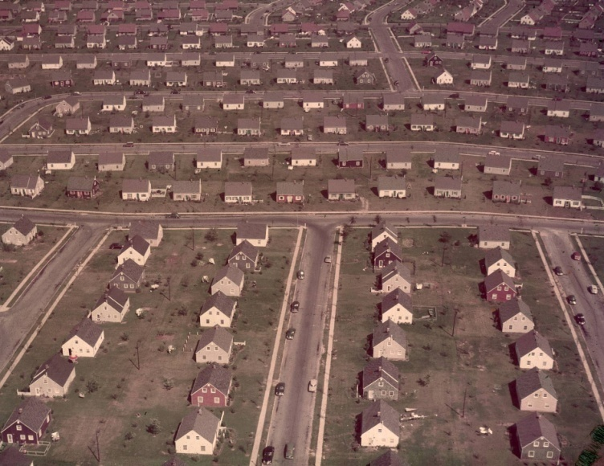
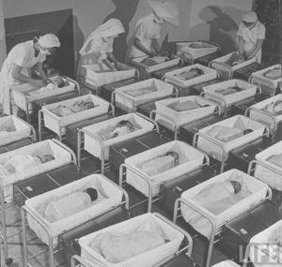
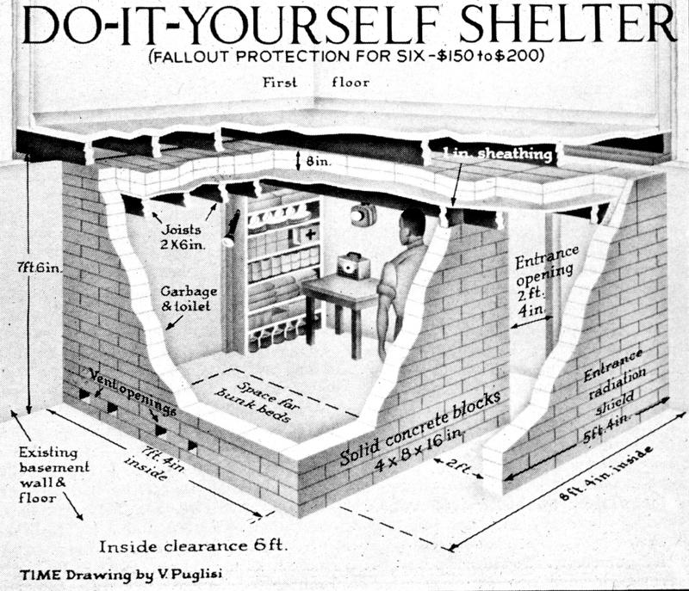

Slide 5
Answer: True or False (make sure to provide evidence!)
1920s and 1950s were similar in that they were times of increased economic prosperity for individuals at every income level.
The Red Scare of the 1950’s was based Soviet influence of US government officials, while that of the 1920’s was anti-immigrant in sentiment.
The youth music of the 1950s was like that of the 1920s in that is had roots in African-American style & rhythms.

Slide 6
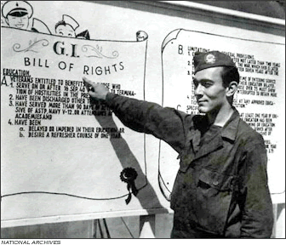
Reconversion
Positives
Negatives
No economic collapse after WWII
Americans had saved wages during war when their were no consumer goods
$6 billion tax cut
GI Bill provided education & economic assistance to veterans
Inflation of 15% annually
Labor strikes (UAW, AFL, UMW) –wages didn’t keep pace w/inflation
Minorities & women replaced, but most wanted to keep working
Move to service work (domestic & pink collar jobs)

Slide 7
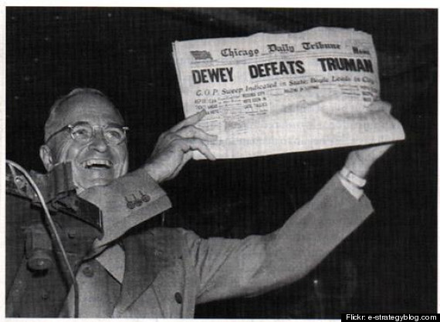
Truman’s domestic agenda
Fair Deal ideas
Expansion of SS benefits (doesn’t pass)
Raise minimum wage
Universal Healthcare (doesn’t pass)
Fair Employment Practices Act (FEPA) (doesn’t pass in its entirety)
Public housing
Nationalization of atomic energy
Republicans control Congress
Defeated most measures
Passed Taft-Hartley Act
Right to work states
‘closed shops’ made illegal (bosses only hiring unionized workers)
Election of 1948
Democrats split over civil rights
Dixiecrats –southern whites
Surprise win lets Truman revive Fair Deal
SS expansion
75 cent minimum wage
National Housing Act

Slide 8
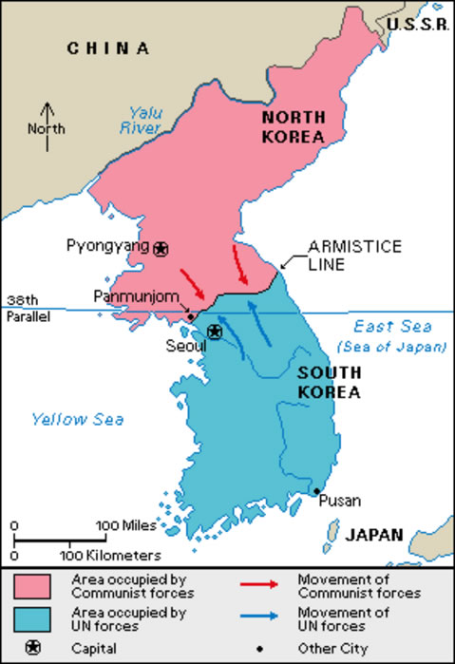
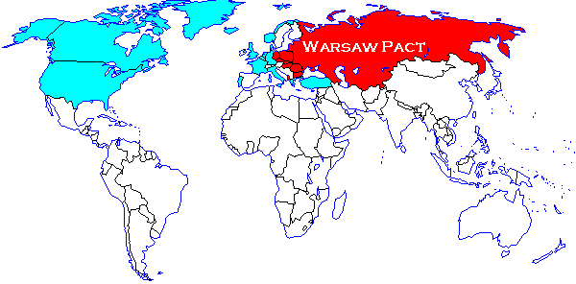

Slide 9
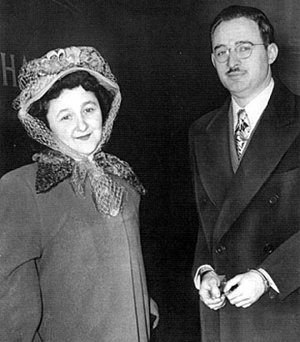
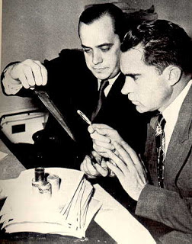
Crusade against subversion
Communism was NOT an imagined enemy of the 1950s
Eastern Europe, Korea, Maoist Revolution
Ethel & Julius Rosenberg
Convicted & put to death for passing atomic weapon plan to the Soviets
House un-American Activities Committee
‘Hollywood Ten’
Alger Hiss
Congressman Richard M. Nixon
Notes:
https://www.youtube.com/watch?v=s-6BfCbrvuM

Slide 10
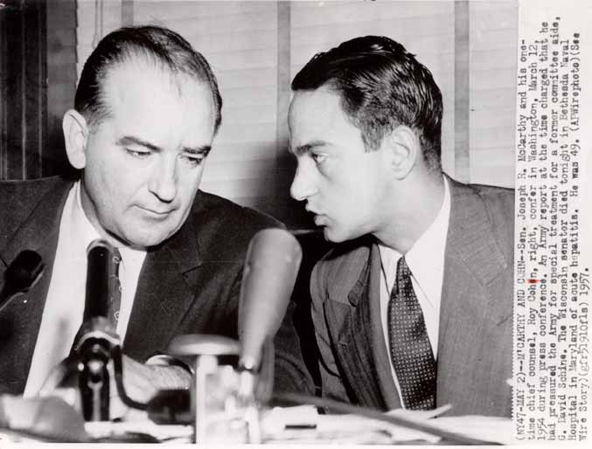
2nd Red Scare
McCarran Internal Security Act, 1950
All communist orgs must register w/Feds
J.Edgar Hoover & FBI investigate thousands of Federal employees
McCarthyism
Senator Eugene McCarthy + asst. Roy Cohn, 1950
Democrats accused of ‘20 years of treason’
Public hearings never produced evidence

Slide 11
Warm up
What do these terms mean to you?
Consensus
Conformity
What do you use your cell phone for?
How necessary is it for your daily life?

Slide 12
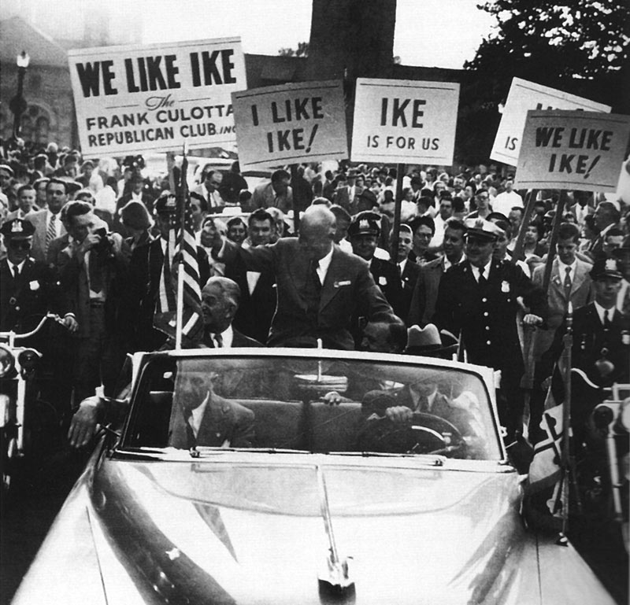
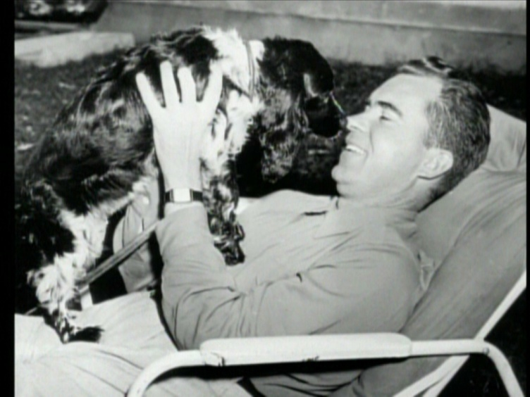
Republican Revival
Dwight D. Eisenhower chosen by Republicans in 1952:
No political identification
WWII hero, Pres. of Columbia University, commander of NATO
No political skeletons
Pledges to settle Korean Conflict
Richard Nixon as vice-president
the ‘communist crusader’ to pacify conservatives
Early accusations of financial improprieties ($18,000)
Checkers speech
Notes:
http://www.youtube.com/watch?v=I9LcAJOsFGg “Checkers Speech”

Slide 13
In the video:
List any important developments of the 1950s that helped create a more “modern” America.

Slide 14
Prof. Alan Brinkley reading
“The years from the end of World War II to the end of the 1950s were dominated by four powerful changes in American life. The first was the birth of the Cold War, and the great fears that it created. The second was the dramatic growth of affluence, which transformed the lives of many, but not all, Americans. The third was a growing anxiety among many Americans who felt that their lives were too constricted by the staid culture of the era. And the fourth was the emergence of a new subversive culture growing beneath the smooth, stable surface of the decade that would explode in the 1960s.”

Slide 15
 | The Cold War | Affluent Society | Society in the 50s | The Shadow Nation
Synopsis of Segment:
Important facts (at least 3)
Why does Brinley describe this segment as a “powerful change”?

Slide 16
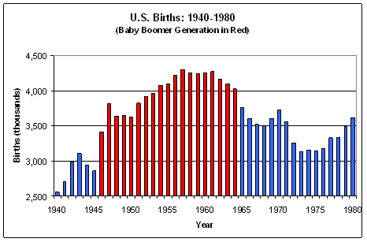
The Economic Miracle
Economic boom of the 1950s was 250% more than the 20’s
Nations population rose 20% from births ‘baby boom’
Interstate highway program, 1956
Increased military spending
Notes:
https://www.youtube.com/watch?v=q2esS4i387U student made 1950s video

Slide 17
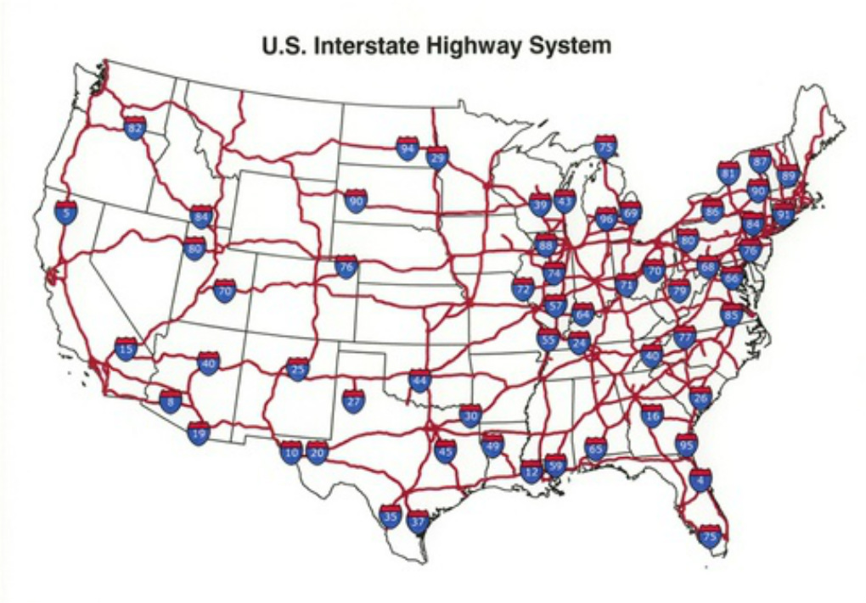

Slide 18
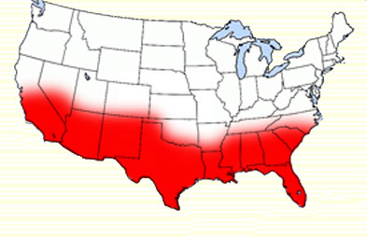
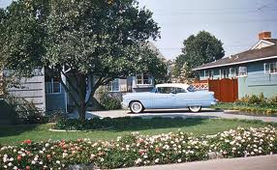
Rise of the Sunbelt
Suburban living
‘New Economics’
John Maynard Keynes

Slide 19
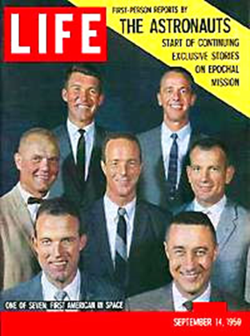
Computer technology
UNIVAC –
Bombs, Rockets & Missiles
Hydrogen Bomb –
Unmanned rockets for bomb delivery -ICBMs
Notes:
https://www.youtube.com/watch?v=yEje927dygM “Castle Bravo”
https://www.youtube.com/watch?v=aMYYEsKvHvk “Tsar Bomba”

Slide 20
The Suburban Nation
Consumer Culture
Car Culture
Suburbs
Leisure time. Drive-ins, family vacations
Garages, parking lots
Fast Food
Suburbs
Levittown –working class homes
white flight; minority population from WWII remains in Northern cities
Nuclear family –two generation families
Gender roles reinforced (dad’s sphere –work) mom’s sphere –home)
Dr. Benjamin Spock –purpose of motherhood was to raise & teach children
Child-centered (child’s needs come first)
TV’s homogenizing message
Notes:
https://www.youtube.com/watch?v=p4p7o5IzlCc “leave it to beaver”

Slide 21
Allen Ginsberg’s “Howl” HAP-P
I saw the best minds of my generation destroyed by madness, starving hysterical naked,
dragging themselves through the negro streets at dawn looking for an angry fix,
Angel-headed hipsters burning for the ancient heavenly connection to the starry dynamo in the machinery of night,
who poverty and tatters and hollow-eyed and high sat up smoking in the supernatural darkness of cold-water flats floating across the tops of cities contemplating jazz,
who bared their brains to Heaven under the El and saw Mohammedan angels staggering on tenement roofs illuminated,
who passed through universities with radiant cool eyes hallucinating Arkansas and Blake-light tragedy among the scholars of war,
who were expelled from the academies for crazy & publishing obscene odes on the windows of the skull....

Slide 22
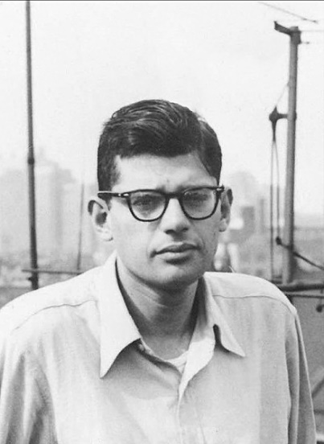
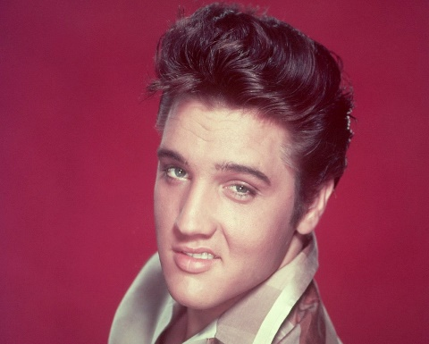
Youth Culture
Rebellion to adult authority
Beat generation (beatniks) –criticized the sterility of middle class life
Rock n’ Roll –’the negro sound’
Drew heavily from black rhythm & blues music
Bill Haley’s Rock Around the Clock (1955)
Buddy Holly (1955)
Elvis Pressley (1956)
Notes:
https://www.youtube.com/watch?v=GMezwtB1oCU “Buddy Holly Everyday”

Slide 23
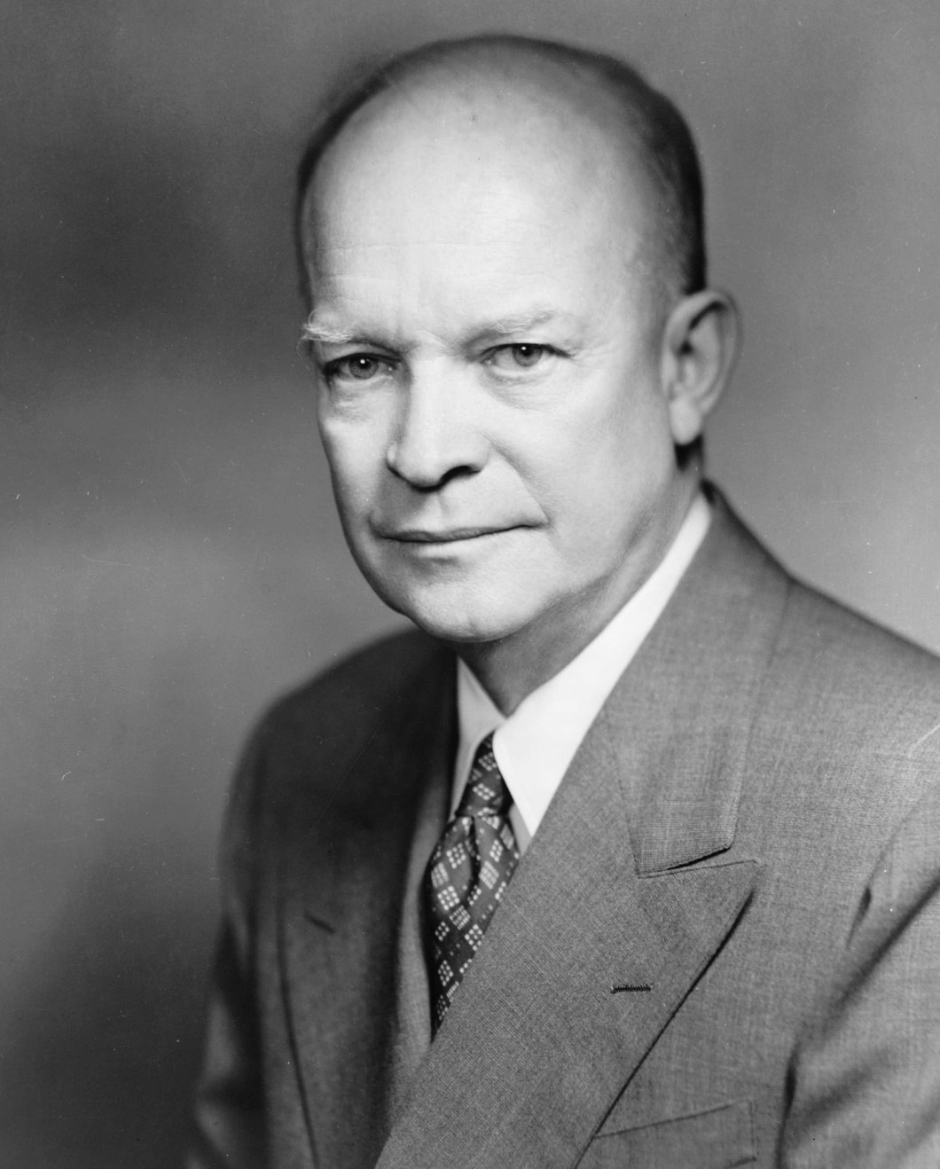
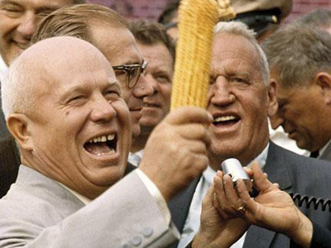
VS

Slide 24
Eisenhower & the Cold War
Diplomacy based on managing Soviet threat at home & abroad
Federal Highway & Defense Act, 1956
40,000 miles of interstate
Secretary of State John Foster Dulles & Eisenhower direct foreign policy
‘massive retaliation’ policy, 1954
Vietnam (early American tensions)
French tried reclaim control of colony after WWII against communist insurgency led by Ho Chi Min, 1954

Slide 25
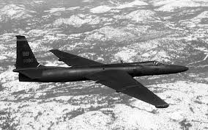
Suez Crisis (1956)
Hungarian Revolution (1956)
Result –Eisenhower Doctrine (1957)
ANY nation could request US $ aid and Military support
Seen as a method to keep USSR out of the Middle East
U2 Crisis (1959) –US spy plane is shot down over Soviet airspace
Pilot Francis Gary Powers held hostage

Slide 26
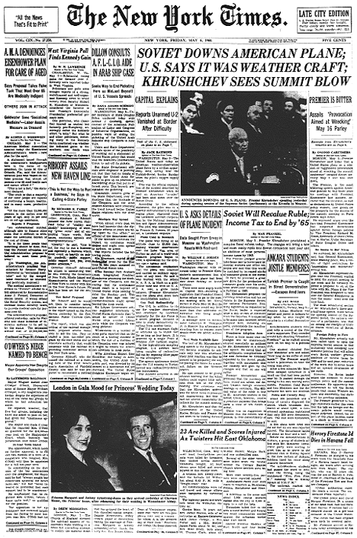
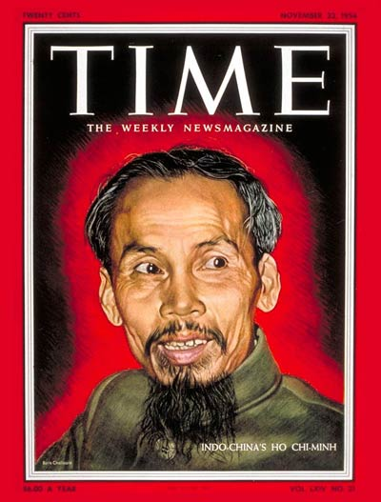
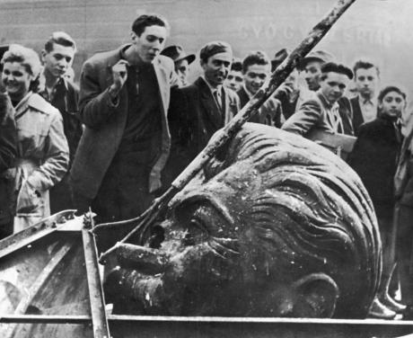
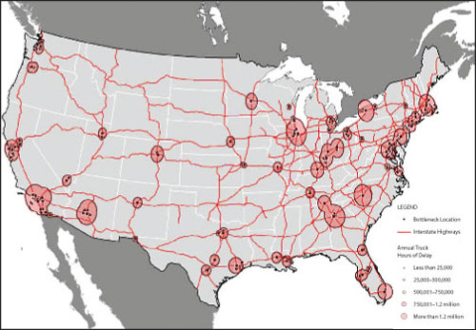
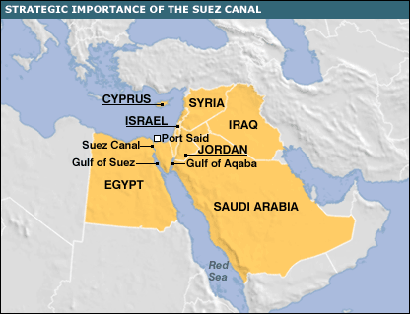
Eisenhower Foreign policy

Slide 28
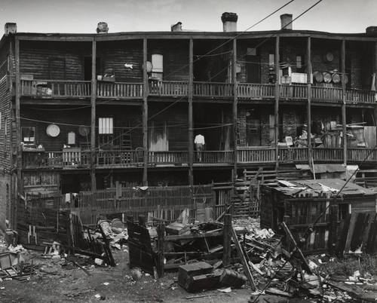
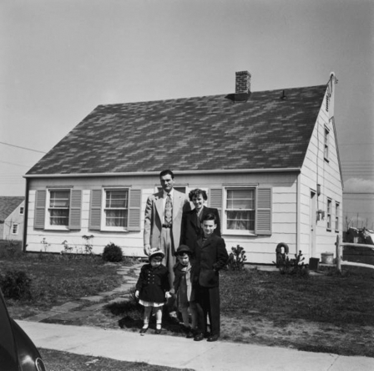
The Other America
Socialist writer Michael Harrington’s ‘The Other America’
In 1960, at least 1/5th of all families lived in poverty (30 mil)
20% of this group lived in persistent poverty
Rise of inner-city “ghettos”
Unskilled industrial jobs begin declining in the 1950s
Created a “culture of poverty” as more middle class whites moved to suburbs
Black Urban migration 1940-1960
Northern manufacturing jobs in WWII
Result of mechanization of cotton harvesting
Mexican & Puerto Rican immigration 1940-1960

Slide 29
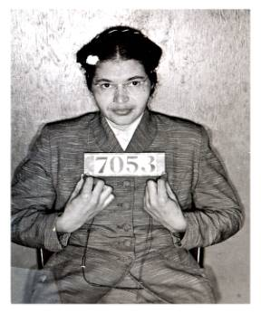
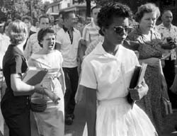
Civil Rights Movement
Brown v. Board of Education of Topeka, KS, 1954
Washington, DC & Northern cities integration came quickly
Whites launch “Massive Resistance” in the south
Shuttlesworth V. Birmingham BOE, 1958
Scholastic ability & social behavior could not be used to maintain segregation
Eisenhower administration did not want to commit themselves to desegregation, but finally had to:
Little Rock Nine, 1957
National Guard sent to enforce federal court order
Montgomery Bus Boycott, 1955
Rosa Parks
Dr. Martin Luther King, Jr –civil disobedience
Lasted 381 days
https://www.youtube.com/watch?v=URxwe6LPvkM

Slide 30
Conformity | Consensus | Reaction

