Slide 1
APUSH Review
Short Answer Thematic responses

Slide 2
Unit 1 & 2 Thematic Review
Answer parts a, b, and c.
How did the growth of plantation based agriculture in the Atlantic World effect either the
Native Americans
Africans
Indentured Servants
Give one example of a technological advancement that had either a long term or short term effect on the Atlantic World society.
Briefly explain how technology impacted the role of labor and plantation based agriculture in the Atlantic World from this time period to 1860.

Slide 3
Unit 2 & 3
Answer parts a and b.
Briefly explain why one of the following developments best marks the beginning of the dependence of African slavery during the colonial and early Federal Period. Provide at least ONE piece of evidence from the period to support your explanation.
Dependable workforce
Expansion of tobacco production
Invention of the cotton gin
Briefly explain why ONE of the other options is not as persuasive as the one you chose.

Slide 4
Unit 3
Early debates over the meaning of the Constitution led to differences of opinion on:
The role of the new government in the economy
The relationship between the government and the states
Foreign affairs
Choose one of the categories from above and give a specific example of a historical controversy from that category 1788-1800.
Choose another example from a different category and give a specific example of a historical controversy 1788-1800.
Explain how these differences caused the rise of political parties in the United States.

Slide 5
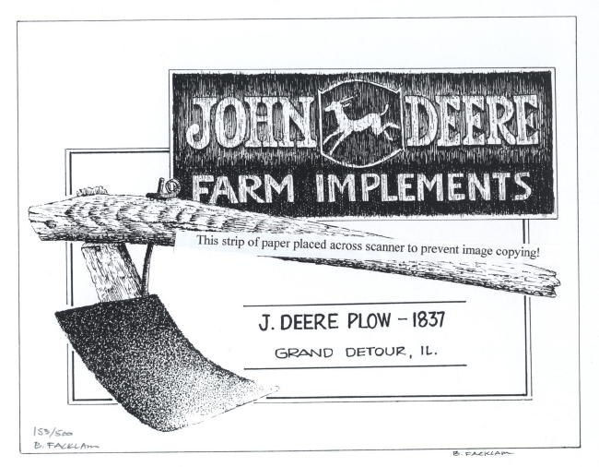
Unit 4
Using the 1837 image above, answer parts a, b, and c.
Explain how the agricultural invention impacted farming practices.
Explain another agricultural invention that had a significant impact from 1800-1848.
Choose one of the inventions and explain how it impacted the economy.

Slide 6
Unit 5
Using your knowledge of United States history, answer parts a and b.
Briefly explain how ONE of the following events led to the creation of the Republican party.
Mexican American War
Kansas-Nebraska Act
Slave Trade
Briefly explain why ONE of the other options is not as influential to the creation of the Republican party.

Slide 7
Unit 6
Briefly explain how government policies/actions brought about the end of the Native American way of life by 1898. Answer parts a and b.
How did the American government respond to Native American action?
Briefly explain/give an example how Native Americans responded to government policies from 1865-1898 to preserve their way of life?

Slide 8
Unit 7
Between 1890 – 1920, Progressives, attempted to respond to changes in the United States through a wide variety of reforms
Explain one Progressive economic reform between 1890 – 1920
Explain one Progressive social or political reform between 1890 – 1920
Explain the short term or long term impact of the economic reform in PART A or the social/political reform explained in PART B

Slide 9
Unit 8
Answer parts a, b, and c.
Briefly explain ONE major factor that contributed to the Great Depression.
Briefly explain how the government responded to that factor.
Briefly explain ONE way in which some Americans responded critically to the government responses to the Great Depression.

