Slide 1
Creating a Republican Culture

Slide 2
Map Activity
Please complete #1 – 3 on the map
(Work quickly, you have 6 minutes)

Slide 3
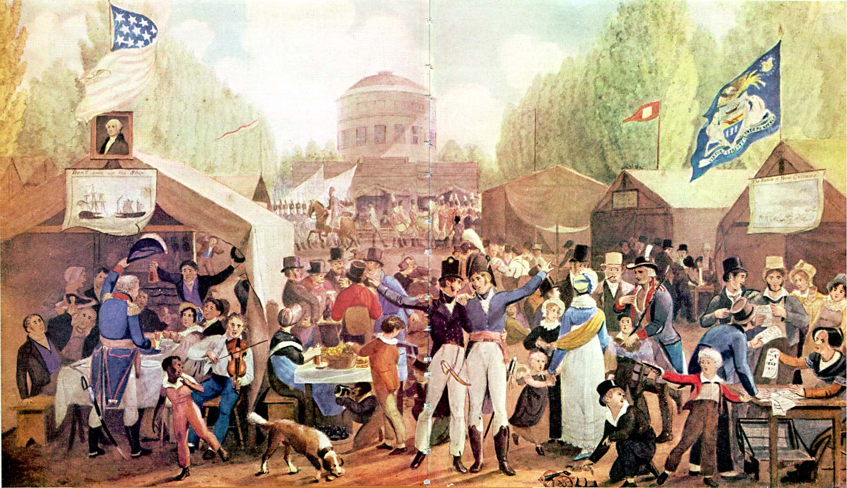
Give this painting a title

Slide 4
Era of Good Feelings
James Monroe (DR)won a landside victory in 1816
Last time Federalist will run a candidate for president
Made the first ’national’ tour for a president, was welcomed even in Federalist strong holds like NE
Boston Gazette called the time ‘the era of good feelings’
1816-1818 were economically stable, but issues of debate were:
Sectionalism
the 1816 Tariff
the National Bank

Slide 5
The American System
After 1814, there was a rise in the spirit of nationalism that could be seen in art, literature and magazines
American industries were threatened after the of 1812
British goods began to flood the market (this also happened after the Treaty of Paris, 1783)
Congress passes the Tariff of 1816
raising import duties to more than 20% of the goods value
protect American manufacturing

Slide 6
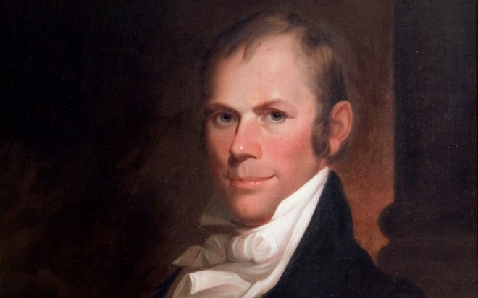
The Rise of Henry Clay
Representative Henry Clay (KY)
Democratic-Republican
war hawk
proposes the ‘American System’
Strong banking system to provide easy credit to American businesses
Protective tariff (Tariff of 1816) to protect NE industry –to fund:
Network of infrastructure (roads, canals –in Western NY and Ohio Valley

Slide 7
Not so good feelings
Panic of 1819 -1st national panic (depression)
National Bank foreclosed on many western farms
Cooled nationalistic spirit
Highlighted the need for prison reform (end debtor’s prison)

Slide 8
Defining National Boundaries (1819 – 1824)
Adams-Onis Treaty gained Florida & Oregon from Spanish, while ceding claims to Texas
Europeans interfering in the Americas
Russia made claims to coastal waters from Alaska to British Columbia
France & Spain wanted to suppress independence in Latin America
British wanted to maintain open trade with newly freed nations
John Quincy Adams (Sec. of State) encouraged Monroe to issue a warning to European powers concerning the Americas
Do not intervene
Do not colonize
Russo-American Treaty, 1824
Russia agreed to not make claims south of 54.40’

Slide 9
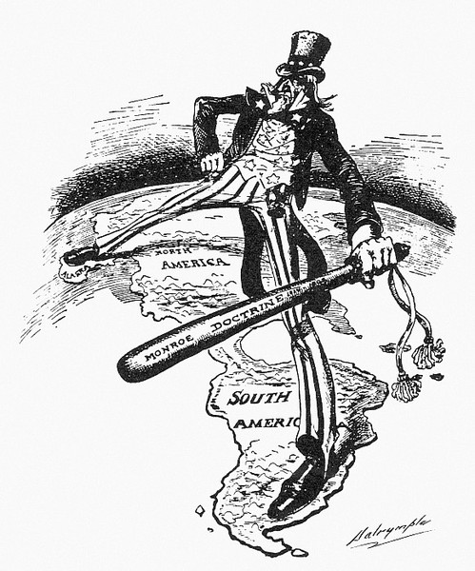
Monroe Doctrine
1823, James Monroe’s State of the Union address
Really authored by John Quincy Adams
Stated that further European colonization in North or South America would be considered an act of aggression
U.S. would not meddle in European affairs nor interfere in current European colonies in the Americas

Slide 10
Choose ONE of the choices below, and explain how your choice had an impact on the industrial growth during this period from prior to the War of 1812 to the middle of the 19th century.
Factory system
Inventions
Labor unions
Contrast your choice against one of the other options, demonstrating why that option is not as good as your choice.

Slide 11
Rise of Sectionalism
Population expansion in the west from 1790 - 1830
Poor New Englanders looking for opportunity during the embargo years
Immigrants from Europe after War of 1812/Napoleonic wars ended
Land Act of 1820 (citizens no longer able to purchase public land on credit)
Westerners in the north typically didn’t have slaves, those in KY and south often did

Slide 12
Missouri Compromise
1820, Missouri asked to be admitted into the Union as a slave state
NW Ordinance made the NW free states, but provisions did not include southern states & those west of Mississippi
Tallmadge Amendment proposed by abolitionists to stop further importation into MO & emancipation for children of slaves
Would end the 11 free, 11 slave state balance
Henry Clay proposed:
Maine enters free, Missouri enters as slave
All future states north of MO’s southern border would be closed to slavery
Compromise lasted 34 years

Slide 13
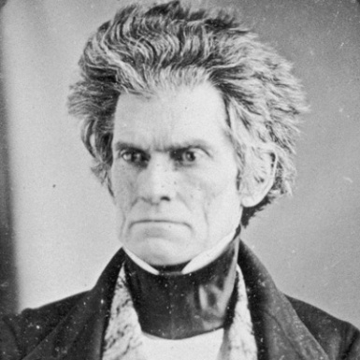
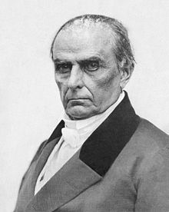
Emergence of a Second Party system
Daniel Webster
John C. Calhoun
Massachusetts
Nationalistic views
Anti-slavery
Early career: represented Northern shipping interests
Represented Federalist interests in Dartmouth v. Woodward
Early member of the Whig party
South Carolina
Promoter of states’ rights & nullification
Free trade (to limit Northern power)
Defender of slavery
Early career –Democratic-Rep.
Will become a leader of the Democratic Party

Slide 14
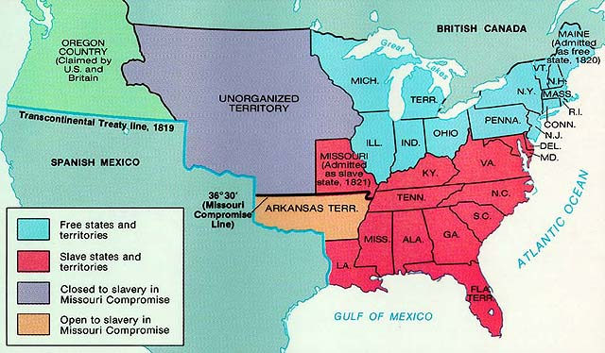
United States,1821

Slide 15
Question
How did Jefferson’s purchase of the Louisiana territory contribute to the rise of sectionalism during the first half of the 19th century?

