Slide 1
The New South and the Last Frontier (1865-1900)

Slide 2
Discussion Q1
Describe the state of the South after the Civil War (1865-1900).

Slide 3
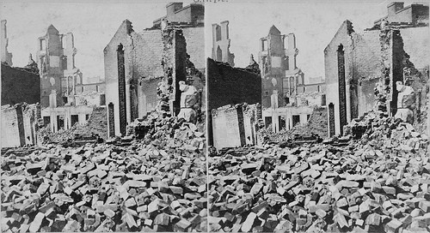
The New South
Henry Grady: need economic diversity and laizze-faire capitalism to rebuild the south

Slide 4
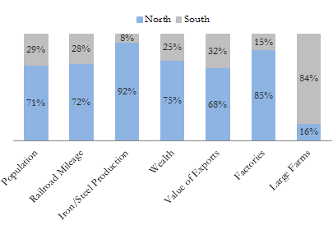
Improvements in Industry and Infrastructure
Birmingham: steel
Memphis: lumber
Richmond: tobacco
Georgia, NC, and SC: overtake New England as largest textile manufacturers
By 1900, 400 mills and over 100,000 workers
Expansion, improvement and standardization of Southern Rail lines
Standard Gauge Rails

Slide 5
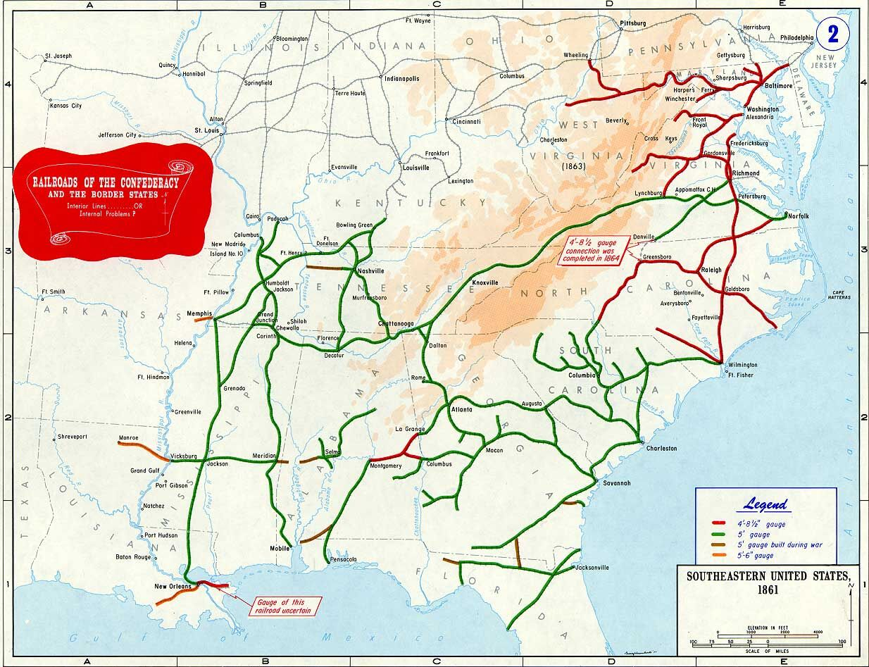

Slide 6
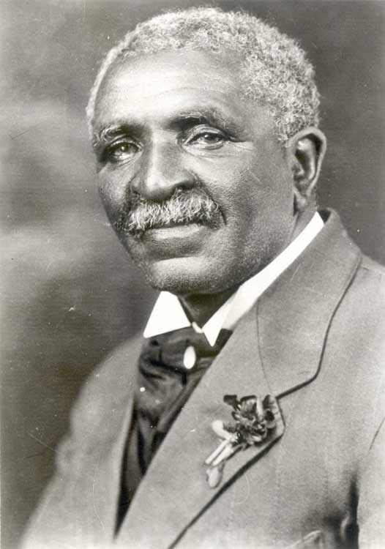
Poverty
Poorest region in the country
Agriculture
Sharecropping and crop lien system is prevalent
Between 1870 and 1900 cotton production doubled;
George Washington Carver: influential in redirecting the south away from cotton
Suggested peanuts, sweet potatoes, and soybeans

Slide 7
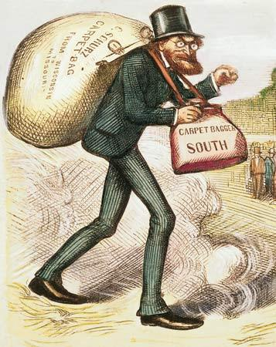
Why was the south impoverished?
Late start
Poorly educated workforce
Little to no capital
Northern financing owns largest percentages of southern industry (steel and rr’s)

Slide 8
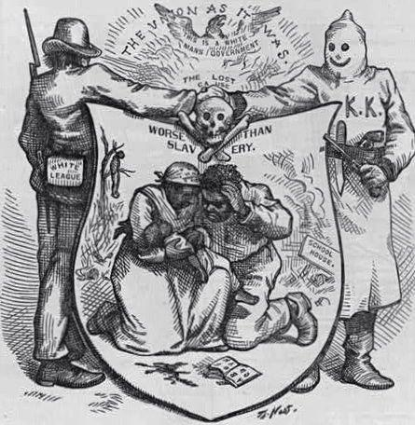
Segregation
Redeemers: Democratic Politicians who came to power after reconstruction

Slide 9
Supreme Court
In late 1870’s, SC began striking down civil rights legislation created during reconstruction
Civil Rights Cases of 1883:
Plessy v. Ferguson (1896): “Separate but equal” is not a violation of 14th amendment
Voting Case of 1898: literacy tests are legal
De facto to De Jure segregation

Slide 10
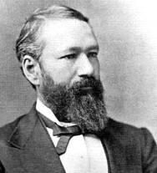
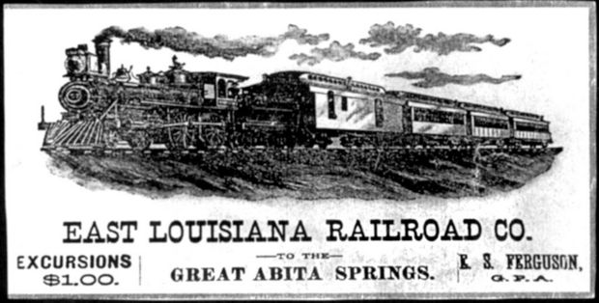

Slide 11
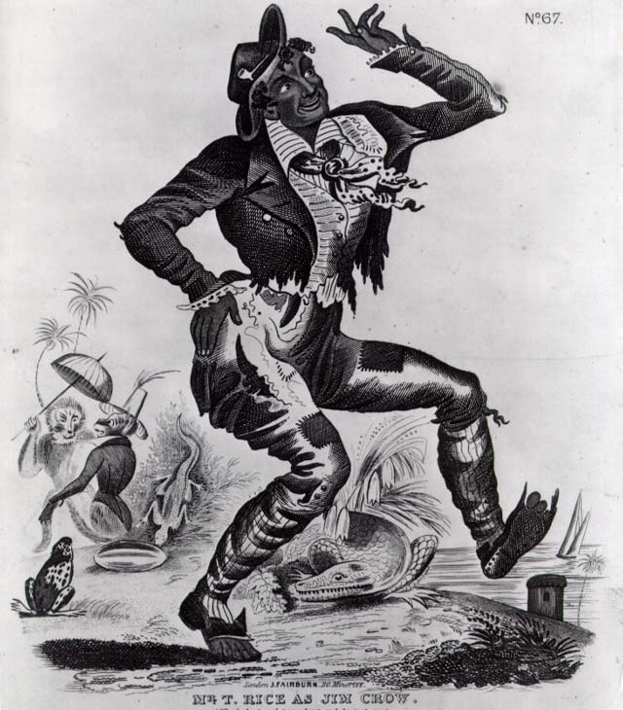
De Jure (“legal”) Segregation
Grandfather Clauses
Poll Taxes and Literacy tests
Primaries for whites only
Jim Crow Laws

Slide 12
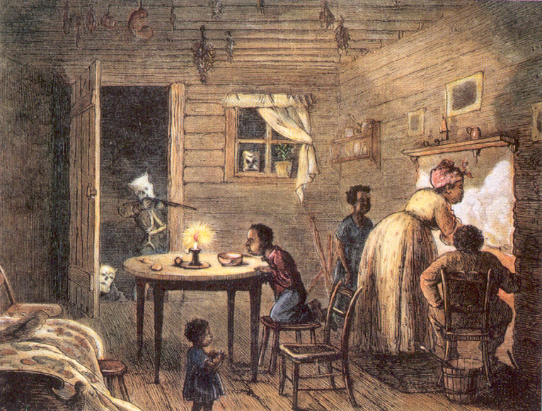
De Facto Segregation
Lynch Mobs and the KKK
Economic discrimination: lack of blacks admitted into skilled trades or factory jobs

Slide 13
Black Response to Segregation
Ida B. Wells: campaigned against lynching and Jim Crow Laws
Henry Turner and International Migration Society (1894)
Booker T. Washington: don’t fight racism, work around it.
Started Tuskeegee Institute

Slide 14
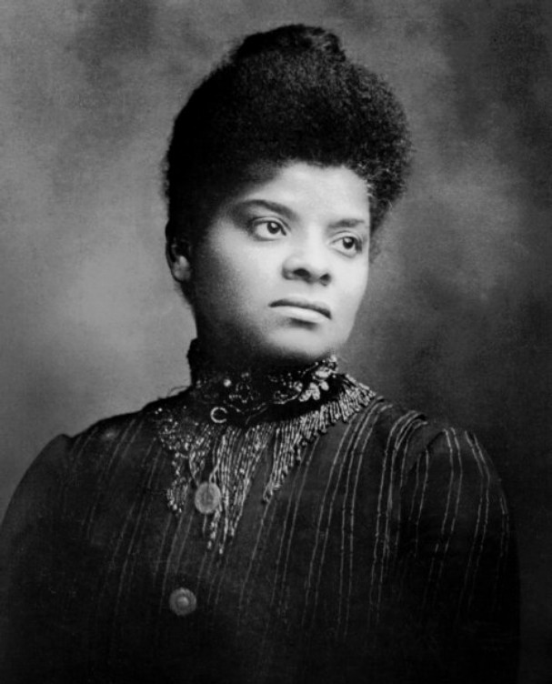
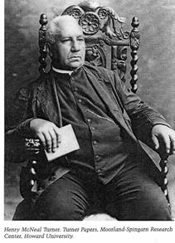
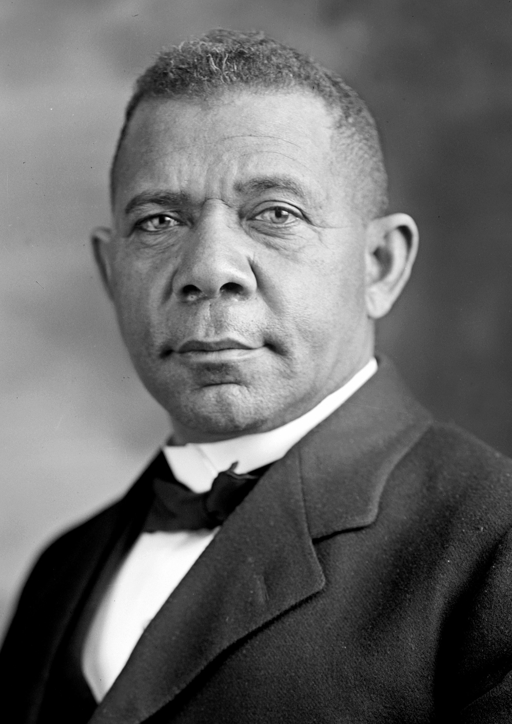

Slide 15
Discussion Q2
What events or circumstances led Americans to expand westward in the 19th century?

Slide 16
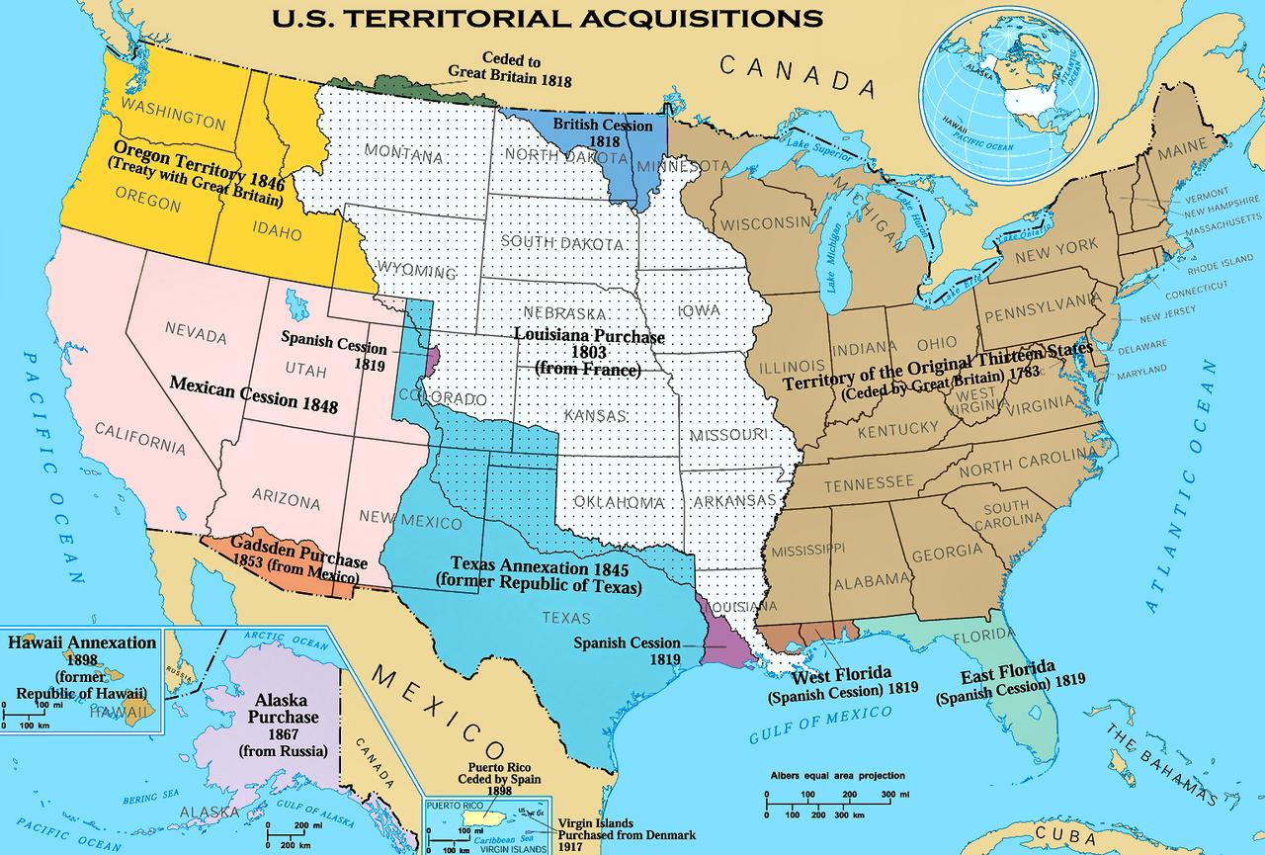

Slide 17
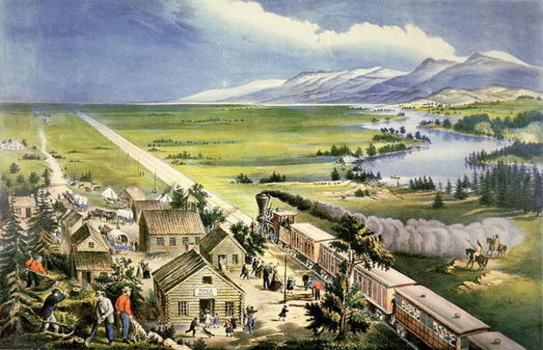
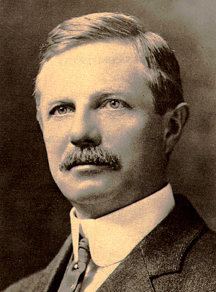
The Last Frontier: The West
American History as defined by “new” west’s: Frederick Jackson Turner
Frontier thesis

Slide 18
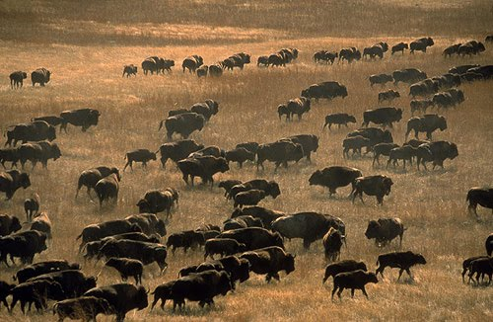
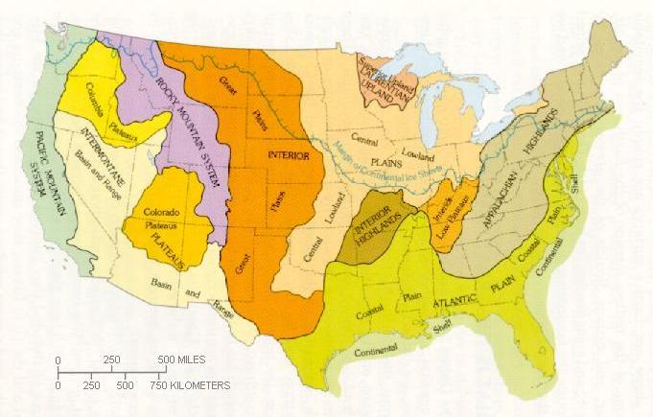
“The Great American Desert”

Slide 19
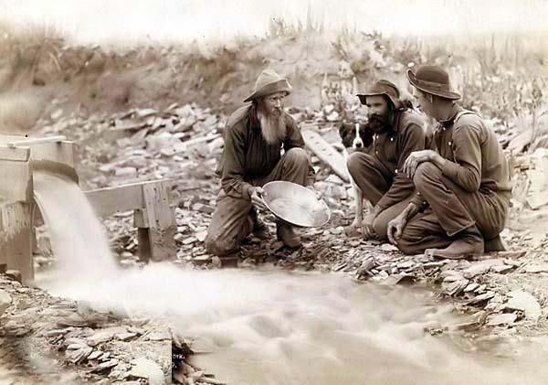
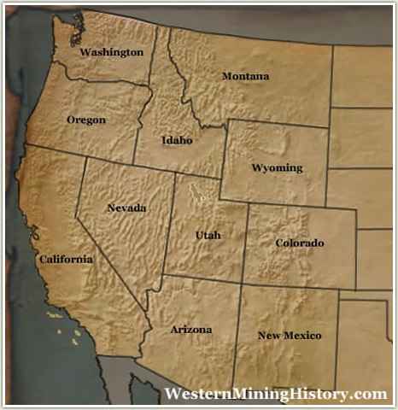
The Mining Rush
1848 Gold Rush in California
1859 Discovery at Pikes Peak, Co.
Comstock Lode in Nevada

Slide 20
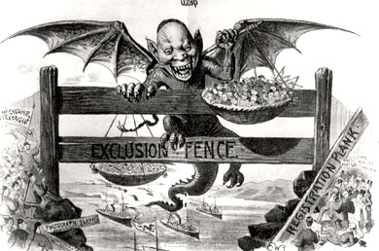
Controversy over foreign workers
Chinese Exclusion Act 1882: prohibited further immigration to the US by Chinese Laborers

Slide 21
Impacts of the Mining Boom
Increased supply of Gold and Silver leads to bitter political debates over currency
Environmental issues
American Indians pushed out of lands

Slide 22
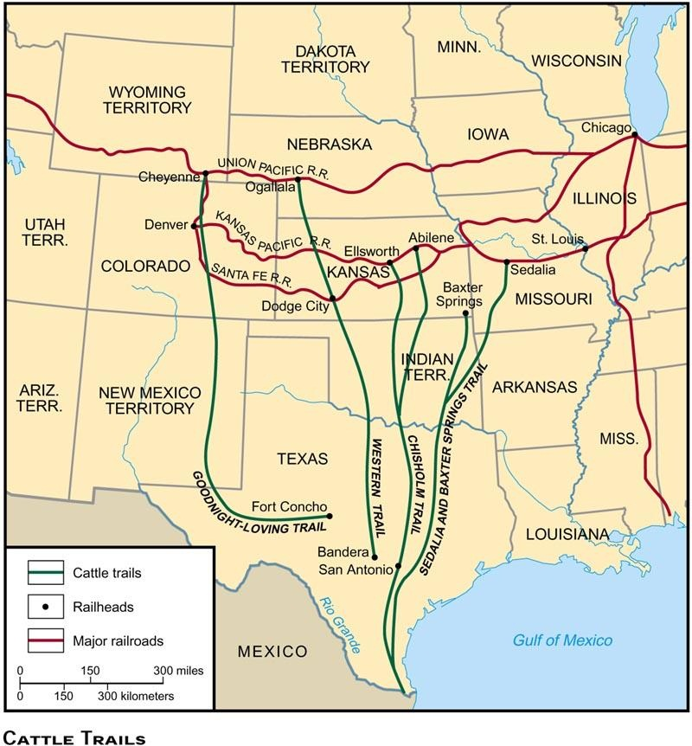
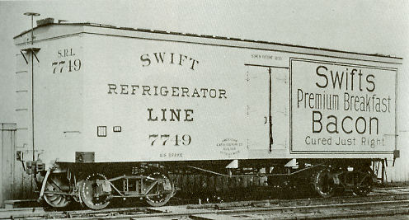
The Cattle Boom

Slide 23
The Farming Boom
Homestead Act of 1862:
Encouraged farming on the Great Plains by offering 160 acres of public land free to any family willing to settle for 5 years
About 500,000 families in all used this
RR’s and Speculators manipulated the system to get free land to sell or use for their own purposes

Slide 24
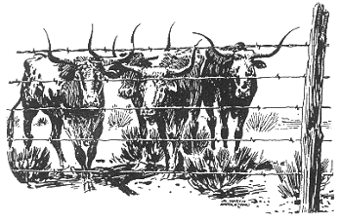
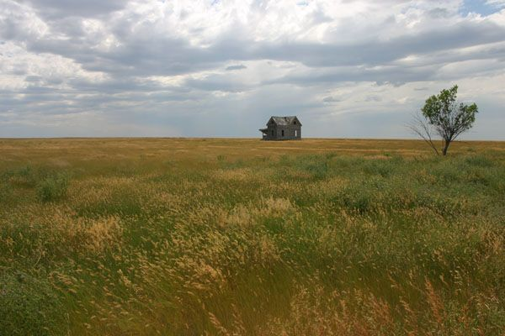

Slide 25
Farmers Issues of the Early 20th Century
Farms became increasingly commercialized after the Civil War
Falling prices
Rising Costs

Slide 26
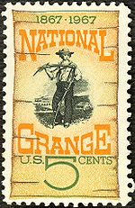
Working Toward Change on Farms
National Grange Movement
Munn v Illinois (1877)
Farmers’ Alliances
Wabash v. Illinois
Interstate Commerce Commission (ICC)

Slide 27
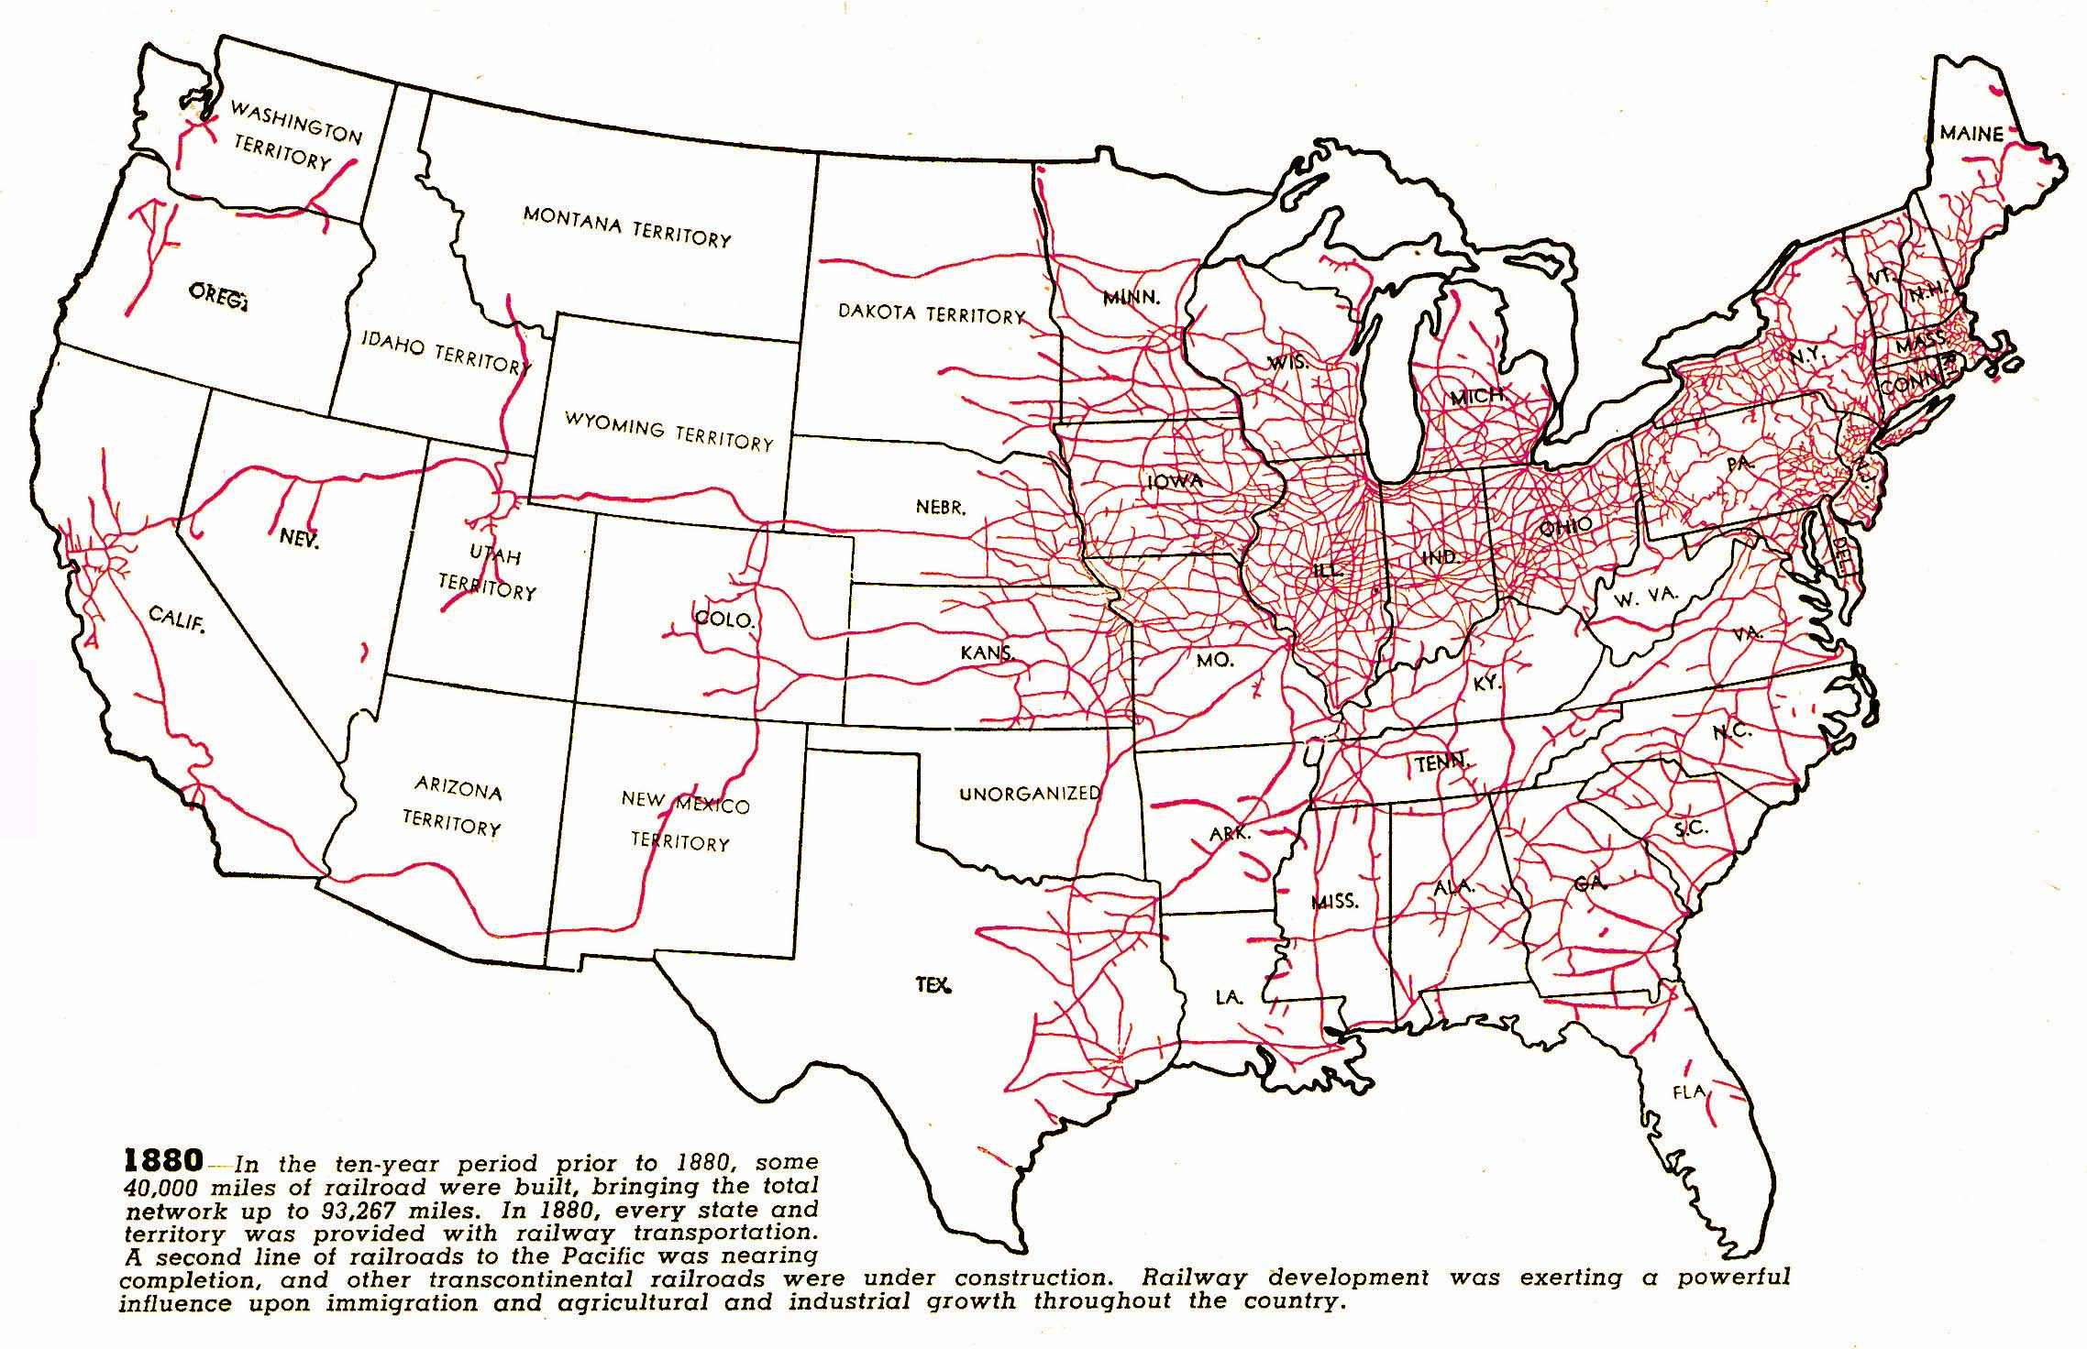

Slide 28
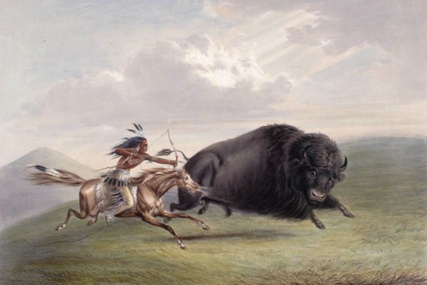
American Indians
Indian Wars
Sioux Wars
“Ghost Dance”
Battle of Wounded Knee (1890)

Slide 29
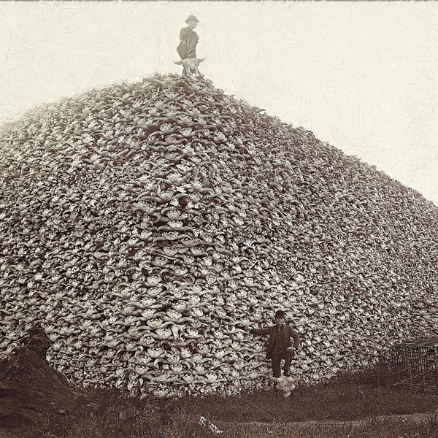
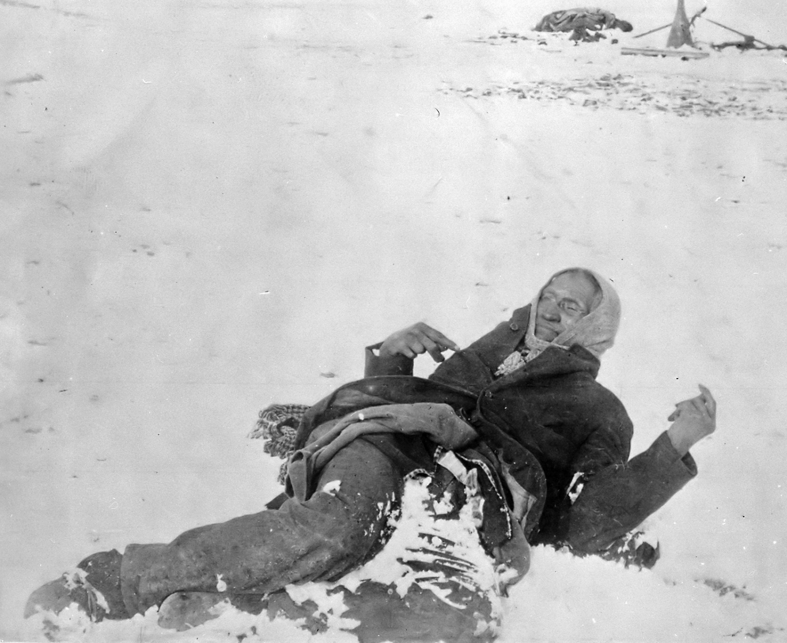

Slide 30
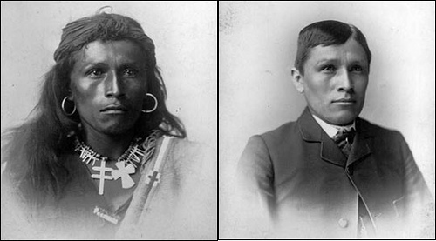
Assimilation of Natives
Dawes Severalty Act (1887)
Legislation created to break up tribal organizations and land
Carlisle School

Slide 31
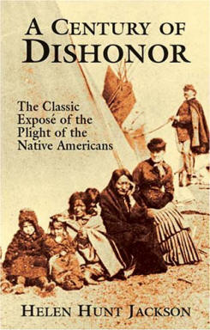
A Century of Dishonor (1881)

Slide 32
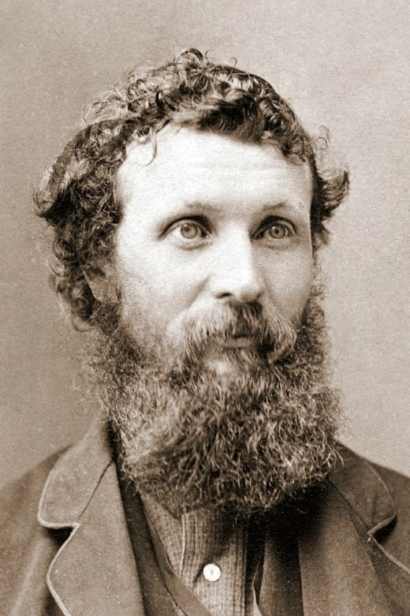
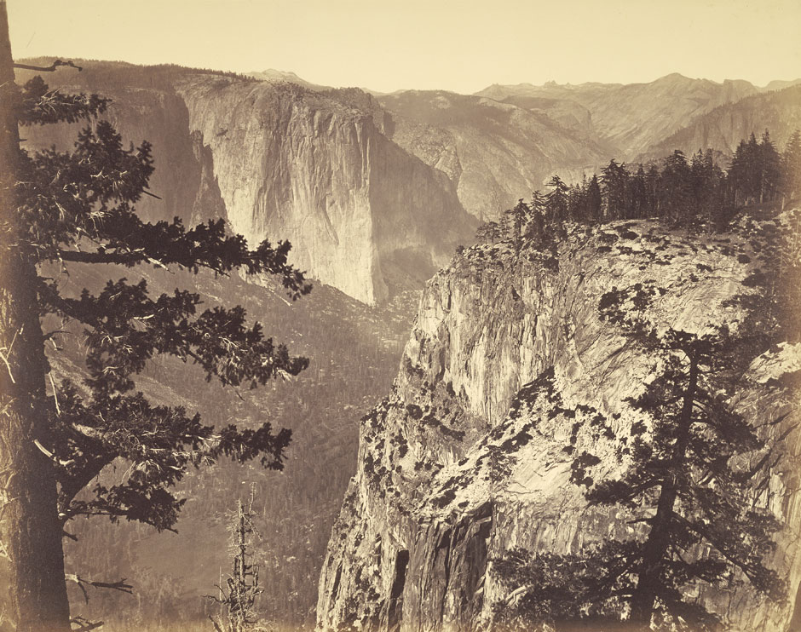
Conservation Movements
Conservationist: regulated use of natural resources
Preservationists: preserve natural resources and land from human interference
John Muir – founded Sierra Club in 1892

Slide 33
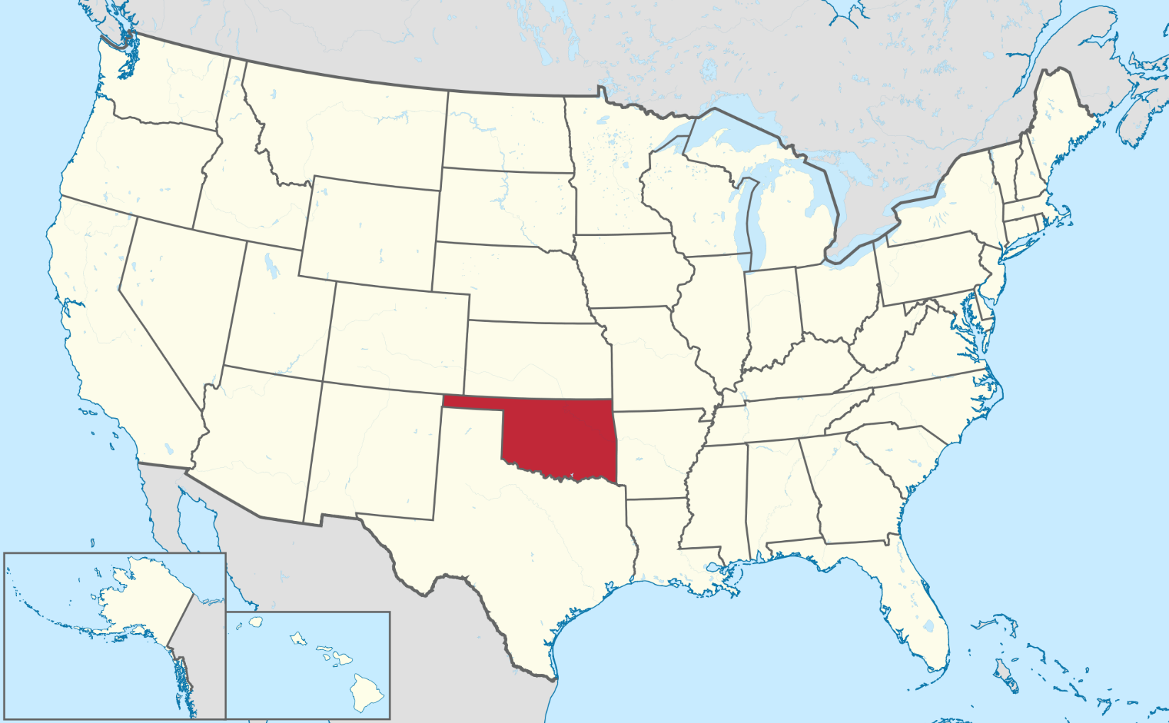
Closing the Frontier
The Last Push: Oklahoma
Next movements: toward cities, away from rural life.

