Slide 1
The Cold War?
American provocation or Soviet duplicity?

Slide 2
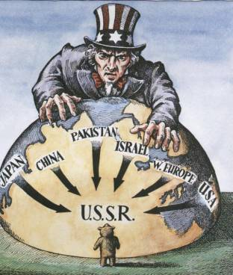
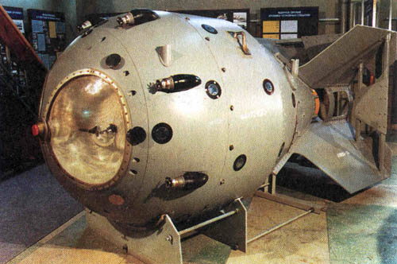
The Cold War: New World Order
1945 -1953

Slide 3
HAP-P
ATTENTION JAPANESE PEOPLE. EVACUATE YOUR CITIES. Because your military leaders have rejected the thirteen part surrender declaration, two momentous events have occurred in the last few days.
The Soviet Union .... has declared war on your nation. Thus, all powerful countries of the world are now at war with you.
Also, because of your leaders' refusal to accept the surrender declaration that would enable Japan to honorably end this useless war, we have employed our atomic bomb.
A single one of our newly developed atomic bombs is actually the equivalent in explosive power to what 2000 of our giant B-29s could have carried on a single mission. Radio Tokyo has told you that with the first use of this weapon of total destruction, Hiroshima was virtually destroyed.
Before we use this bomb again and again to destroy every resource of the military by which they are prolonging this useless war, petition the emperor now to end the war. Our president has outlined for you the thirteen consequences of an honorable surrender. We urge that you accept these consequences and begin the work of building a new, better, and peace-loving Japan.
Notes:
http://www.pbs.org/wgbh/americanexperience/features/bonus-video/presidents-endwar-truman/

Slide 4
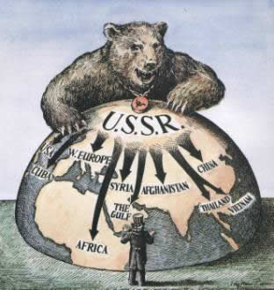
The Origins of the Cold War
Signers of the Atlantic Charter (Aug. 1941) had different visions of post war Europe
FDR championed free elections, no military alliances or spheres of influence (dies 4/12/45)
Churchill uneasy about ‘self-determination’ in the British empire
Stalin wanted a secure communist sphere of eastern Europe & the USSR

Slide 5
Explain the importance for each event in one sentence:
Atlantic Charter
Casablanca Conference
Tehran Conference
Dumbarton Oaks
Bretton Woods
Yalta
Potsdam

Slide 6
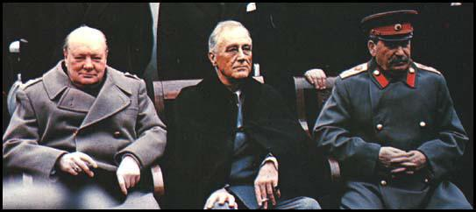
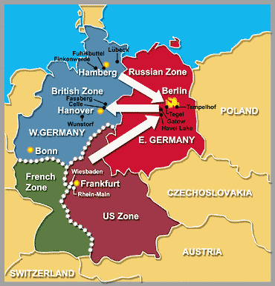
Wartime Diplomacy
Atlantic Charter, 1941
Casablanca Conference, Jan. 1943
US/GB will not invade Europe
But will fight until ‘unconditional surrender’ w/no separate peace
Tehran Conference, Nov. 1943
USSR would declare war on Japan as soon as European war ended
US/GB would attack Europe w/in 6 months
Debate over post-war Poland
Dumbarton Oaks, Summer 1944
Plans for United Nations drawn up
Bretton Woods, 1944
Sets up International Monetary Fund & regulate money & finance
Yalta, Feb. 1945
USSR would gain back territory from Japan lost in 1904
Big three agree to Security Council & General Assembly of UN
‘zones of occupation’ for post-war Germany

Slide 7
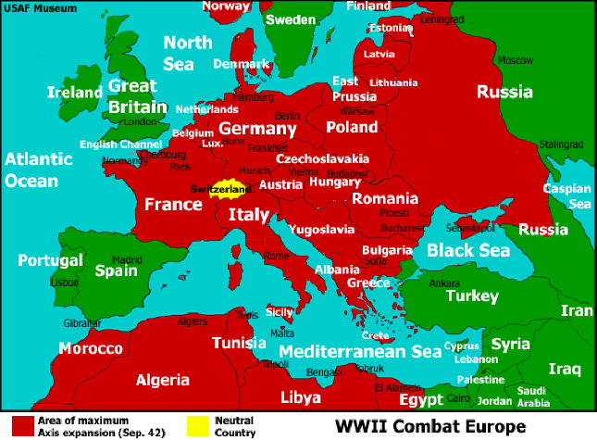
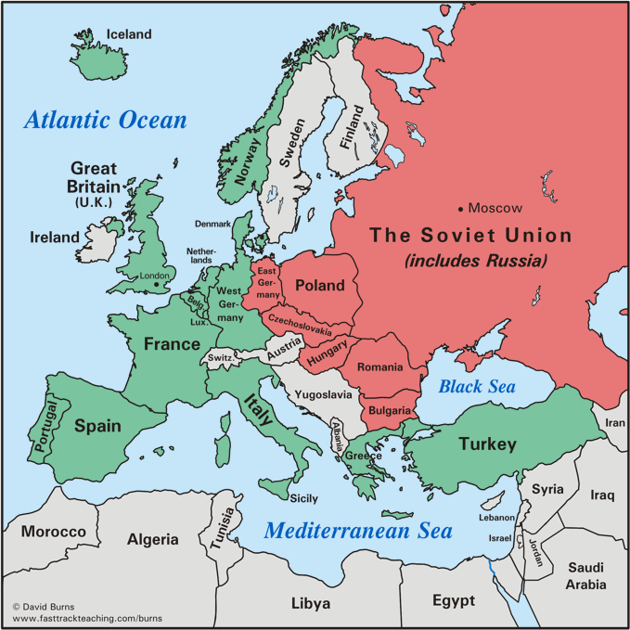

Slide 8
Truman Presidency
Meets Stalin at Potsdam Conference July, 1945
Concedes on Poland’s eastern boundary & gov’t
Agreement on reparations payments to Russia
Sets up East/West Germany divide
Establishes Nuremberg tribunals for war criminals
China: Choose to support nationalist leader Chiang Kai-Shek over communist Mao Zedong until revolution of 1947
Decides on option for Asia stability –Rebuild Japan

Slide 9
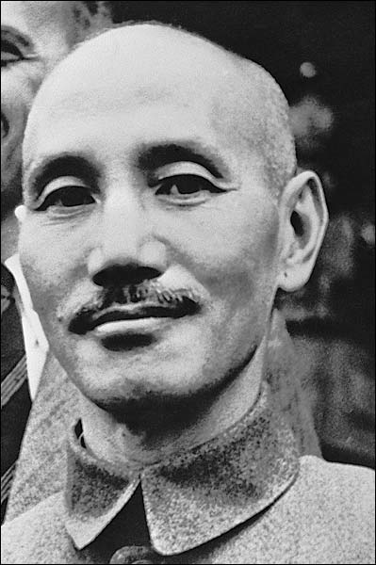
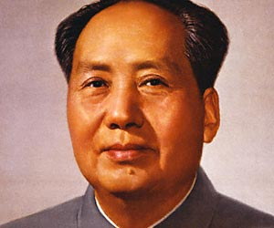

Slide 10
HAP-P
Speech by a US President
Notes:
https://www.youtube.com/watch?v=pD_yaNR7kHM

Slide 11
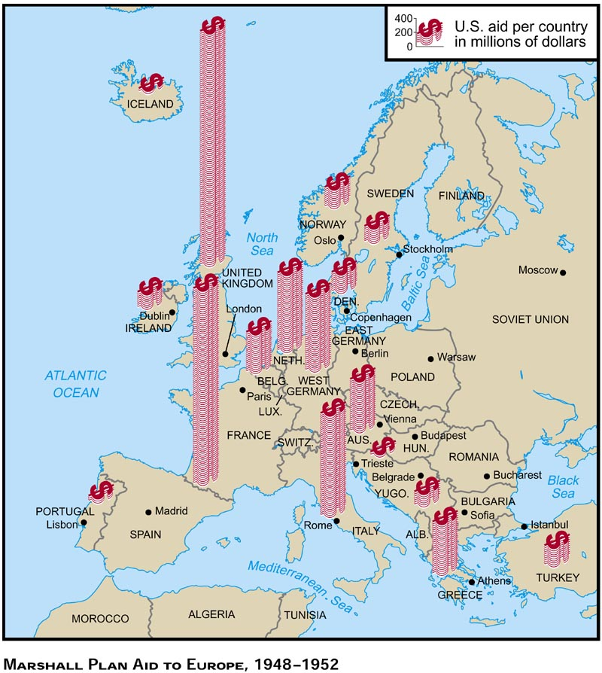
Containment Policy
“open” world order of Wilson & FDR not possible –new plan “containing” Soviet expansion
1946 Greece & Turkey crises: British ends aid
Truman Doctrine (1947), NSC-68 (1950) outline containment policy
Marshall Plan –Sec. of State George Marshall’s plan for rebuilding of Europe and asia, $13 billion (European Recovery Program)
Primarily designed to stop the spread of communism
USSR & other communist gov’ts rejected after 1948 coup in Czechoslovakia
Notes:
https://www.youtube.com/watch?v=lf0axpYS6CA up to 5:45 start again at 24:00 to 25

Slide 12
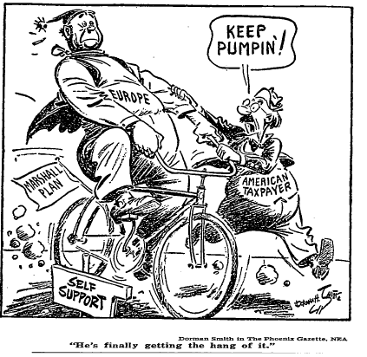
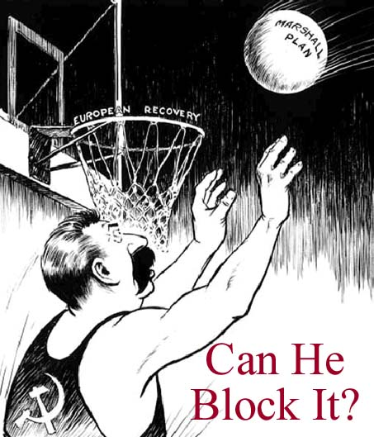

Slide 13
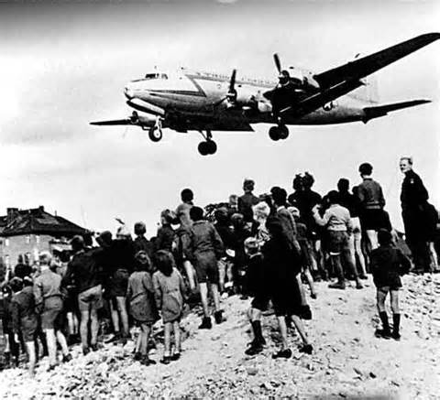
Berlin Airlift, 1948 – 1949
NATO (1949) –North Atlantic Treaty Organization (military alliance) vs. Warsaw Pact
1947 National Security Act, estab. NSC, CIA, Dept. of Defense
1948 Selective Service System brought back (2 yrs of service)
Notes:
https://www.youtube.com/watch?v=cH-GVf9floo Berlin Airlift and the Formation of NATO

Slide 14
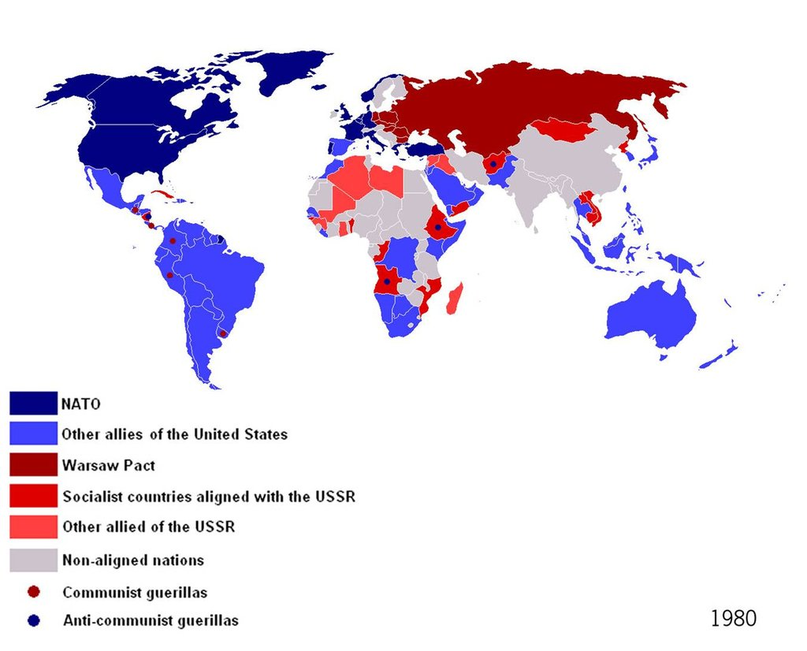
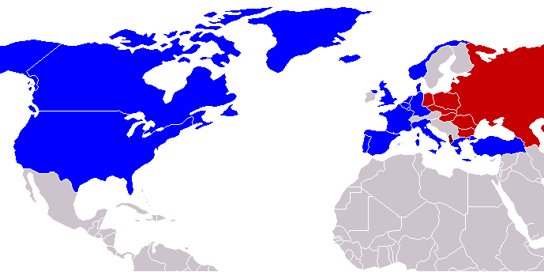

Slide 15
QUESTIONS
Which Cold War Superpower was responsible for starting the Korean War?
How effective were the following in resolving this conflict?
Truman Doctrine
George Kennan’s ‘containment policy’
The United Nations

Slide 16
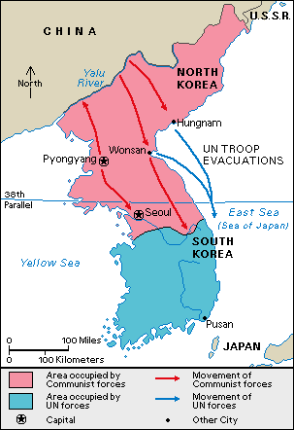
The Korean War...the more things change
By 1949 both the USSR & US begin removing troops from Korea’s 38th parallel
Above 38th –USSR supports communist gov’t & military supplies
Below 38th –US supports anti-communist Syngman Rhee
June 1950, North Korean take over -> capture capital of Seoul
UN Security Council nations vote to send forces to repel communists from south Korea
Boycotting USSR does not use veto (also UNSC refuses to recognize Maoist Chinese gov’t)
Notes:
https://www.youtube.com/watch?v=-X7nbwFxGRU

Slide 17
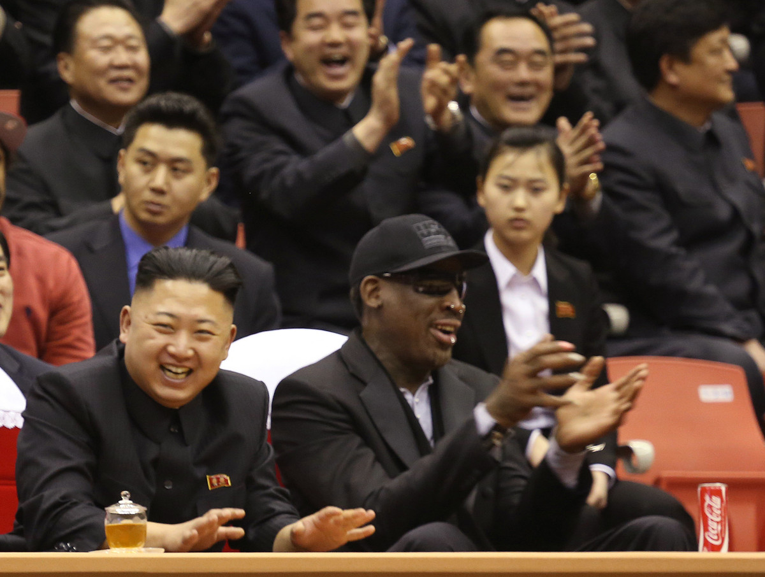

Slide 18
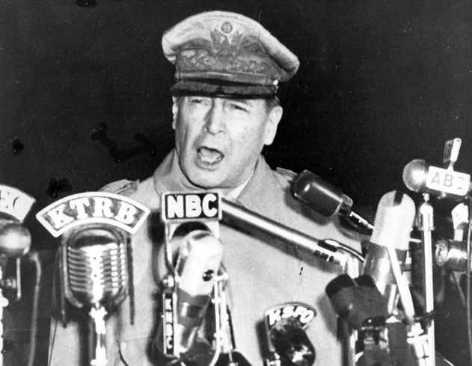
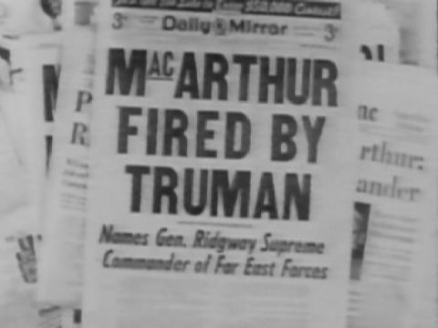
Containment AND liberation
By the end of 1950, US containment policy expands to providing military support & intervention to bring about democratic gov’ts in areas of conflict
General MacArthur vs. President Truman
Truman wanted a negotiated peace
MacArthur argued for invasion of N.Korean/Chinese border
Fired MacArthur (who’s in charge here??)
Took until 1953 to bring truce (38th parallel border)
140,000 injured and dead

Slide 19
Create a thesis statement and three supporting outlines for the following prompt:
Some historians have argued the development of the policy of containment after the second world war marked a turning point in United States foreign policy. Refute, modify, or support this contention using specific evidence.

