Slide 1
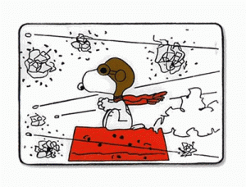
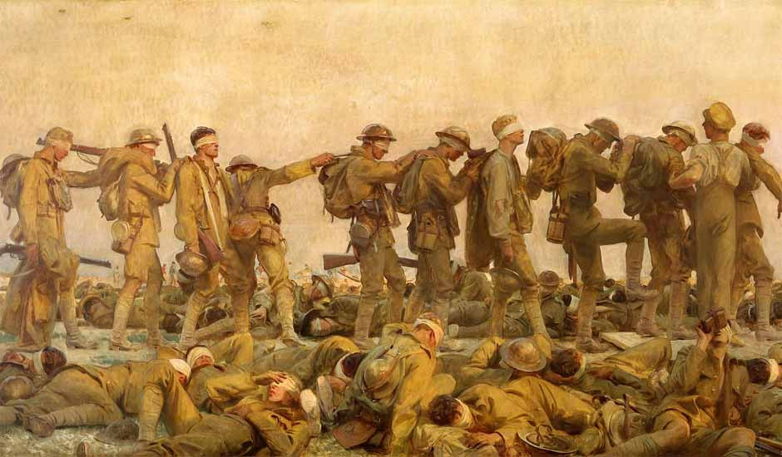
The War to End War

Slide 2
Warm up: Interpret
Prayer of a Soldier in France (1918)
My shoulders ache beneath my pack (Lie easier, Cross, upon His back). I march with feet that burn and smart (Tread, Holy Feet, upon my heart).
Men shout at me who may not speak (They scourged Thy back and smote Thy cheek).
I may not lift a hand to clear My eyes of salty drops that sear.
(Then shall my fickle soul forget Thy Agony of Bloody Sweat?)
My rifle hand is stiff and numb (From Thy pierced palm red rivers come).
Lord, Thou didst suffer more for me Than all the hosts of land and sea.
So let me render back again This millionth of Thy gift. Amen.

Slide 3
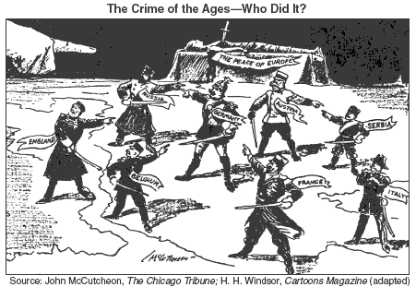

Slide 4
Wilson’s First Term -Foreign Policy
Halt imperialism
End to ‘Dollar Diplomacy’ and start “Moral Diplomacy”
Repealed Panama Canal Tolls (1914); Jones Act (1916) eventual US withdrawal in Philippines
BUT Intervenes in Haiti & DR
Mexican Revolution
Refused to recognize President Huerta, seizing Port of Veracruz
Pancho Villa –crossed border into US, Killing 19 Americans (1916)

Slide 5
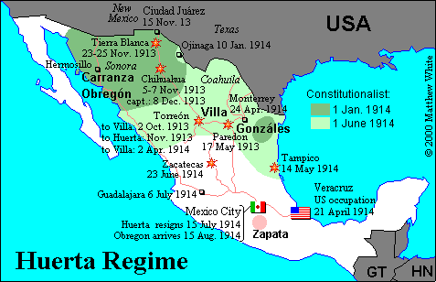
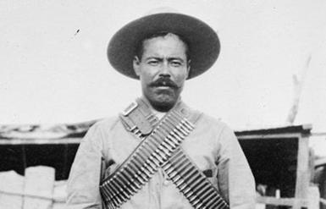

Slide 6
Yellow Peril
Anti-Chinese & Anti-Japanese policies in Western US –post Russo-Japanese War, 1905
Intervenes in California, to keep peace w/Japan
Neutrality –War in Europe beginning in August 1914

Slide 7
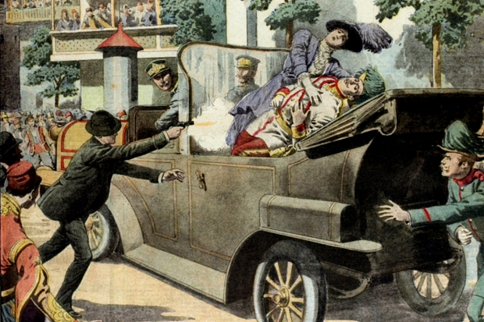

Slide 8
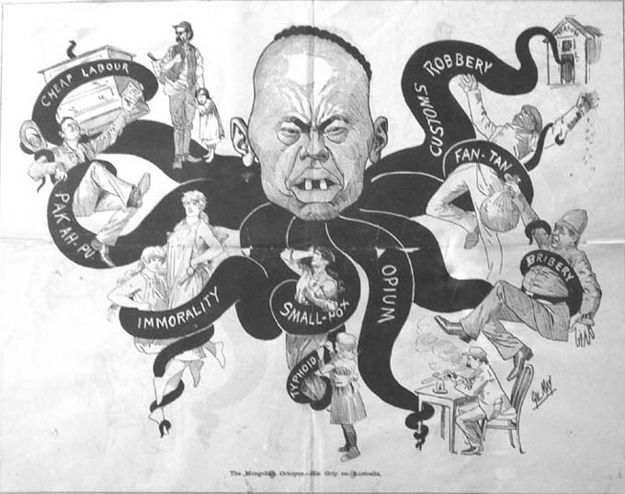
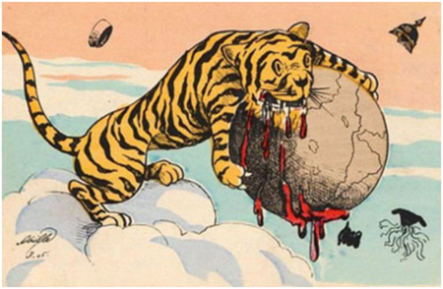

Slide 9
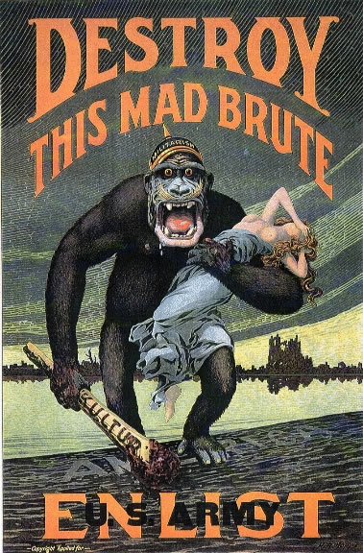

Slide 10
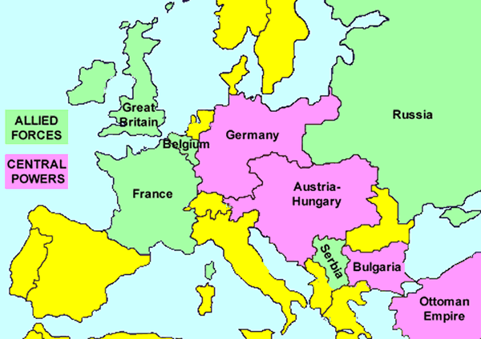

Slide 11
I. Wilson’s Neutrality
1. 1914 Wilson urged neutrality but many Americans sympathized w/ certain nations
a. German + Irish immigrants=Central
b. most Natives & immigrants= GB + Allies
2. Strong US-GB economic ties
b. shun trade w/ Central nations- “arsenal of Allies”
Germany began using submarine warfare 1915 to combat GB naval domination
1915 sinking of Lusitania and Arabic
1916 Sussex sinking led Wilson to call on Germans to recognize rights of neutrals
House-Grey Memorandum, 1916 –attempt at peace conference by US & GB diplomats

Slide 12
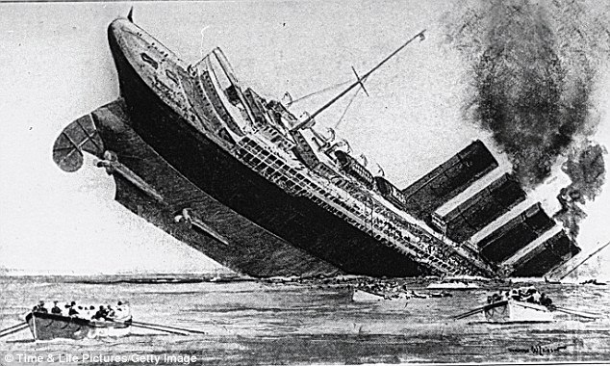

Slide 13
Preparedness vs Pacifism
Wilson did not intervene for either side b/c of re-election + domestic division
Economic + militarily preparations debated by pacifists and interventionists
BUT by 1916 military armament largely under way
Wilson won extremely close 1916 b/c of association w/ ability to keep US independent
Campaign slogan “He kept Us Out of War”
Democrats barely held on to Congressional majorities

Slide 14
Jan. 16, 1917 (intercepted message)
"We intend to begin on the first of February unrestricted submarine warfare. We shall endeavor in spite of this to keep the United States of America neutral. In the event of this not succeeding, we make Mexico a proposal of alliance on the following basis: make war together, make peace together, generous financial support and an understanding on our part that Mexico is to reconquer the lost territory in Texas, New Mexico, and Arizona. The settlement in detail is left to you. You will inform the President of the above most secretly as soon as the outbreak of war with the United States of America is certain and add the suggestion that he should, on his own initiative, invite Japan to immediate adherence and at the same time mediate between Japan and ourselves. Please call the President's attention to the fact that the ruthless employment of our submarines now offers the prospect of compelling England in a few months to make peace.

Slide 15
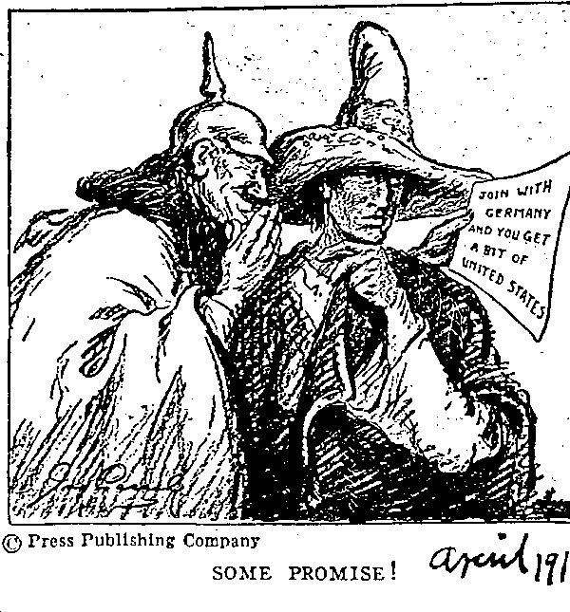

Slide 16
A War for Democracy
a. After election, Wilson wanted country unified and justified upon entering war, should fight to create new progressive world order + not for material gains
b. January 1917 Germany began offensive + continuation of unrestricted submarine warfare to defeat Allies before US entrance
February, Zimmerman Telegram urged Mexico to join w/ Germany (increased public sentiment toward war)
Americans remembered Pancho Villa’s 1916 attacks of civilians in New Mexico
March Russian Revolution
April 1917 US officially declares war on side of Allies

Slide 17
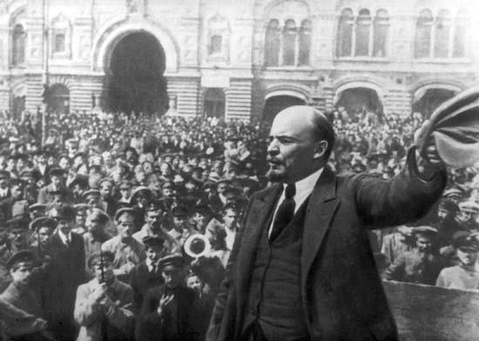
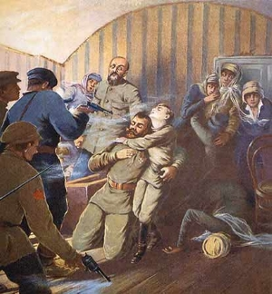

Slide 18
“War Without Stint”
Entering the War
i. Immediately w/ US entrance Allied navy able to dramatically reduce sinking’s in troop + supply convoys
ii. 1917 withdrawal of Russian forces after Bolshevik Revolution (Lenin)
led Germans to put resources on Western Front
Allies needed US ground troops
Notes:
Over There
http://www.youtube.com/watch?v=wbggEGUaE28

Slide 19
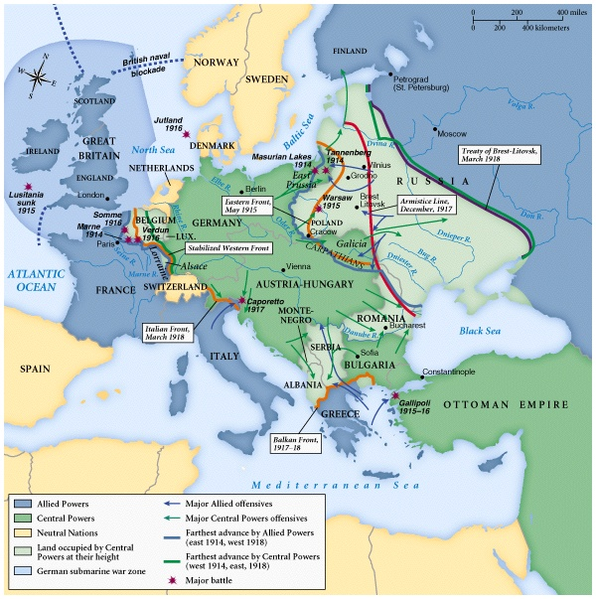

Slide 20
American Expeditionary Force (AEF)
Arrives 8 mos. after war declared led by General ‘Blackjack’ Pershing
Large contingents of U.S. soldiers made it possible for Allies to push Germans back into their own land
Major Engagements
Chateau-Thierry early June 1918
Belleau Wood mid-June 1918
Meuse-Argonne Offensive Sept. – Nov. 1918*

Slide 21
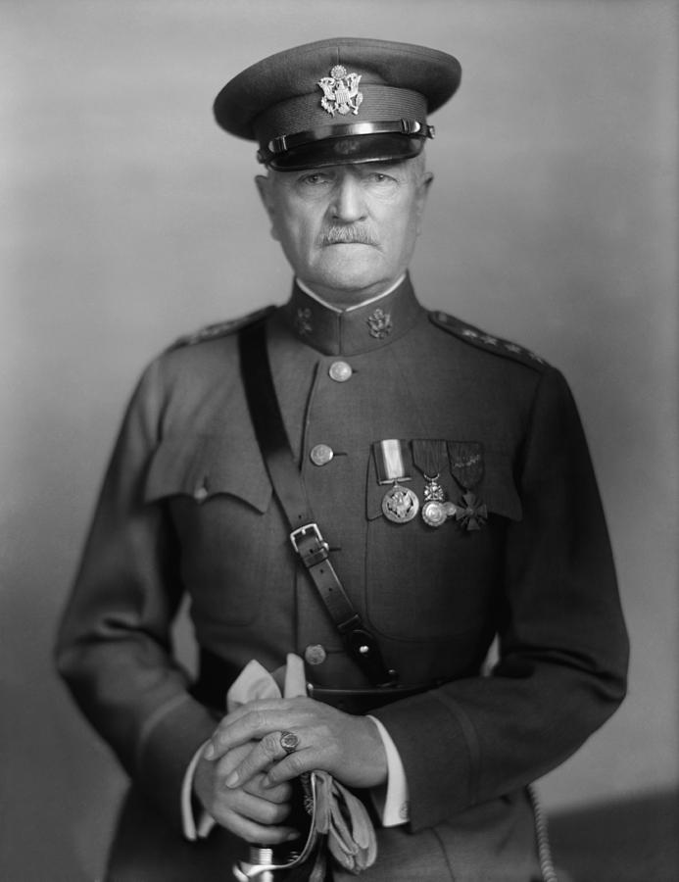
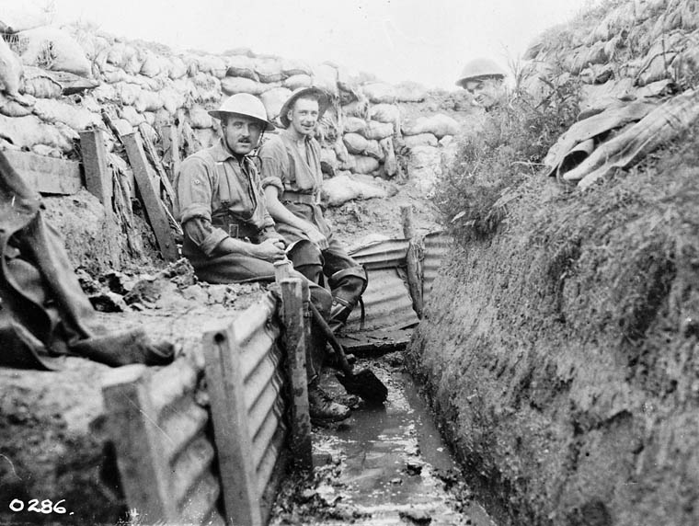

Slide 22
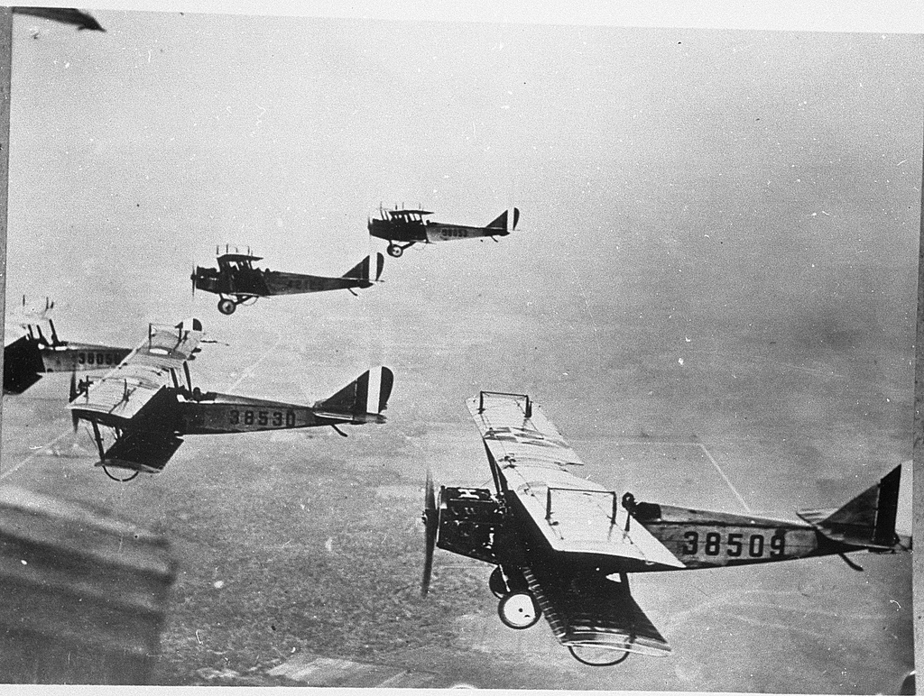
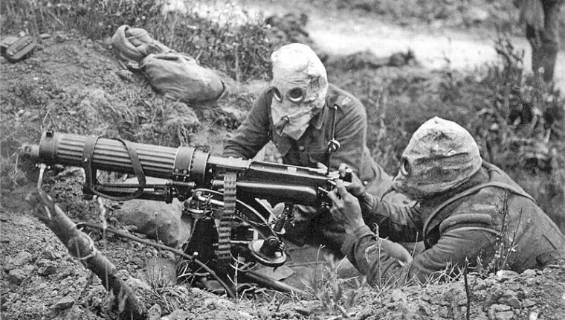
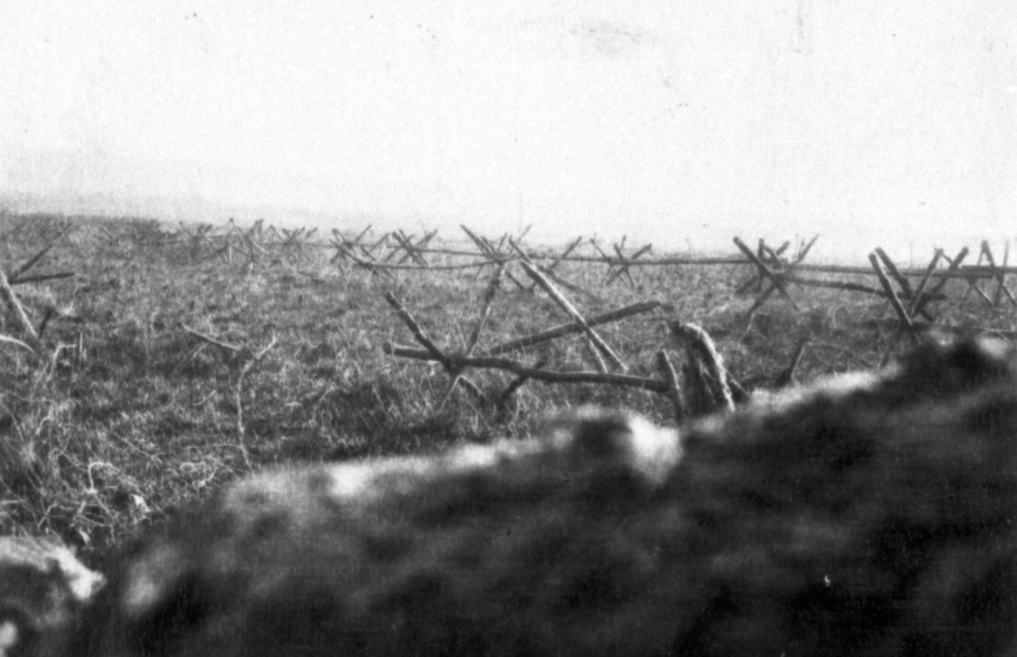

Slide 23
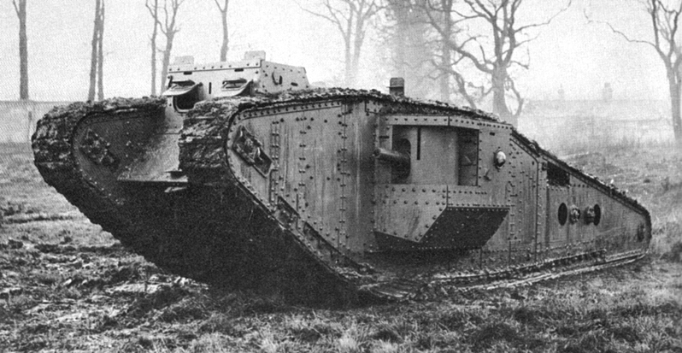
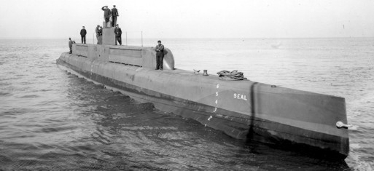

Slide 24
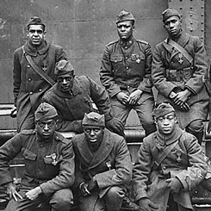
America Goes to War
Selective Service Act (1917)
more than 3 mil. Drafted
2mil. Voluntarily joined
Women allowed to join the military
African-Americans in segregated units; usually acted as drivers & stevedores (400,000)

Slide 25
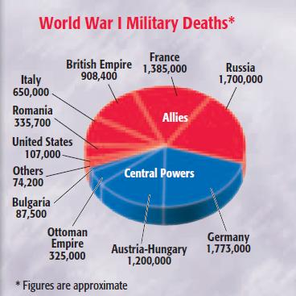

Slide 26
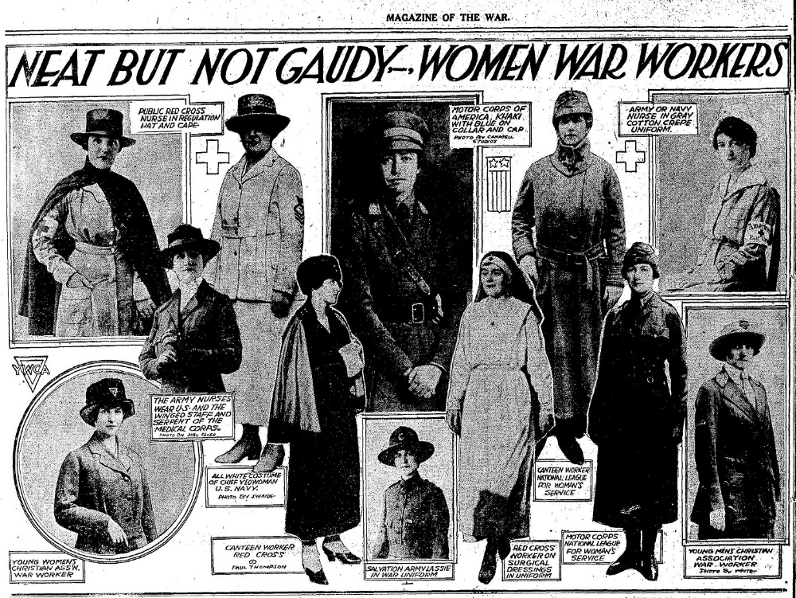
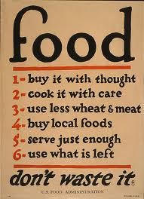
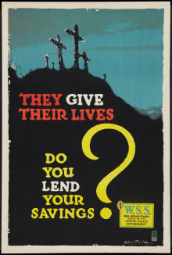
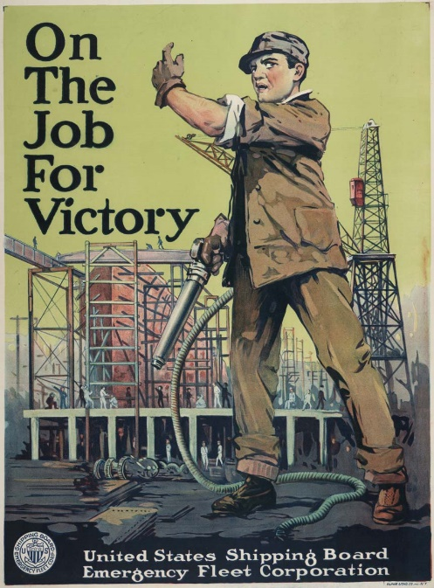
Total War
Financing the war
4 Liberty bond drives & increased taxes
War Industries Board
Scientific management “Taylorism” of boards to oversee specific elements of the economy
Food Administration led by Herbert Hoover
National War Labor Board –settle labor disputes
8 hr day + time and a-half
Equal pay
Allowed union organization
But no striking

Slide 27
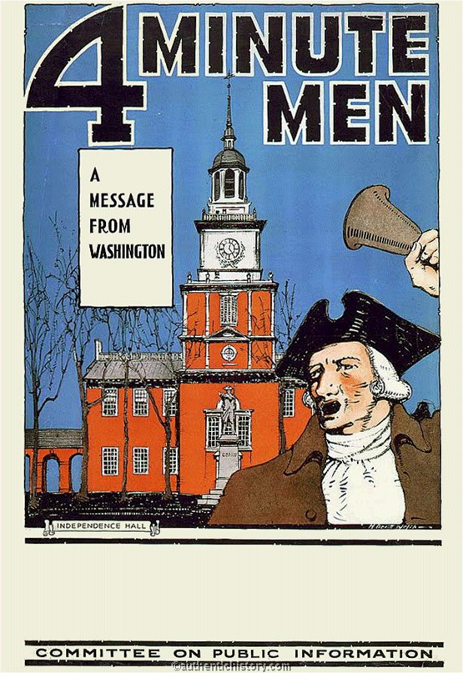
War brings social change
Committee on Public Information (CPI)
Run by journalist George Creel
75 mil. Pieces of pro-war material
4 minute men
Newspapers printed official gov’t accounts of war
Great Migration –400,000 blacks moved from the deep south to cities like Chicago, NYC, Cleveland & Detroit (as did Mexican & Puerto Ricans)
Women’s Suffrage
NAWSA –pro War (Carrie Chapman Catt)
NWP –pacificism (Alice Paul)

Slide 28
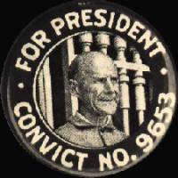
"I would no more teach children military training than I would teach them arson, robbery, or assassination."
Espionage Act of 1917 –new penalties for spying, sabotage & ‘obstruction of war effort’
Sedition & Sabotage Acts of 1917 –any public expression of opposition of the war illegal
Socialist Party & IWW
Eugene V. Debs
More than 1,500 people arrested
Schenck v. US
Abrams v. US
defendants did not have a 1st Amendment right to speak against the draft during World War I
established the "clear and present danger" test

Slide 29
AP PARTS

Slide 30
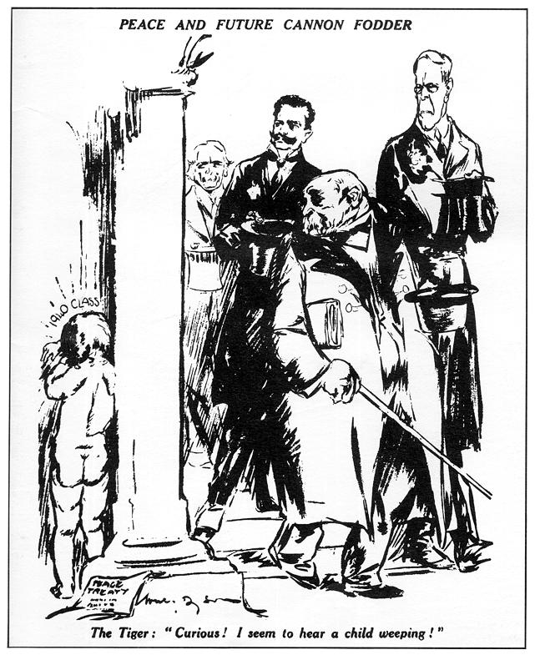
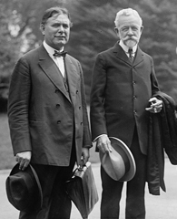
Wilsonians –Pro-Treaty & League of Nations Reservationists –Amended Treaty
Irreconcilables –No Treaty & no League

Slide 31
Post-WWI Time Line
14 Points –part of Wilson’s State of the Union Address to Congress January, 1918
Armistice to end WWI Nov. 11, 1918
Versailles Conference January 1919
Signing of Treaty of Versailles June, 1919
Congress votes down Treaty & League of Nations member ship Nov. 1919
League of Nations opens January, 1920

Slide 32
Wilson’s 14 Points
1. No more secret agreements ("Open covenants openly arrived at").
2. Free navigation of all seas.
3. An end to all economic barriers between countries.
4. Countries to reduce weapon numbers.
5. All decisions regarding the colonies should be impartial
6. The German Army is to be removed from Russia. Russia should be left to
develop her own political set-up.
7. Belgium should be independent like before the war.
8. France should be fully liberated and allowed to recover Alsace-Lorraine
9. All Italians are to be allowed to live in Italy. Italy's borders are to "along clearly recognizable lines of nationality."
10. Self-determination should be allowed for all those living in Austria-
Hungary.
11. Self-determination and guarantees of independence should be
allowed for the Balkan states.
12. The Turkish people should be governed by the Turkish government.
Non-Turks in the old Turkish Empire should govern themselves.
13. An independent Poland should be created which should have access
to the sea.
14. A League of Nations should be set up to guarantee the political and
territorial independence of all states.

Slide 33
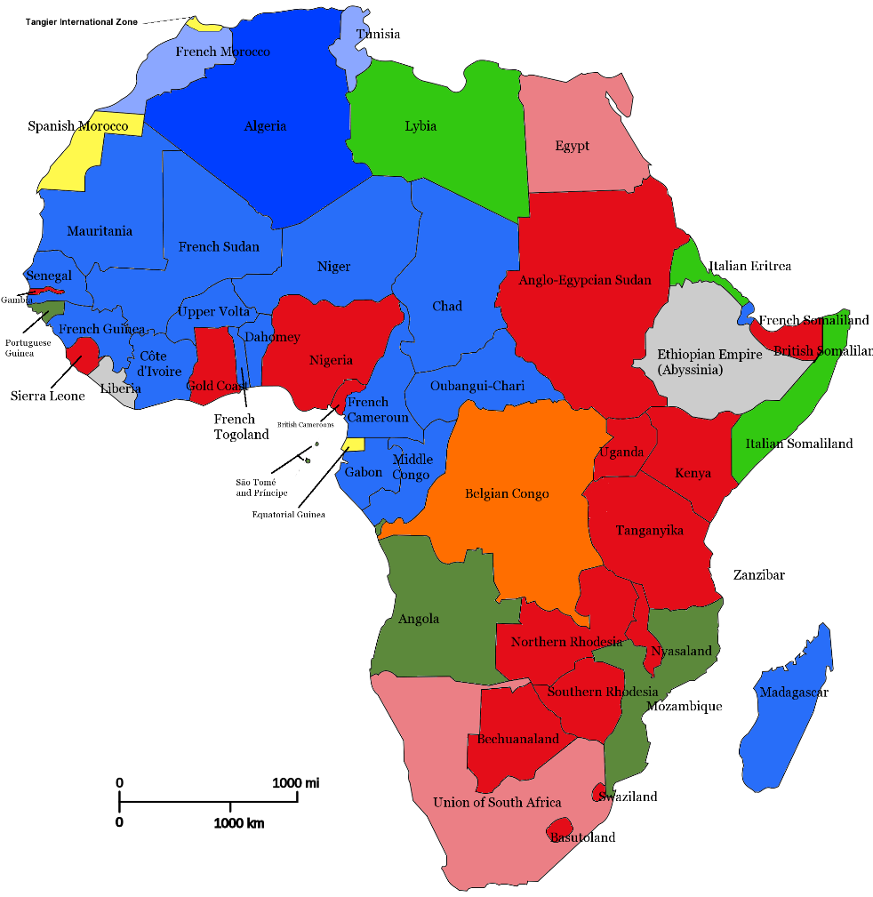
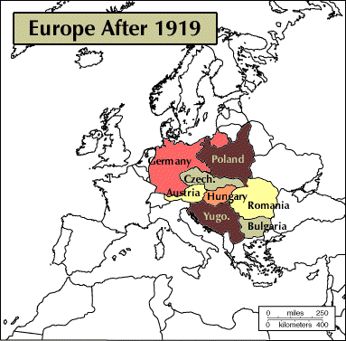
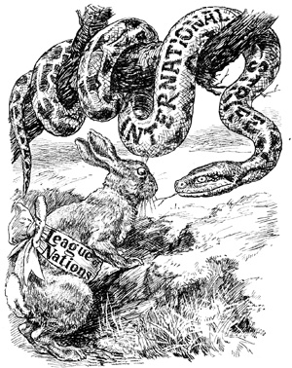
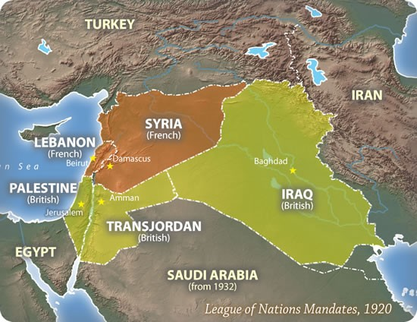
New World Order?

